Slide 1
Welcome to 2G!
Meet The Teacher 2023

Slide 3
About your child
4Cs activity!
Collect 2 different colour Post-it notes
Write something you want us to know about your child and a goal for them this year
Place your post-it notes on the A3 piece of paper
Pink Post-it Note
Blue Post-it Note
Write something you want me to know about your child
Write a goal for your child this year

Slide 4
01
Meet Mrs. Gavanas
02
Positive behaviour for learning
03
4Cs - Learning Disposition Wheel
Outline
04
Curriculum
05
Technology
06
Community Partnerships

Slide 5
01
Meet Mrs. Cassandra Gavanas

Slide 6
Stage 1 2023
There are 5 Stage 1 classes this year:
1B (Mrs Boutsikakis)
1W (Mrs Wallace)
2G (Mrs Gavanas) – our class consists of 23 students
2L (Mr Lao)
2M (Miss Mieszkuc)
Our Assistant Principals are: Mrs White and Mrs Lee

Slide 7
Who Supports Us?
Library
Community Languages (Italian)
Mrs Ingram, Mrs Montgomery &
Mrs McDougall
Ms Johnstone (Signora)
Student Support (in class)
English as an Additional Language or Dialect (EALD)
Mrs Bannister
Mrs White

Slide 8
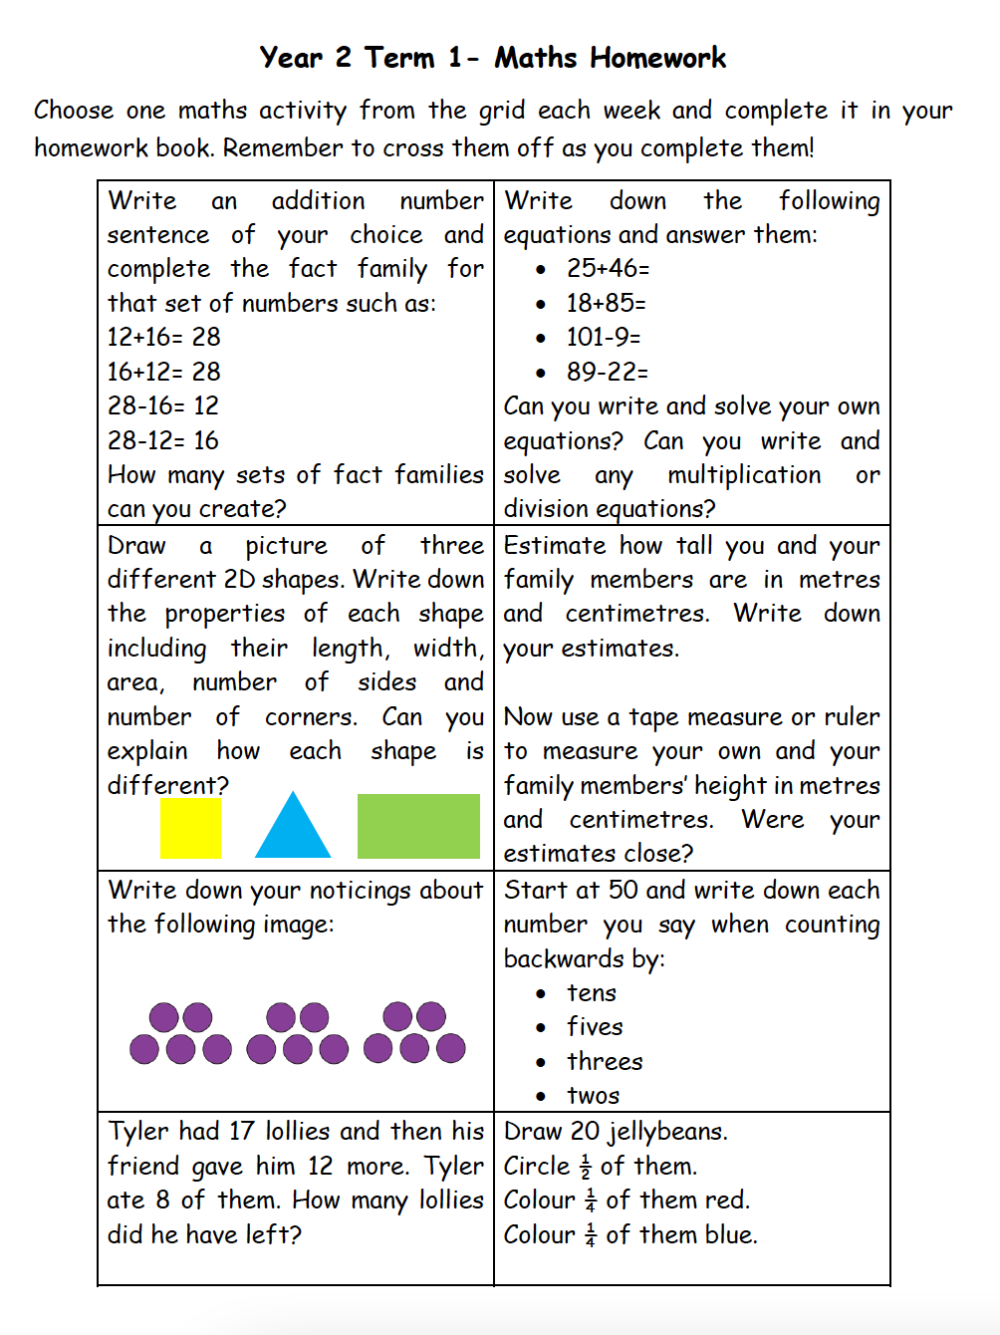
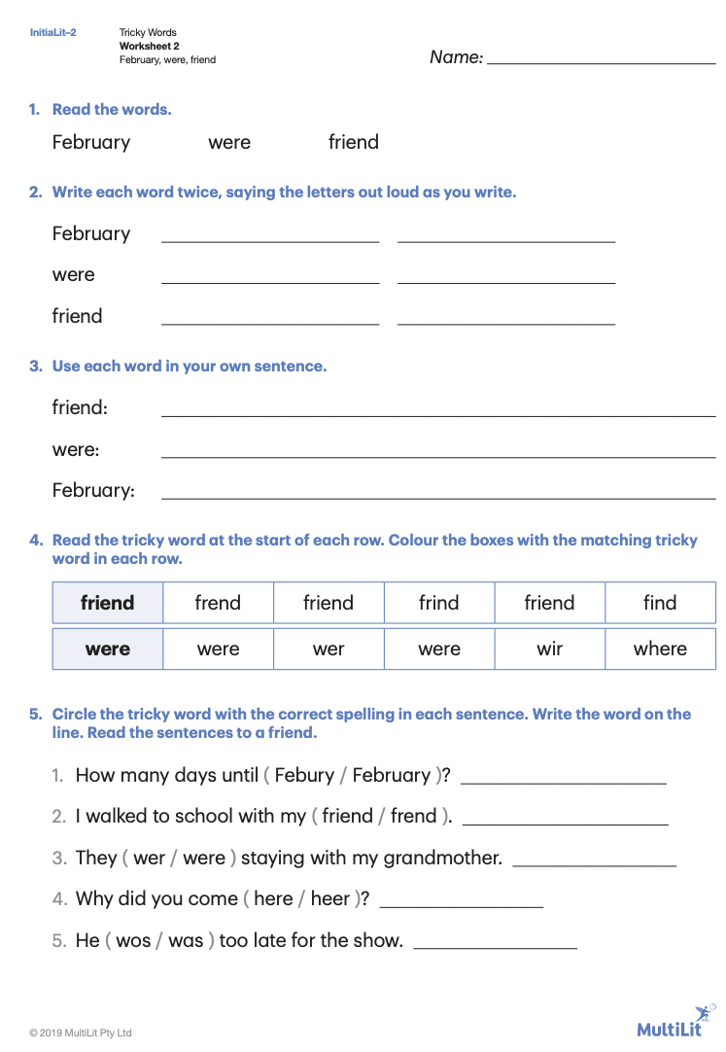
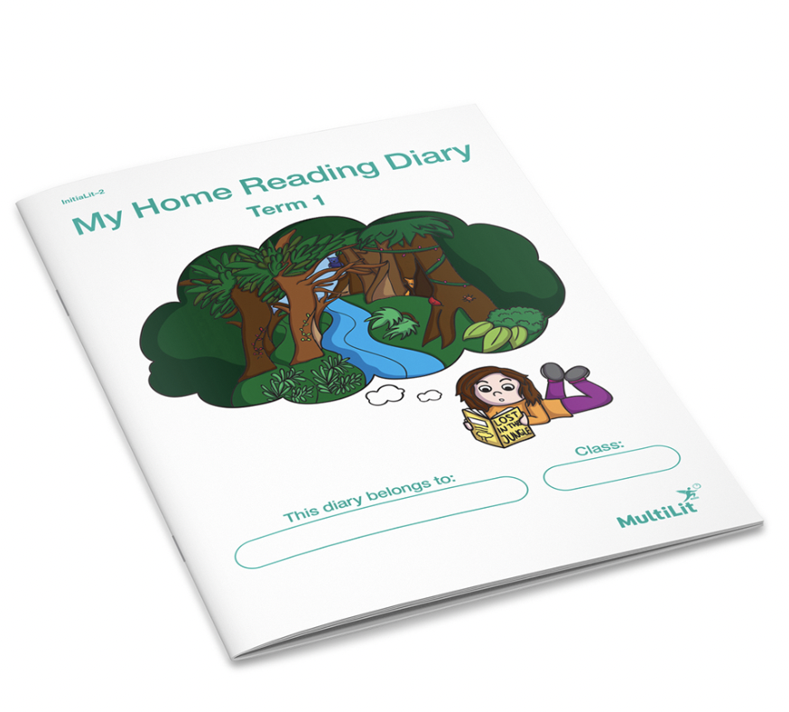
Homework
Homework is handed out every Friday and is due back to school the following Thursday.

Slide 9
Key Days to Remember
Monday
Got Game with 2L
Tuesday
Italian
Wednesday
Scripture: 9:50-10.20am
(Protestant, Catholic, Greek Orthodox, Ethics and Non-Scripture)
Friday
Library with Mrs. McDougall

Slide 10
News

Slide 11
Food at School
Canteen
Birthdays
The school canteen is open Monday - Thursday (inclusive).
All lunch orders must be ordered via Flexischools.
We welcome birthday treats on your child’s special day. We ask that all birthday treats are individually portioned and packed ready to hand out e.g. cupcakes, lolly bags etc
PLEASE NOTE: due to an increase in students with severe allergies we ask that you please be mindful when packing lunches and incorporate foods that do not contain nuts.

Slide 12
02
Positive Behaviour for learning

Slide 13
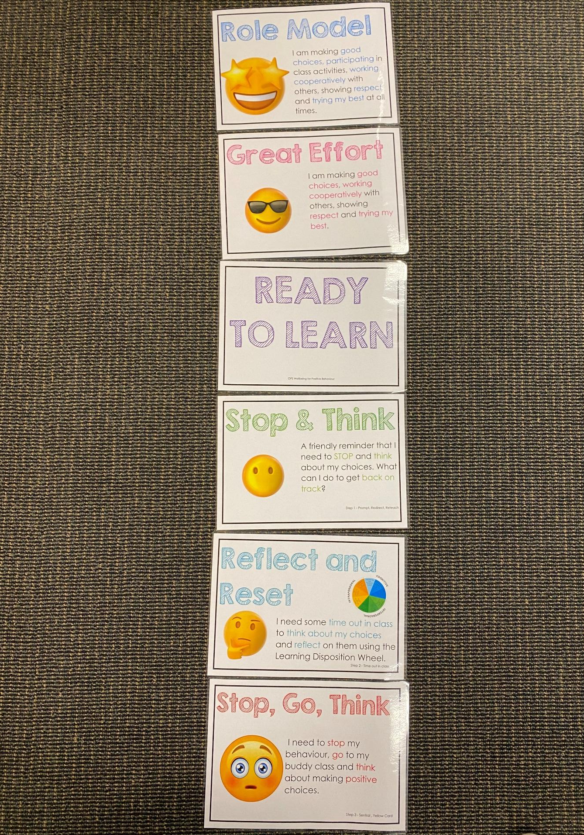
Positive Behaviour for Learning
Classroom Expectations
NSW public schools are committed to providing safe, supportive and responsive learning environments for everyone. We teach and model the behaviours we value in our students.
Every student begins on ‘READY TO LEARN’.
Every day is a new day.

Slide 14
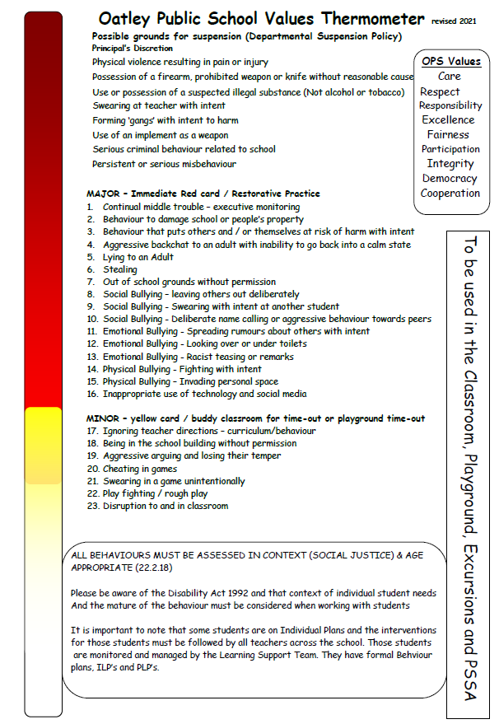
Minor and Major Incidents
Procedures
Behaviour aligned to thermometer through discussion with teacher or assistant principal.
Minor - monitored by classroom teacher
Major - parents contacted, managed by Assistant Principal

Slide 15
03
4Cs
Learning Disposition Wheel

Slide 16
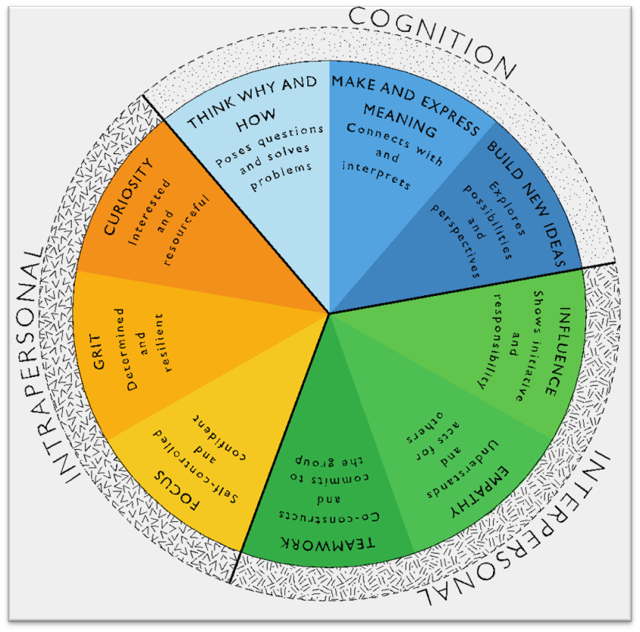
Learning Disposition Wheel
Communication, Creativity, Collaboration
& Critical Reflection
The Learning Disposition Wheel is a tool used to talk about learning and drive a deeper understanding of the 4Cs
Development of these dispositions is fundamental for students to develop an awareness of the way they learn and establish attitudes to learning.
This facilitates a common language about learning which empowers students to critically reflect.

Slide 17
04
Curriculum

Slide 18
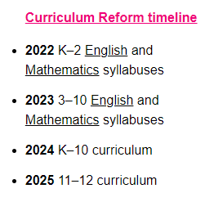
Curriculum Reform

Slide 19
Learning in Stage 1 - Key Learning Areas
English
Mathematics
Science & Technology
Spelling
Grammar
Comprehension
Storybook- vocabulary

Slide 20
Learning in Stage 1 - Key Learning Areas
Personal Development, Health & Physical Education (PDHPE)
Creative Arts
History and Geography

Slide 21
05
Technology

Slide 22
Protocols for Technology Use
Stage 1 classes utilise the K-2 shared iPads.
All parents/carers need to sign the online ICT Agreement before the student’s class is allowed to commence using technology in their classroom.
This agreement includes the use of mobile phones and smart watches worn by students to school.
Inappropriate or irresponsible use of devices will result in the student losing access to the device for that lesson.
Students need to show the utmost respect and care for the technology at all times. It is a privilege to use any of the school-managed devices.

Slide 23
06
Community Partnerships

Slide 24
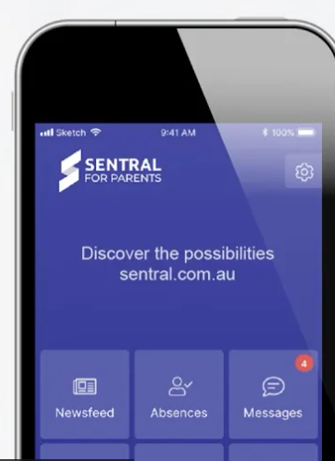
Community Partnerships at Oatley Public School
School Stream app
School Bytes via Email
Time-critical alerts
School and P&C Newsletters
Student absence notifications
All requests for permission
All requests for payment
Oatley Public School Email: oatley-p.school@det.nsw.edu.au
School Website
Sentral Parent Portal
https://oatley-p.schools.nsw.gov.au
School Calendar and more static information
Any booking for 1-on-1 K-6 scheduled parent/teacher interviews
Digital copies of semester reports
Oatley Public School Phone Number: 9580 5519

Slide 25
Community Partnerships at Oatley Public School
School Stream Phone App
Used by:
Teachers and administration staff for sending out time-critical alerts and the weekly newsletter on Sunday afternoons at 5pm.
P&C for their weekly newsletter.
Parents/carers to formally notify the school of their child’s absence.
If you haven’t registered for School Stream, download the app via the Apple or Android app store (depending on your type of phone). Then open the School Stream app and select Oatley Public School when prompted. The administrative staff will then approve your connection. Following this approval, you will begin receiving updates from the school.

Slide 26
Community Partnerships at Oatley Public School
How do I pay for excursions/incursions/PSSA and give permission?
Permission and payment for any student is completed online via the School Bytes system.
The preferred parent/carer contact for communication will be sent an email from School Bytes, requesting online permission and payment (where applicable).
One email per child in each family will be sent by the school. For example, if there are three children in one OPS family, the preferred contact will receive 3 separate emails requesting permission and/or payment. One permission form per child in each family needs to be completed.
A cut-off date for response will always be clearly indicated in your email message and the school administration staff will send at least one reminder to you via email before the event is effectively ‘closed’ for payment.

Slide 27
Community Partnerships at Oatley Public School
School Website: https://oatley-p.schools.nsw.gov.au/
The school’s website has an up-to-date calendar of future events.
School Email address: oatley-p.school@det.nsw.edu.au
Please use this email address to contact the school at any time for matters that are not time-critical. This is also an effective mechanism for sending a message to your child’s teacher. These messages will be forwarded by the school administration staff.
School Phone Number: 9580 5519
Please use this number to contact the school for any time-critical questions or to pass on time-critical information.

Slide 28
Community Partnerships at Oatley Public School
Sentral Parent Portal
Used by:
Teaching and administrative staff to schedule Term 2 Parent/Teacher interviews.
Parents/carers to book Term 2 Parent/Teacher interviews (more information on this process will be available later this term).
Teaching and administrative staff to send a digital copy of formal semester reports to parents/carers.
Messaging between class teachers and parents/carers - this functionality is currently being reviewed by the school.

Slide 29
Questions
?

Slide 30
THANK YOU!
I look forward to a productive and rewarding year working with you and your child in 2G.

