Slide 1
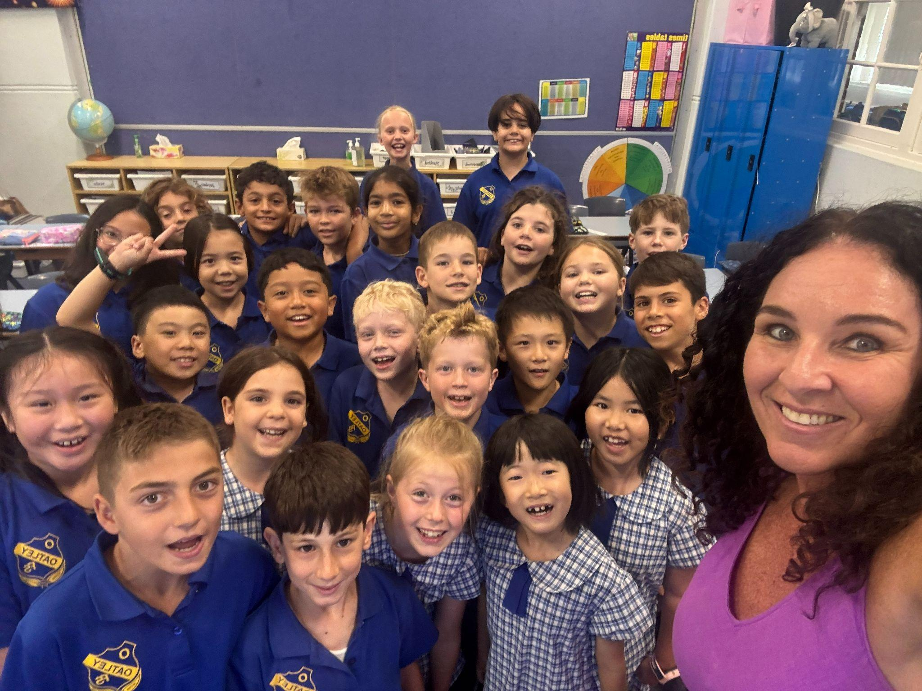
Welcome to Meet the Teacher 2025
3/4H
Ms Hogan

Slide 3
About your Child
4Cs activity!
Write something you want me to know about your child and a goal for them this year
Blue Side
Yellow Side
Write something you want me to know about your child
Write a goal for your child this year

Slide 4
A Little About Me!
About Ms Hogan
Bachelor of Education.
I have been teaching for 28 years.
Full time teacher at Oatley PS for 22 years.
I have 2 children who have and are attending OPS.
I have taught all grades.
I set high expectations.
I instil a safe, happy, kind and respectful classroom.
I pride myself on being approachable to students and parents.

Slide 5
Meet the Team
There are four Stage two and four Stage 3 classes this year:
3KV (Mrs Montgomery & Mrs Worthington) 5L (Mr Lao)
3/4H (Ms Hogan) 5P (Mr Prenzel)
4A (Mrs Anthony) 6M (Miss Gorman)
4/5R (Mrs Rozmeta – Stage 2 AP) 6G (Mrs Gadaleta – Stage 3 AP)

Slide 6
Who Supports Us?
Community Languages
(Italian)
Signora Johnstone
Library
Mrs Haman
Curriculum Support
Mrs Gavanas
Mrs White
Wellbeing
Mrs Edwards

Slide 7
Homework
Term 1 homework consists of 3 components:
1. Reading (Min 30 mins per day)
Home Readers will be sent home with some
year 3 students.
2. Maths (differentiated)
3. Spelling/Grammar
Due on Thursday, redistributed Friday
Later in the term, the homework will change to support our upcoming ‘Multicultural Perspectives Public Speaking Competition’.

Slide 8
Days to Remember
Monday –Got Game | Thursday –
Tuesday – Italian | Friday – PSSA / School sport Peer Support
Wednesday - Library Scripture: 9:20am-9.50am (Protestant, Catholic, Greek Orthodox, Ethics, Islamic and Non-Scripture) | NAPLAN - Term 1, Week 7

Slide 9
Food At School
Canteen Birthdays
The school canteen is Monday - Thursday. We welcome birthday treats on your
child’s special day. We ask that all
All lunch orders must be ordered via birthday treats are individually
Flexischools. portioned and packed ready to hand
out, e.g. cupcakes, lolly bags.
Please note: due to an increase in students with severe allergies, we ask that you please be mindful when packing lunches.

Slide 10
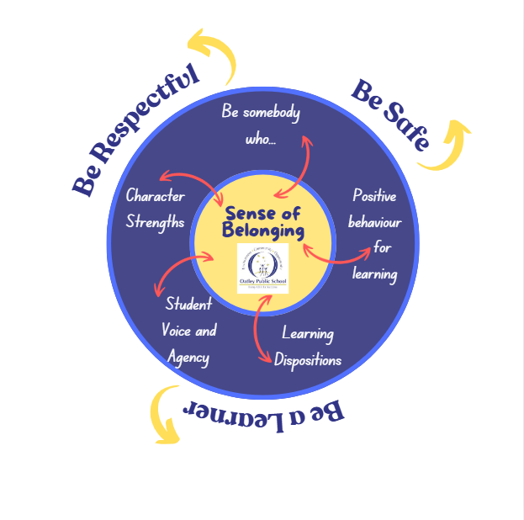
Wellbeing

Slide 11
Positive Behaviour for Learning

Slide 12
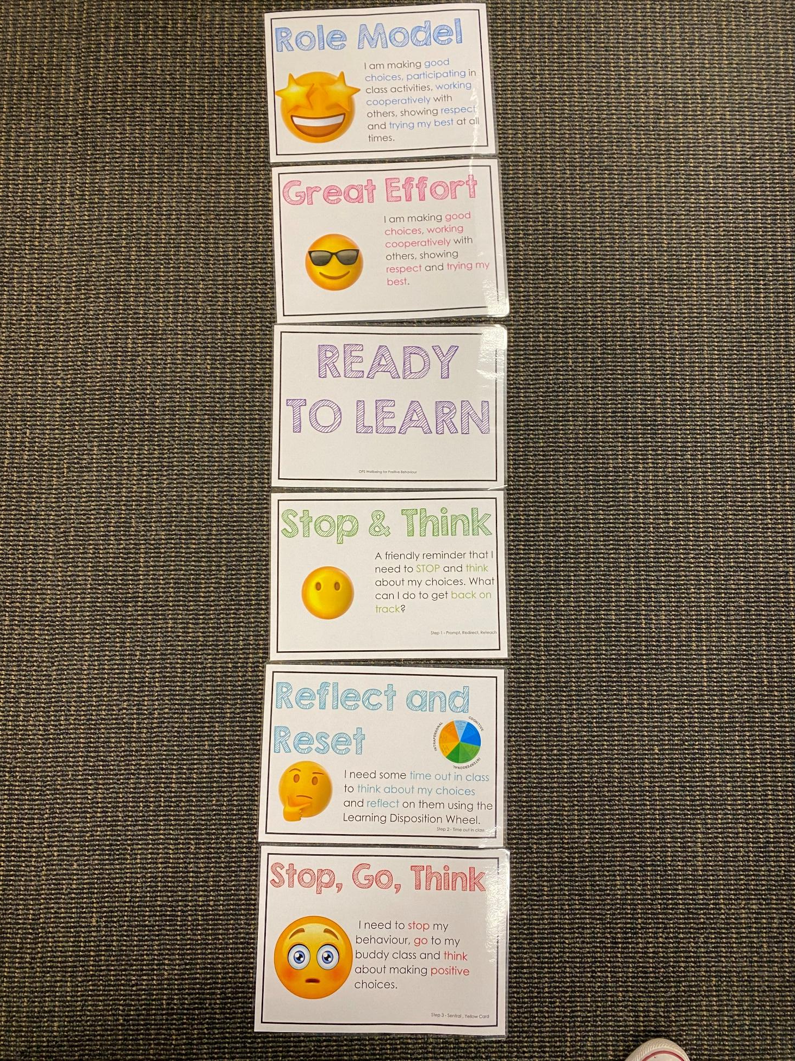
Positive Behaviour for Learning
NSW public schools are committed to providing safe, supportive and responsive learning environments for everyone. We teach and model the behaviours we value in our students.
Every student begins on ‘READY TO LEARN’.
Every day is a new day.

Slide 13
Be Somebody Who…

Slide 14
Student Wellbeing Focus
Growing Strong Minds
Gratitude Journals/Got Game Resilience Program
Student Voice experiences
Peer Support
Incursions – Zero Bullying, Backflips against Bullying, Life Education

Slide 15
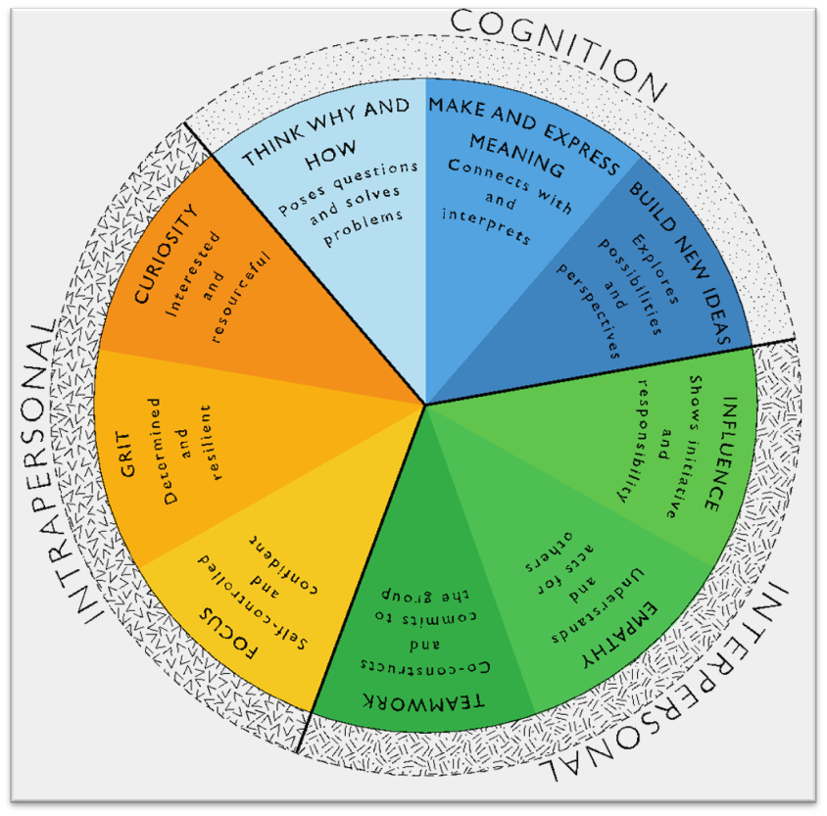
Learning Dispositions
Communication, Creativity, Collaboration
& Critical Reflection
The Learning Disposition Wheel is a tool used to talk about learning and drive a deeper understanding of the 4Cs
Development of these dispositions is fundamental for students to develop an awareness of the way they learn and establish attitudes to learning.
This facilitates a common language about learning which empowers students to critically reflect.

Slide 16
Curriculum

Slide 17
Technology
Stage 2 classes utilise Chromebooks.
All parents/carers need to sign the online ICT Agreement before the student’s class is allowed to commence using technology in their classroom.
This agreement includes the use of mobile phones and smart watches worn by students to school.
Inappropriate or irresponsible use of devices will result in the student losing access to the device for that lesson.
Students need to show the utmost respect and care for the technology at all times.
It is a privilege to use any of the school-managed devices.

Slide 18
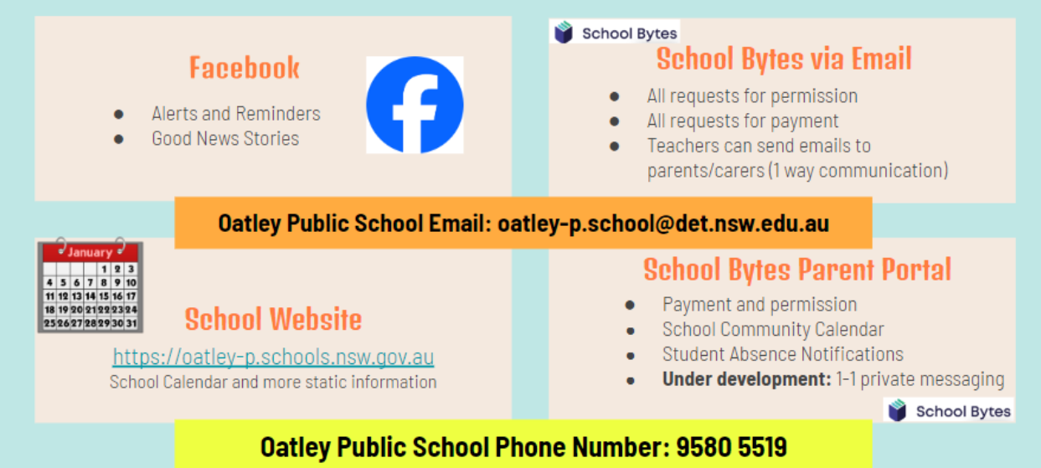
Community Partnerships

Slide 19
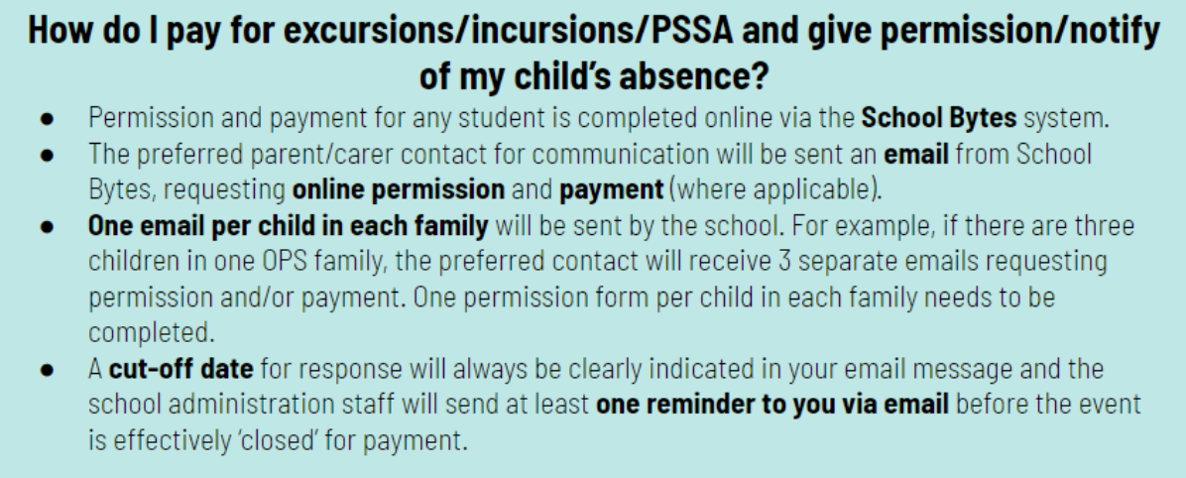
Payment Excursions/Incursions

Slide 20
Communication
School Website: https://oatley-p.schools.nsw.gov.au/
The school’s website has an up-to-date calendar of future events.
School Email address: oatley-p.school@det.nsw.edu.au
Please use this email address to contact the school at any time for matters that are not time-critical. This is also an effective mechanism for sending a message to your child’s teacher. These messages will be forwarded by the school administration staff.
School Phone Number: 02 9580 5519
Please use this number to contact the school for any time-critical questions or to pass on time-critical information.

Slide 21
Interviews
Parent teacher interviews will commence early next term. This will give me the opportunity to discuss your child’s progress at school.
If you have any other concerns throughout the year, please feel free to approach me or email the office to make an appointment.
I am are here to help and support!
☺

Slide 22
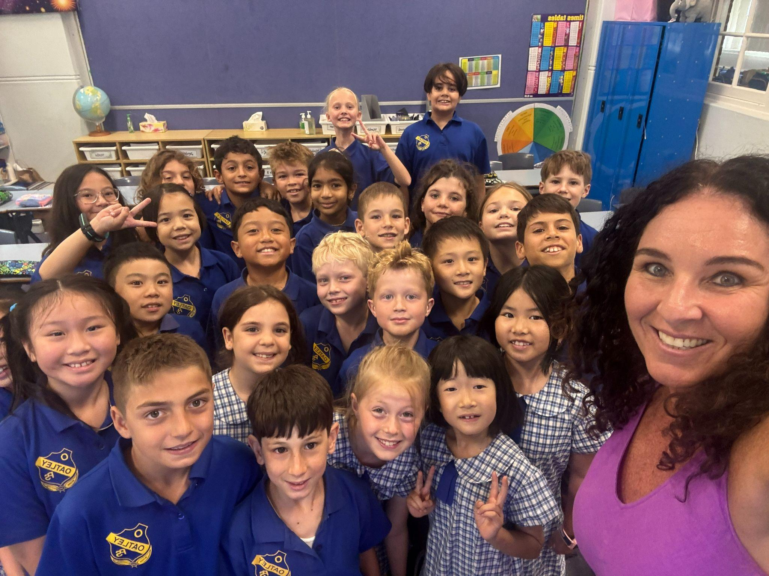
Thank You

