Slide 1
Welcome
to
5H
Mrs Darleen Hogan

Slide 3
About Your Child
4Cs Activity!
Collect 2 different colour Post-it notes
Write something you would like me to know about your child on the blue
and a goal for your child this year on the yellow Post-It Note
Place your post-it in the bucket
Blue
Post-It Note
Yellow
Post-It Note
Write something you would like me to know about your child
Write a goal for your child this year

Slide 4
My Teaching Philosophy
I pride myself on being: approachable, fair and a positive role model and mentor.
I set high expectations for all students of all levels.
Focus on praising students for effort.
As a Year 5 teacher my goal is to help all students adjust to stage 3 and achieve success, independence and accomplishments.
Focus on the social, emotional, physical and mental well being.
Develop and maintain positive friendships, respect and resilience
Help students to self-regulate and maintain focus and through strategies.

Slide 5
Stage 3:
5H - 24 students
12 boys and 12 girls
5D
5/6G
6A
6P

Slide 6
Semester 1:
Reading:
Novel Study - Boy Overboard by Morris Gleitzman and
comprehension strategies
Writing: - Narrative / Persuasive
Grammar - Nouns, Proper Nouns, Plurals, Clauses, Complex/Compound
Sentences etc
Mathematics: - Number and Algebra, Statistics and Probability and
Measurement and Geometry
Integrated Unit:
Geography - Factors That Shape Places
Science - Growth, Survival and Adaptations of Living Things
PD/Health:- Child Protection - Safe/Unsafe Relationships

Slide 8
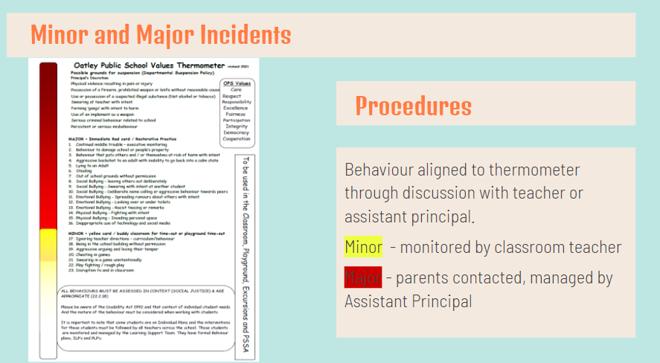

Slide 15
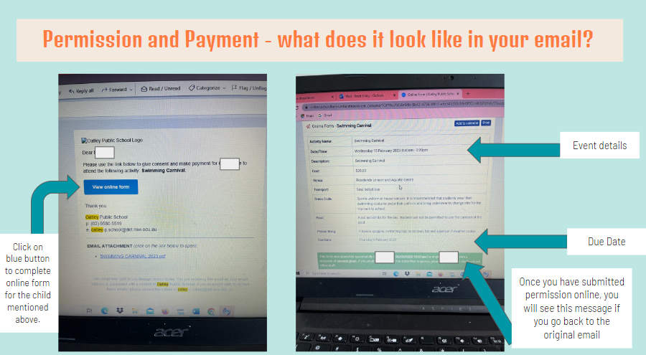

Slide 17
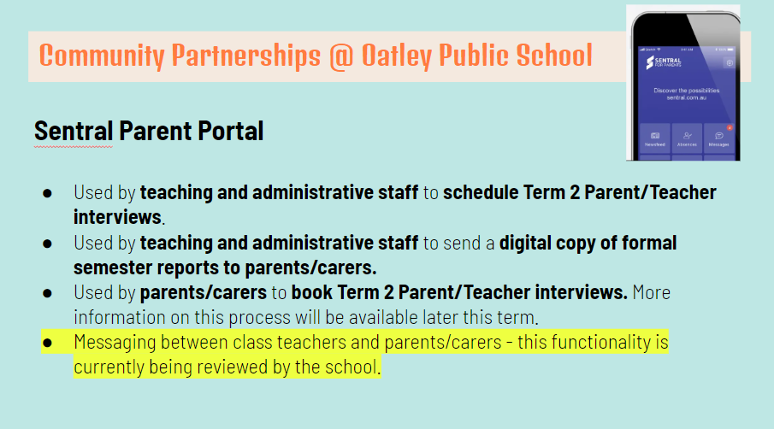

Slide 18
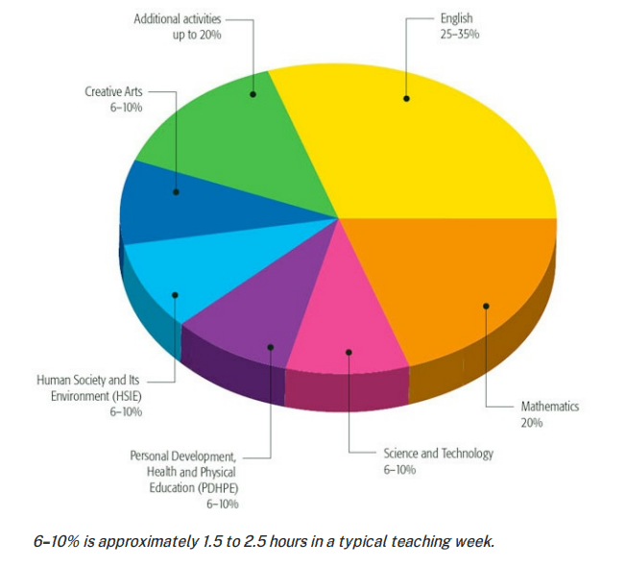
Allocation of curriculum across a school week:

Slide 19
Our Week:
Got Game - Monday (sports uniform)
Library - Thursday
Italian - Friday
Sport - Friday (sports uniform)

Slide 20
Homework:
Helps to establish habits of study, concentration and discipline
Please encourage your child to seek our help if needed
Handed out on Friday and brought back on Thursday

Slide 21
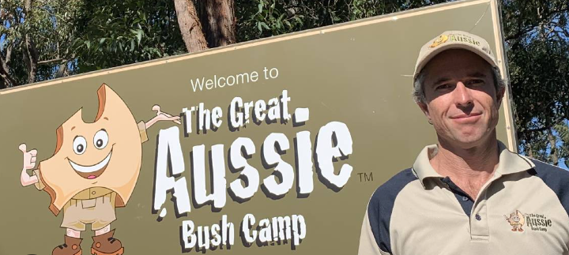
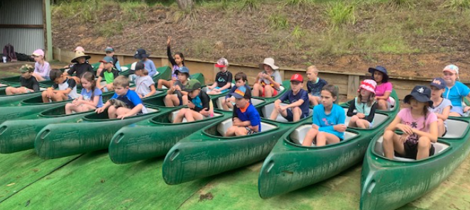
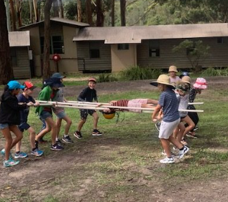
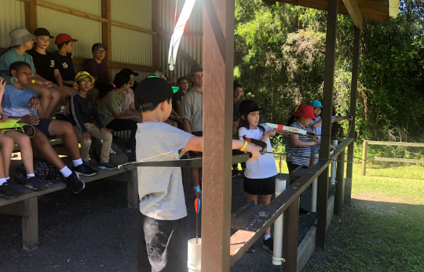
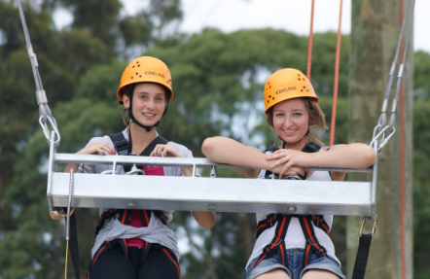

Slide 22
Key Dates:
NAPLAN - 15th - 27th - March
Camp - 29th - 31st May
(Kincumber)

Slide 23
Thank you for joining me.
I look forward to working with you to help your child achieve their educational goals.
Any Questions?

