Slide 1
Welcome to 4G
Meet The Teacher 2023

Slide 3
About your child
4Cs activity!
Collect 2 different colour Post-it notes
Write something you want us to know about your child and a goal for them this year
Place your post-it notes in the container out the front. Please make sure you identify your child on each note.
Pink Post-it Note
Yellow Post-it Note
Write something you want us to know about your child
Write a goal for your child this year

Slide 4
01
Meet Miss Gorman
02
Positive behaviour for learning
03
4Cs - Learning Disposition Wheel
Outline
04
Curriculum & Key days
05
Technology
06
Community Partnerships

Slide 5
01
Meet Miss Gorman

Slide 6
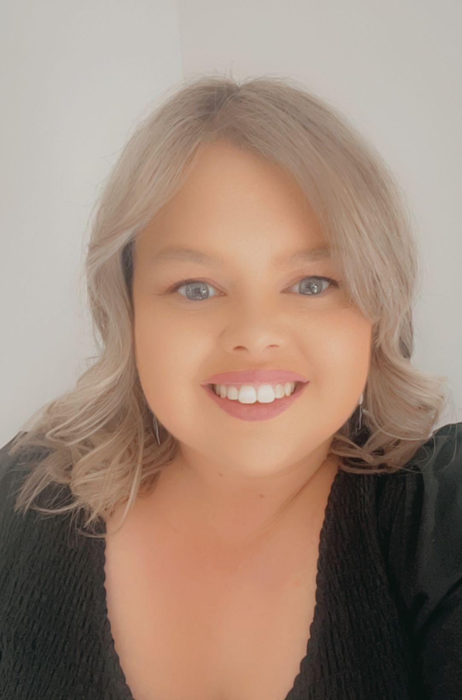
Bachelor of Primary Education
I have been teaching for 12 years. I have been full time at Oatley PS for nearly 7 years throughout my teaching career. In fact, I did my very first casual teaching day at Oatley back in 2011!
I am passionate about teaching and fostering an inclusive and fun learning environment.
My interests are student wellbeing, geography, literacy and performing arts.
Miss Melissa Gorman

Slide 8
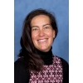
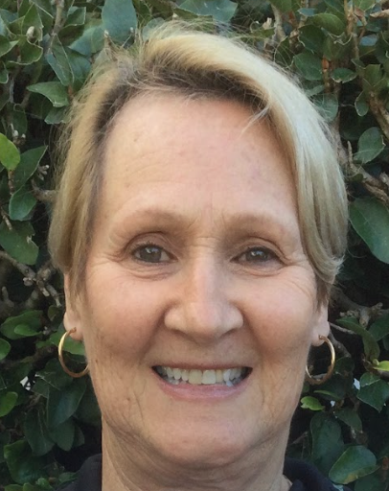
Other 4G Teachers
 | Ms Penny Johnstone (Signora) - Italian (Wednesday)
 | Mrs Leonie McDougall - Library (Friday)

Slide 9
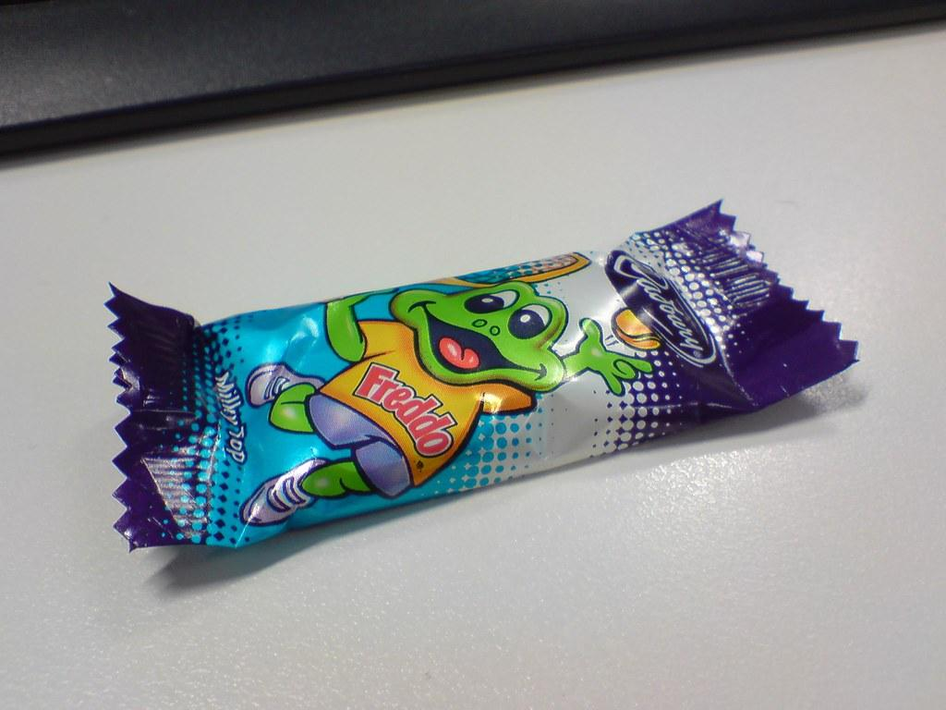
4G Class Profile
4G consists of 25 students - 14 girls & 11 boys
4G Birthday Protocols:
We LOVE celebrating birthdays in 4G but would like to request the following regarding any treats that your child brings in to share for their birthday:
They are required to be NUT-FREE
They should be individually wrapped for hygiene purposes
We will only hand out the treats just before the last bell at 3:20pm and we will ask the students to show you the treat and ask your permission to eat it.

Slide 10
02
Positive Behaviour for learning

Slide 11
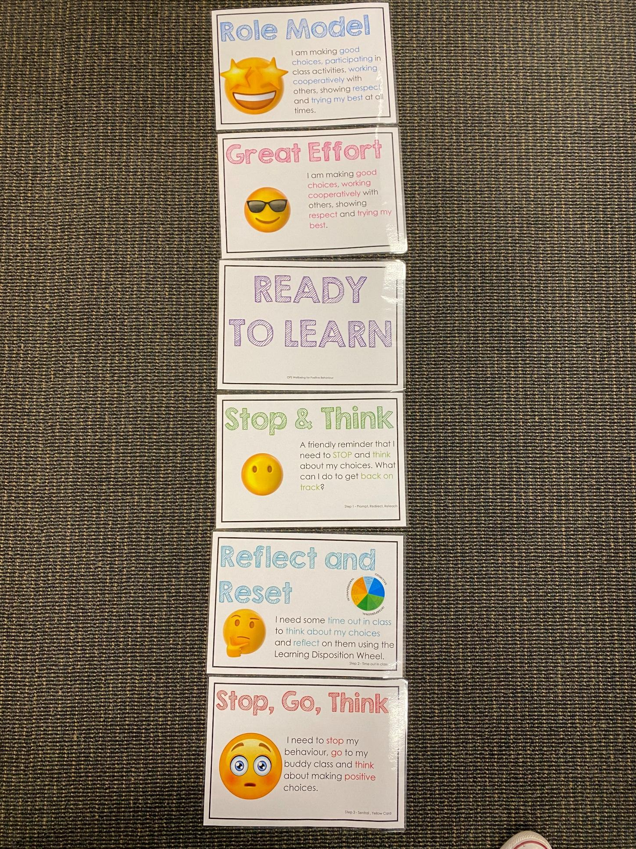
Positive Behaviour for Learning
Classroom Expectations
NSW public schools are committed to providing safe, supportive and responsive learning environments for everyone. We teach and model the behaviours we value in our students.
Every student begins on ‘READY TO LEARN’. Every day is a new day.

Slide 12
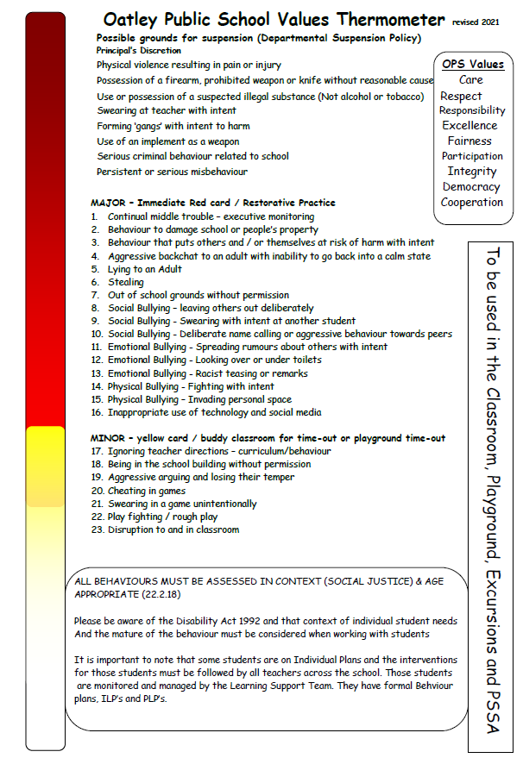
Minor and Major Incidents
Procedures
Behaviour aligned to thermometer through discussion with teacher or assistant principal.
Minor - monitored by classroom teacher
Major - parents contacted, managed by Assistant Principal

Slide 13
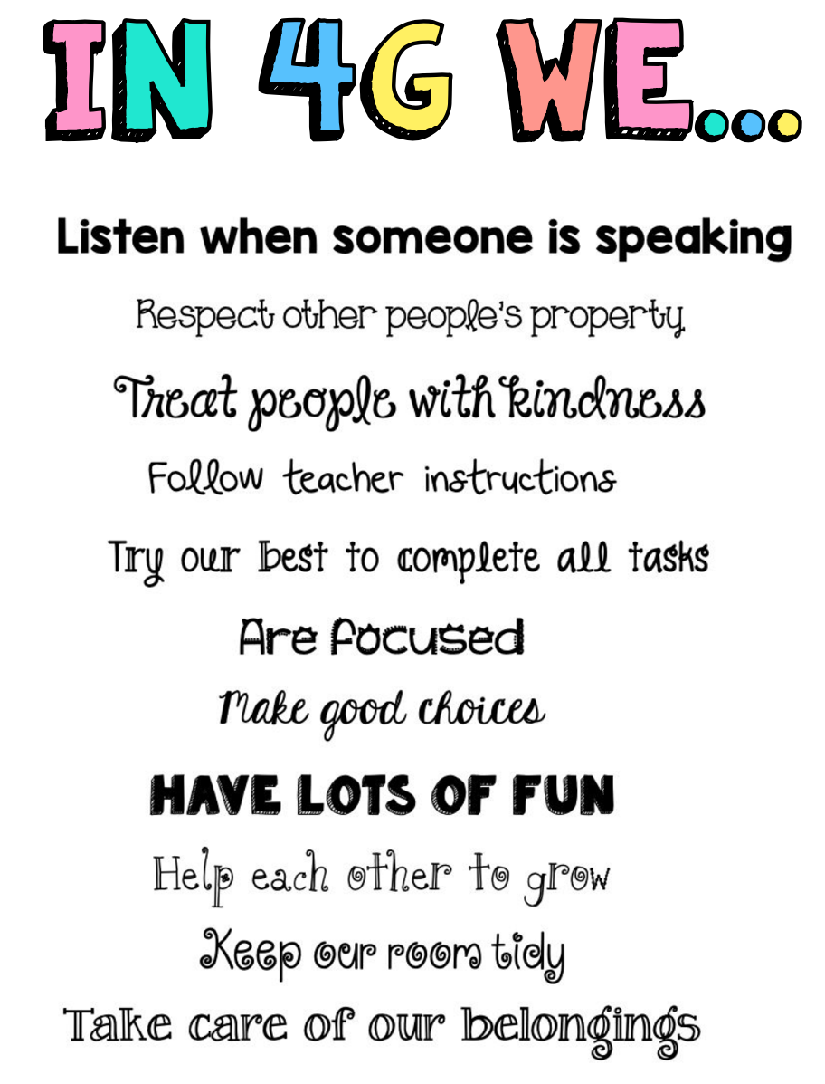
Classroom Rules
In 4G I have high expectations for behaviour. I like to use positive statements to affirm what I want the children to display rather than tell them what not to do.

Slide 14
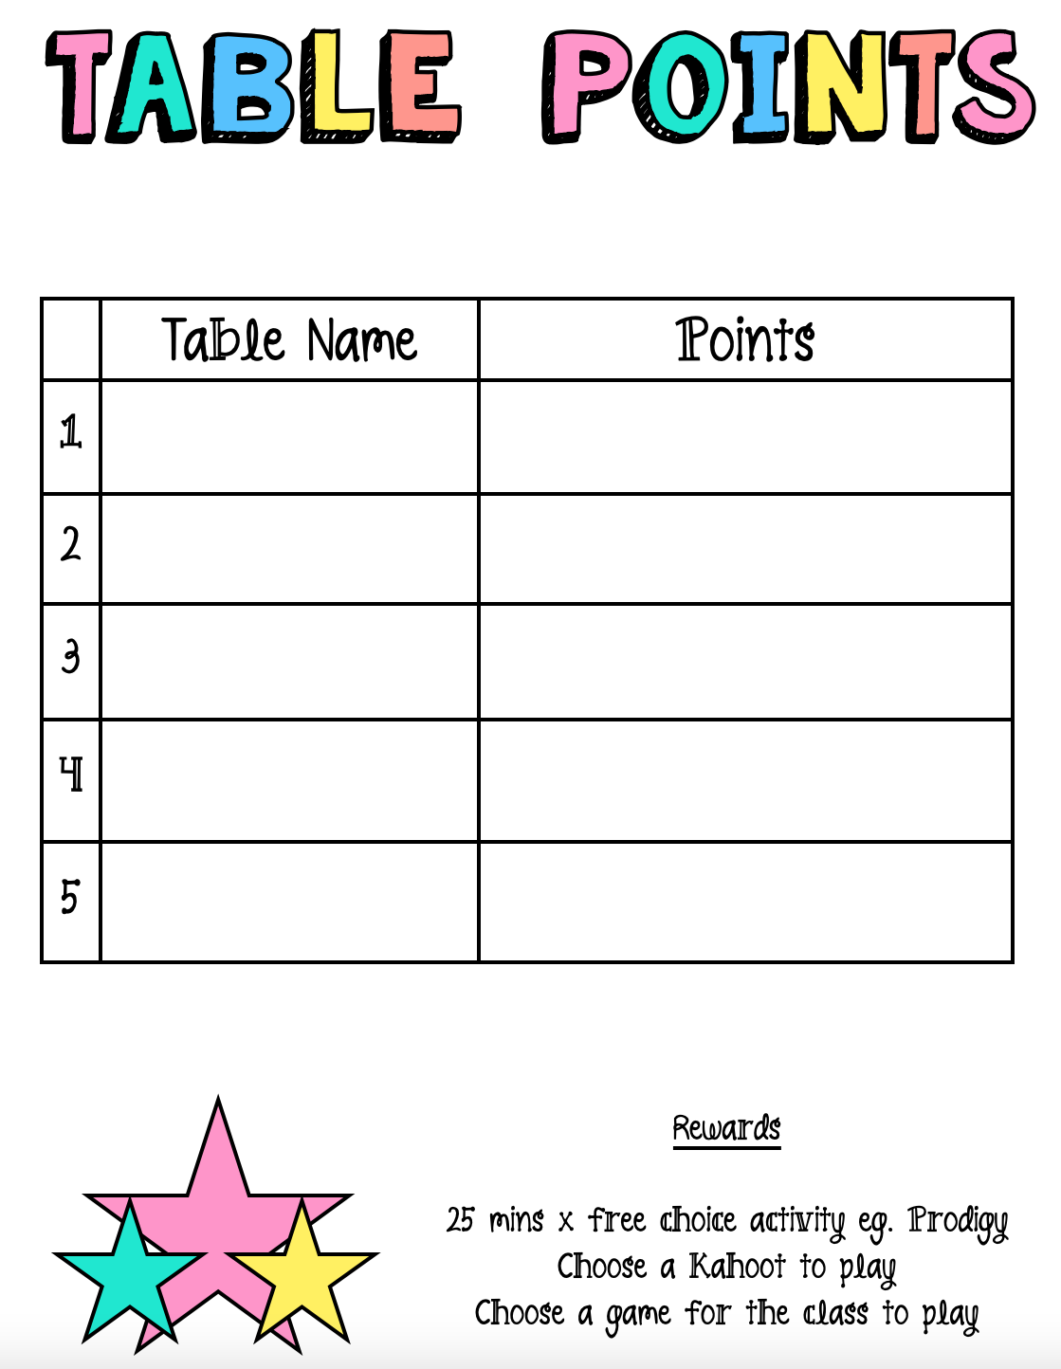
Classroom Reward System
Weekly
I have a table points system where students can earn points for their table by following class rules, displaying role model behaviour, showing initiative, keeping their learning space tidy and participating in activities. At the end of the week the winning table gets to redeem a negotiated reward the following week. eg. time on their iPad, picking a game/sport for the class to play.

Slide 15
03
4Cs
Learning Disposition
Wheel

Slide 16
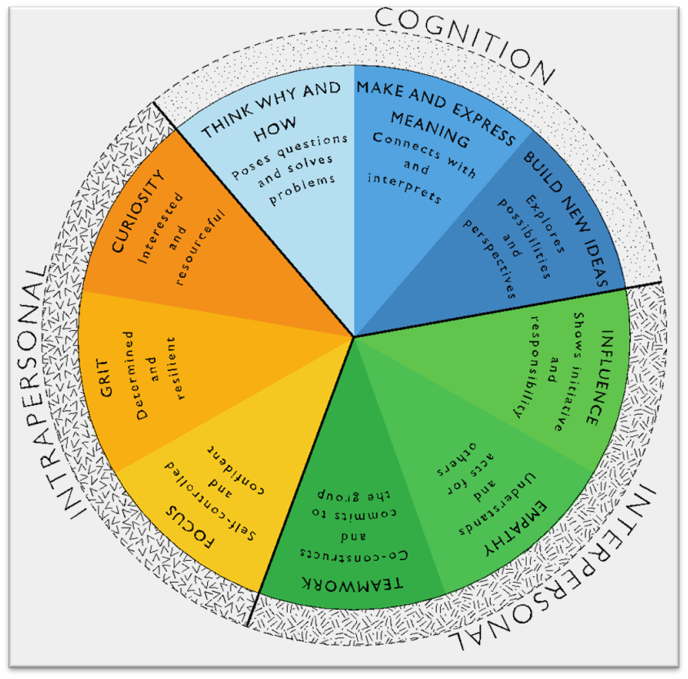
Learning Disposition Wheel
Communication, Creativity, Collaboration
& Critical Reflection
The Learning Disposition Wheel is a tool used to talk about learning and drive a deeper understanding of the 4Cs
Development of these dispositions is fundamental for students to develop an awareness of the way they learn and establish attitudes to learning.
This facilitates a common language about learning which empowers students to critically reflect.

Slide 17
04
Curriculum

Slide 18
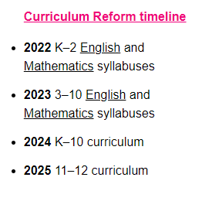
Curriculum Reform

Slide 19
What are we learning about?
Writing: Sentence structure, Grammar, Narrative, Informative and Persuasive
Reading & Spelling: Comprehension strategies, Vocabulary, MultiLit program
Maths: Place Value, Addition & Subtraction, Multiplication & Division, Problem Solving
Geography: ‘Earth’s Environment’ Looking at specific biomes, flora & fauna
Science: ‘Earth’s changing surface’ erosion, landforms, sustainability
PDHPE: Fitness, Got Game, Sport, Road Safety, Cyber Bullying & Respectful Relationships
Library & Italian: These lessons compliment our English & Geography units

Slide 20
Homework
Homework will commence in Week 5 (this week)
It will be handed out every Friday and due the following Thursday.
The following tasks are to be completed weekly:
One page of the Maths Mental booklet. Note: Students will be provided with answers to each week’s questions at the back of their booklets. Please ensure they mark their work after attempting the questions.
Complete the Spelling worksheet for the current week (Spelling worksheets will be in a booklet clearly labelled with relevant dates to complete).
Read a minimum of 15 minutes per day and complete the reading log

Slide 21
05
Technology

Slide 22
Technology @ Oatley Public School
School-Managed Devices:
Year 4: 1-to-1 iPads.
Technology Tools:
Many iPads apps, which are utilised because that they are grade-specific and appropriate to specific class context and current study.
Years 3-6: Google Suite of tools including Google Classroom, Google Docs, Google Slides and Google Sheets.
Focus is on utilising technology as a tool to enhance curriculum learning, 4C’s and student engagement.

Slide 23
Protocols for Technology Use @ Oatley Public School
All students’ parents/carers need to sign the online ICT Agreement before the student’s class is allowed to commence using technology in their classroom.
Technology is only to be used when instructed by a teacher.
Technology is not to be used with casual teachers or in break times.
Teachers using iPads will utilise Apple Classroom for monitoring purposes but our goal is also to teach the students to self-regulate their behaviour.
If inappropriate use of devices i.e. students are using devices at the incorrect time or are not completing the set task - the teacher will take the student’s device from them for the day. If behaviour is consistently repeated - parents will be notified.
Students need to show the utmost respect and care for the technology at all times. It is a privilege to use any of the school-managed devices.

Slide 24
06
Community
Partnerships

Slide 25
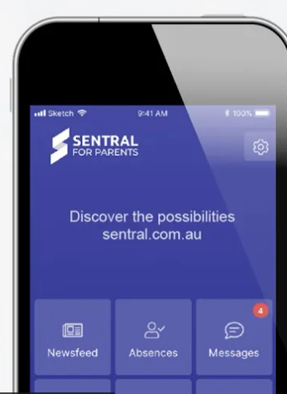
Community Partnerships @ Oatley Public School
School Stream app
School Bytes via Email
Time-critical alerts
School and P&C Newsletters
Student absence notifications
All requests for permission
All requests for payment
Oatley Public School Email: oatley-p.school@det.nsw.edu.au
School Website
Sentral Parent Portal
https://oatley-p.schools.nsw.gov.au
School Calendar and more static information
Any booking for 1-on-1 K-6 scheduled parent/teacher interviews
Digital copies of semester reports
Oatley Public School Phone Number: 9580 5519

Slide 26
Community Partnerships @ Oatley Public School
School Stream Phone App
Used by teaching and administration staff for sending out time-critical alerts and the weekly newsletter on Sunday afternoons at 5pm.
Used by the P&C for their weekly newsletter.
Used by parents/carers to formally notify the school of their child’s absence.
If you haven’t registered for School Stream, you need to download the app via the Apple or Android app store (depending on your type of phone). Then open the School Stream app and select Oatley Public School when prompted. The administrative staff will then approve your connection. Following this approval, you will begin receiving updates from the school.

Slide 27
Community Partnerships @ Oatley Public School
How do I pay for excursions/incursions/PSSA and give permission?
Any permission and payment for any K-6 student is completed online via the School Bytes system.
The preferred parent/carer contact for communication will be sent an email from School Bytes, requesting online permission and payment (where applicable).
One email per child in each family will be sent by the school. For example, if there are three children in one OPS family, the preferred contact will receive 3 separate emails requesting permission and/or payment. One permission form per child in each family needs to be completed.
A cut-off date for response will always be clearly indicated in your email message and the school administration staff will send at least one reminder to you via email before the event is effectively ‘closed’ for payment.

Slide 28
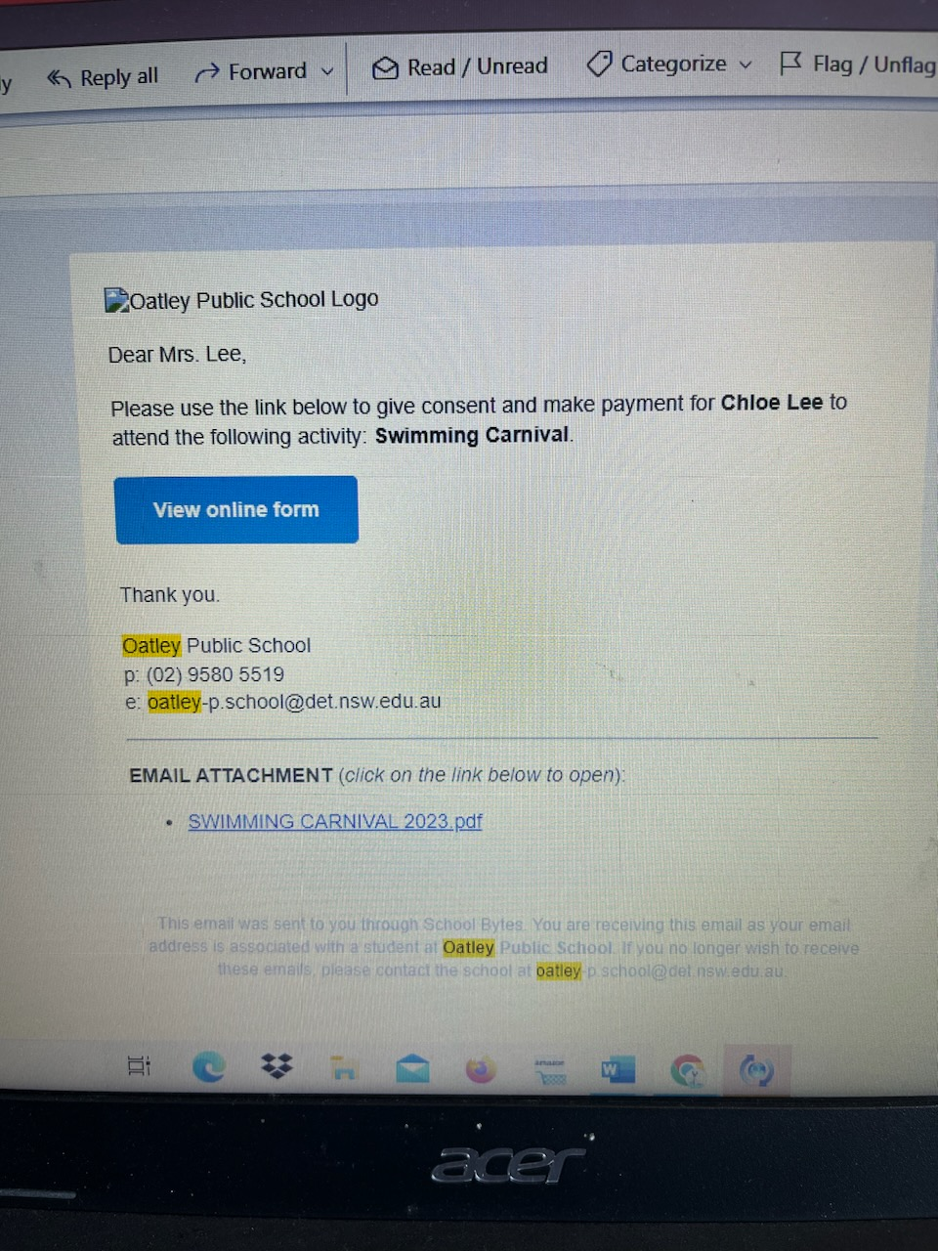
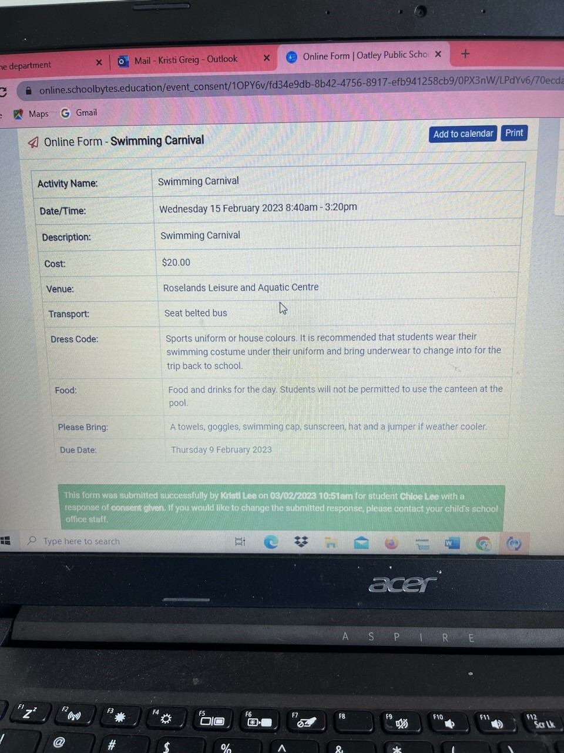
Permission and Payment - what does it look like in your email?
Event details
Click on blue button to complete online form for the child mentioned above.
Due Date
Once you have submitted permission online, you will see this message if you go back to the original email

Slide 29
Community Partnerships @ Oatley Public School
School Website: https://oatley-p.schools.nsw.gov.au/
The school’s website has an up-to-date calendar of future events.
School Email address: oatley-p.school@det.nsw.edu.au
Please use this email address to contact the school at any time for matters that are not time-critical. This is also an effective mechanism for sending a message to your child’s teacher. These messages will be forwarded by the school administration staff.
School Phone Number: 9580 5519
Please use this number to contact the school for any time-critical questions or to pass on time-critical information.

Slide 30
Community Partnerships @ Oatley Public School
Sentral Parent Portal
Used by teaching and administrative staff to schedule Term 2 Parent/Teacher interviews.
Used by teaching and administrative staff to send a digital copy of formal semester reports to parents/carers.
Used by parents/carers to book Term 2 Parent/Teacher interviews. More information on this process will be available later this term.
Messaging between class teachers and parents/carers - this functionality is currently being reviewed by the school.

Slide 31
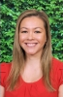
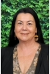
Communication
Speak positively about school to your child
Allow your children to be independent – encourage them to be resilient and self sufficient
If you have a question or an issue regarding anything happening at school please raise it with us as your first port of call.
If the issue cannot be resolved with us, the Stage 2 Assistant Principal (Mrs Angela Rozmeta) will assist. Mrs Rozmeta will escalate the issue to the Principal (Mrs Debbie Hunter) if necessary.
Mrs Angela Rozmeta
Stage 2 Relieving Assistant Principal
Mrs Debbie Hunter
Principal

Slide 32
THANKS!
Looking forward to working in partnership with you!
Does anyone have any questions?

