Slide 1
High School from 2025
Schools in GRC are changing…

Slide 2
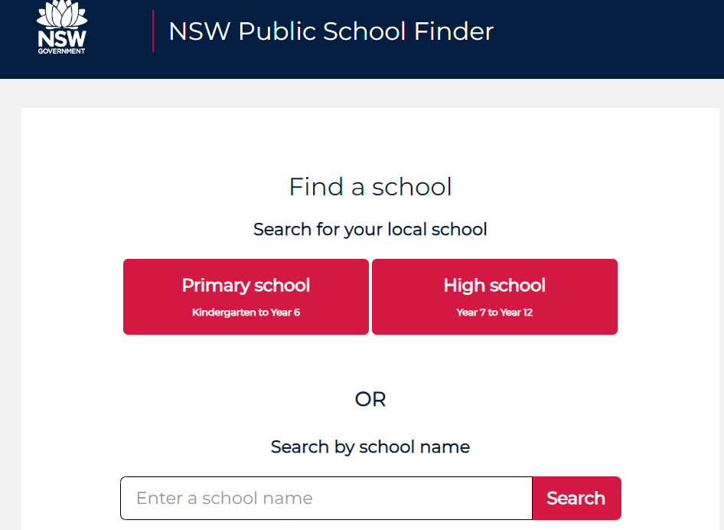
To find your high school, you need to go to: https://schoolfinder.education.nsw.gov.au
Make sure you have also updated your address if you have moved since enrolment.
Use the ‘Change of Details’ form on School Bytes.

Slide 3
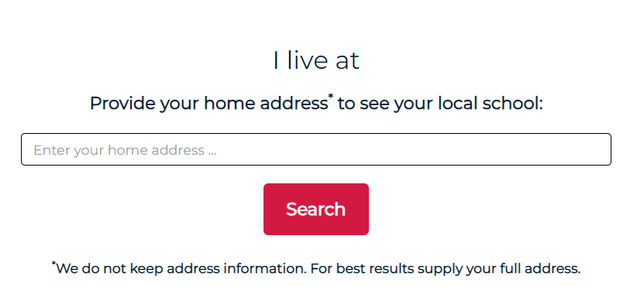

Slide 4
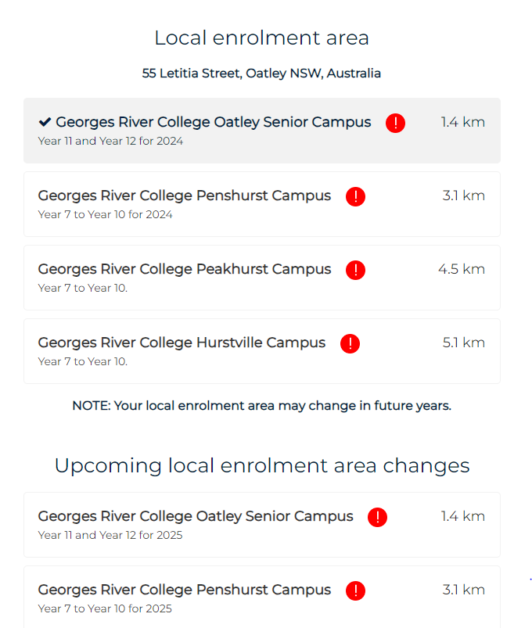
2024: Options for High School enrolment for in area students
2025: Options for High School enrolment for in area students

Slide 5
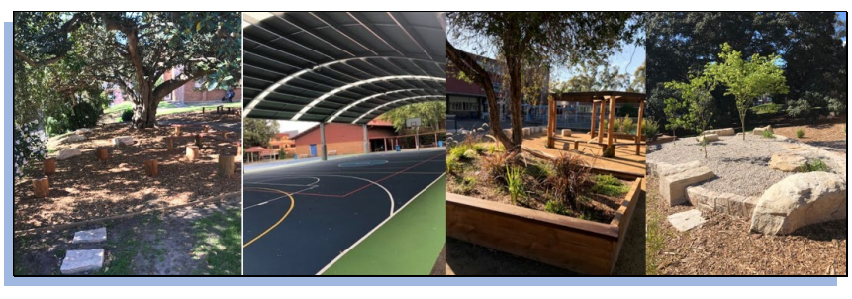
Our feeder High School is Penshurst Campus

Slide 6
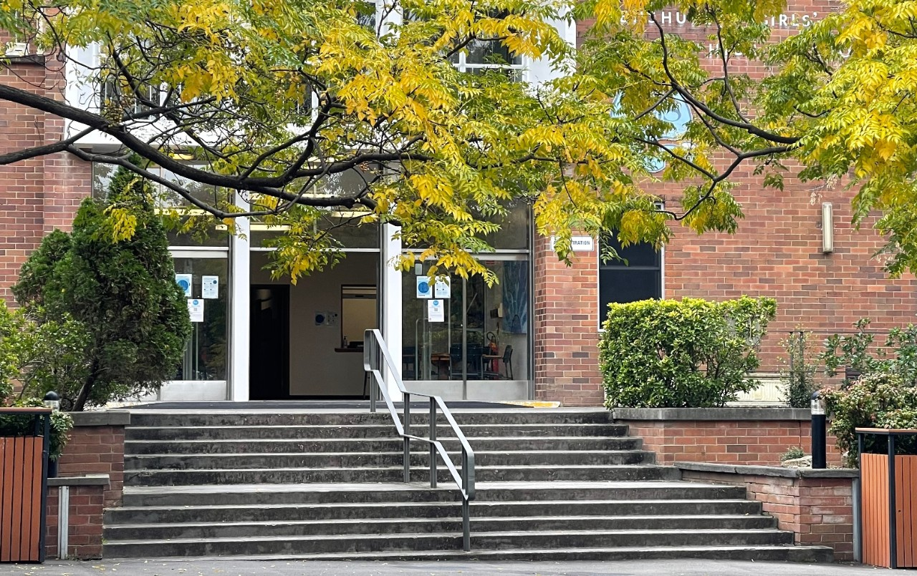
From 2025, Georges River College Penshurst Campus will become co-educational.
In 2025 the school will become co-educational in Years 7 and 8. Years 9 and 10 will become coeducational in 2026. Care will be taken in the transition to ensure all students are well supported during the changes.

Slide 8
Moving into Year 7 in a NSW Government School in 2025
You need to apply online https://education.nsw.gov.au/content/dam/main-education/going-to-a-public-school/media/documents/translated-documents-/moving-into-year-7/english-moving-into-year-7-EOI.pdf
You must complete sections A & B of this form if your child is attending a NSW Government High School (even if you intend to apply for a Selective high school placement).
Section C allows you to apply for 3 out of area high schools (in order of preference).
If your child is not attending a NSW Government High School, you must still complete sections A & E of this form.

