Slide 1
Welcome to Kindergarten
Meet The Teacher 2024

Slide 3
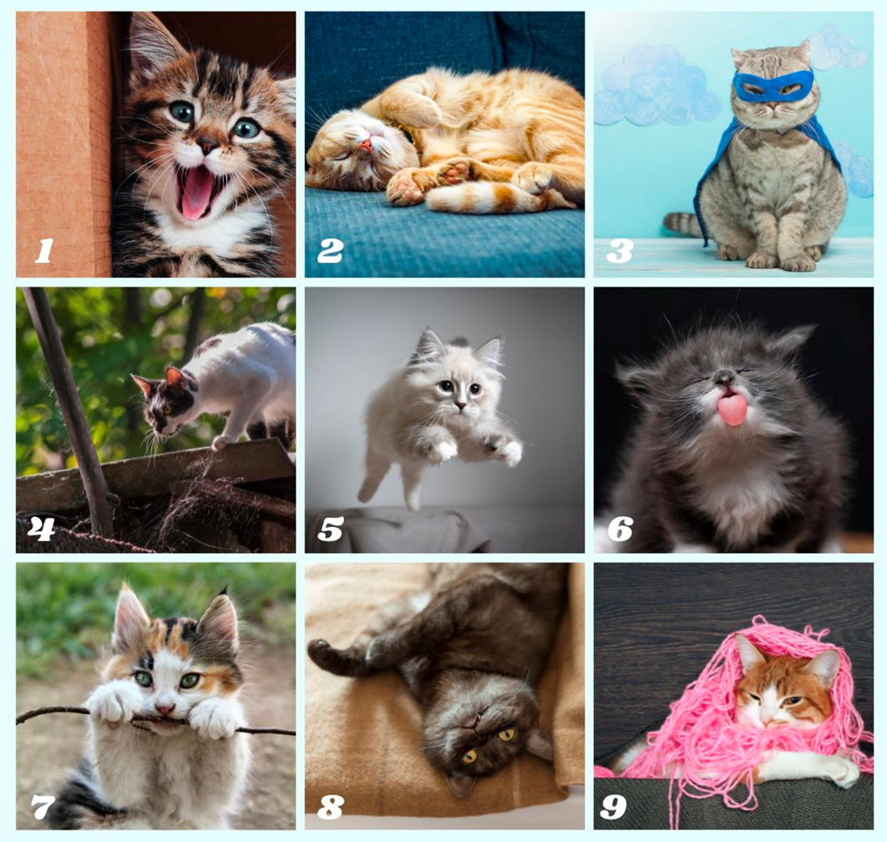
Scale of Cat
Think about how you feel about your child’s start to the new school year.
Which cat best represents how you are feeling?
What cat are you?

Slide 4
Popcorn
Make eye contact with someone in the circle.
Walk towards that person and place your hands together like a high five and say ‘pop’
You have one minute to introduce yourself and identify your cat and speak to your partner about your choice.
It is then the other person’s turn to share their thoughts with you.
At the end of the discussion, you will be guided to ‘unpop’ and choose a new partner

Slide 5
About your child
4Cs activity!
Collect 2 different colour Post-it notes
Write something you want us to know about your child and a goal for them this year
Place your post-it notes on the whiteboard
Blue Post-it Note
Yellow Post-it Note
Write something you want us to know about your child
Write a goal for your child this year

Slide 6
01
Meet Miss Dayman
02
Positive behaviour for learning
03
4Cs - Learning Disposition Wheel
Outline
04
Curriculum
05
Technology
06
Community Partnerships

Slide 7
01
Meet Kindy Teacher

Slide 8
Stage 1 2024
There are 2 Early Stage One classes this year:
Mrs Banister and Mrs Worthington (KBW)
Miss Dayman (KD)
Our Assistant Principal is: Mrs Edwards

Slide 9
Who Supports Us?
Library
Community Languages (Italian)
Mrs Adams
Ms Johnstone (Signora)
Curriculum Reform
Mrs White

Slide 10
Homework- Due on Thursday, redistributed Friday
Term 1 homework consists of 3 components:
1. Reading to your child and recording it in the Home Reading Diary (there are opportunities to practice InitiaLit work treated in class inside of the diary also.
2. Grid with tricky word, maths and other KLA tasks (choose how many you do)
3. Me Bag (Speaking and Listening)
4. Tricky Words- need to be learned, signed off on and then tested by the teacher before moving onto the next set of words.

Slide 11
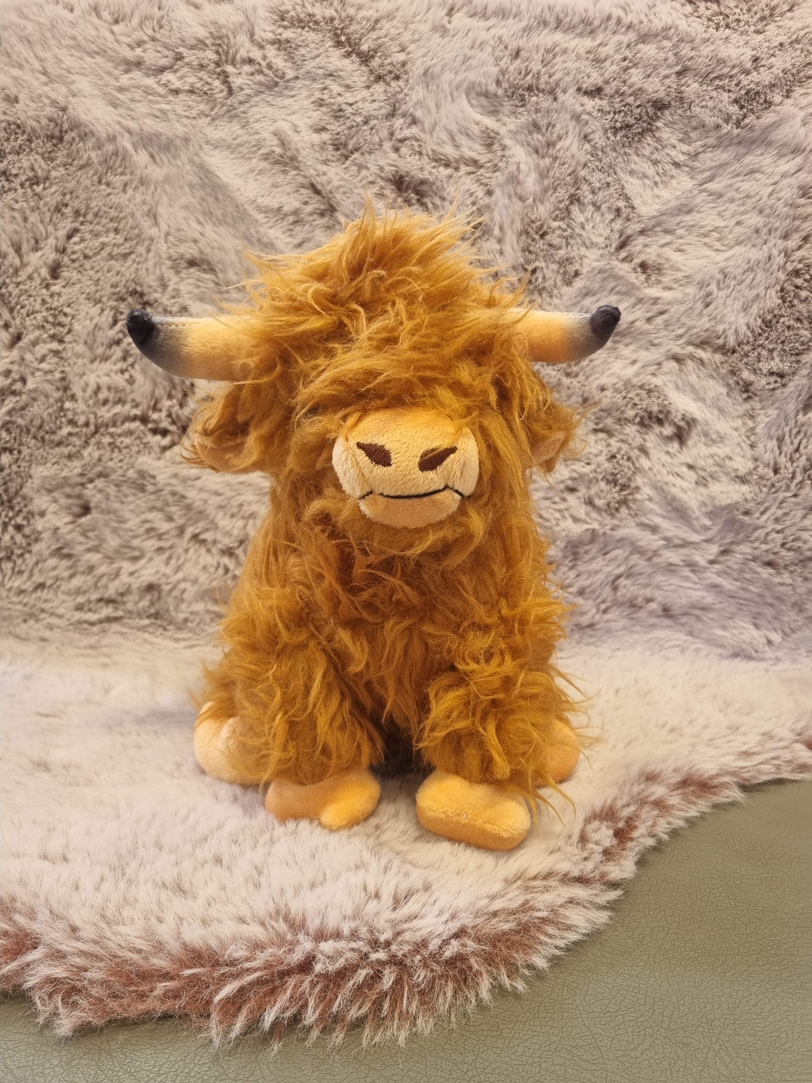
KD and Henry’s Learning Disposition Diary
Coming in Term 2!
Everyone will take it in turns to take home Henry and show him how they display the different learning dispositions e.g. focus. Please use one double page, take photographs and write about the activities you get up to together. He will be handed out on Fridays to be returned to school the following Thursday.

Slide 12
Key Days to Remember
Monday
Got Game
Tuesday
Library
Wednesday
Scripture: 9:50am-10.20am
(Protestant, Catholic, Greek Orthodox, Ethics and Non-Scripture)
Thursday
Homework due to the teacher
Friday
Italian
Fitness (optional joggers)

Slide 13
Food at School
Canteen
Birthdays
The school canteen is open Monday - Thursday (inclusive).
All lunch orders must be ordered via Flexischools.
We welcome birthday treats on your child’s special day. We ask that all birthday treats are individually portioned and packed ready to hand out e.g. cupcakes, lolly bags etc
PLEASE NOTE: due to an increase in students with severe allergies we ask that you please be mindful when packing lunches and incorporate foods that do not contain nuts.

Slide 14
02
Positive Behaviour for Learning

Slide 15
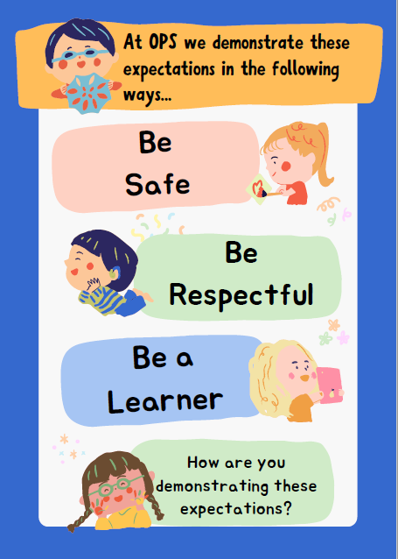
Our OPS Expectations
Be Safe
Be Respectful
Be a Learner.

Slide 16
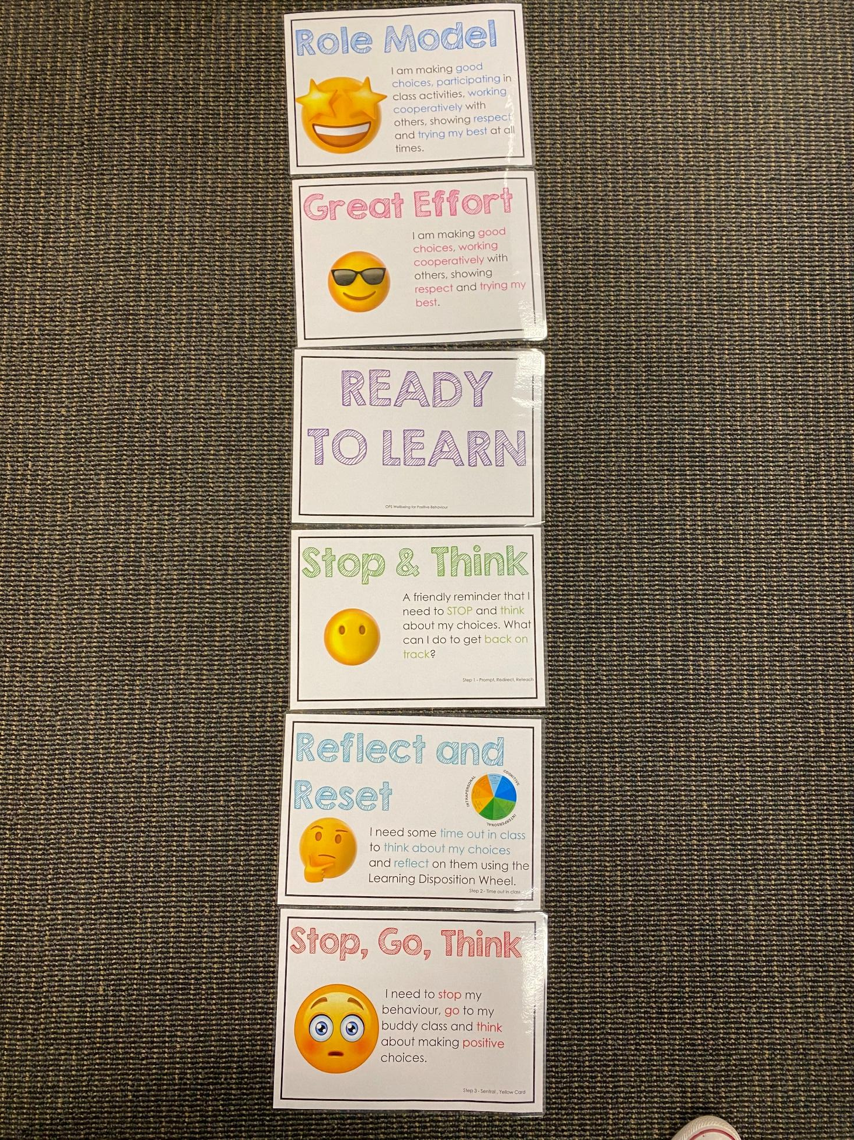
Positive Behaviour for Learning
Classroom Expectations
NSW public schools are committed to providing safe, supportive and responsive learning environments for everyone. We teach and model the behaviours we value in our students.
Every student begins on ‘READY TO LEARN’. Every day is a new day.

Slide 17
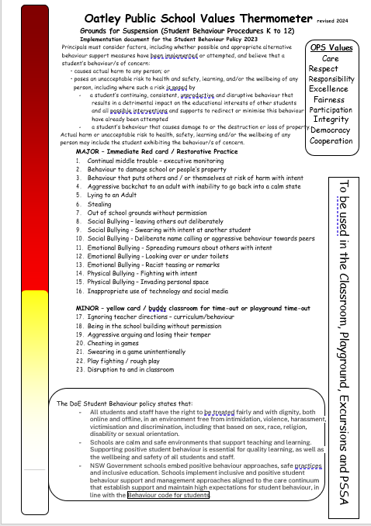
Minor and Major Incidents
Procedures
Behaviour aligned to thermometer through discussion with teacher or assistant principal.
Minor - monitored by classroom teacher
Major - parents contacted, managed by Assistant Principal

Slide 18
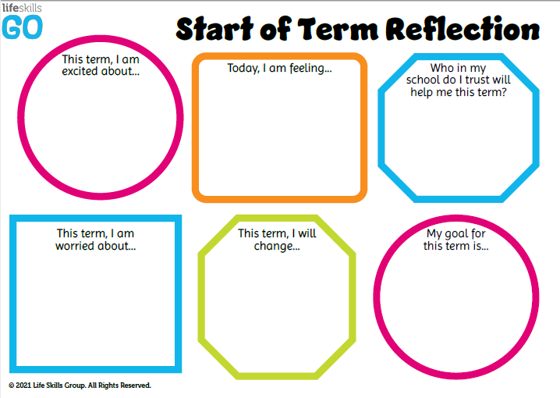
Student Wellbeing Focus
Experiences
Growing Strong Minds
Gratitude Journals
Student Voice experiences
Incursions – Zero Bullying, Backflips against Bullying

Slide 19
03
4Cs
Learning Disposition
Wheel

Slide 20
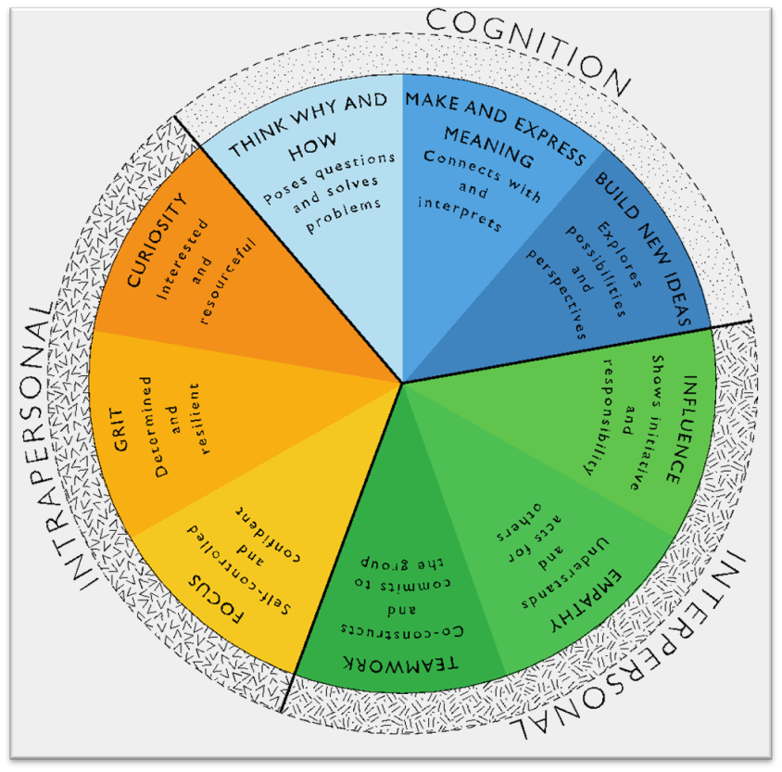
Learning Disposition Wheel
Communication, Creativity, Collaboration
& Critical Reflection
The Learning Disposition Wheel is a tool used to talk about learning and drive a deeper understanding of the 4Cs
Development of these dispositions is fundamental for students to develop an awareness of the way they learn and establish attitudes to learning.
This facilitates a common language about learning which empowers students to critically reflect.

Slide 21
04
Curriculum

Slide 22
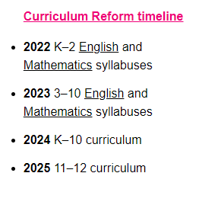
Curriculum Reform

Slide 23
Learning in Stage 1 - Key Learning Areas
English
Mathematics
Science & Technology

Slide 24
Learning in Stage 1 - Key Learning Areas
Personal Development, Health & Physical Education (PDHPE)
Creative Arts
History and Geography

Slide 25
05
Technology

Slide 26
Protocols for Technology Use @ Oatley Public School
Early Stage 1 classes utilise the K-2 shared iPads.
All parents/carers need to sign the online ICT Agreement before the student’s class is allowed to commence using technology in their classroom.
This agreement includes the use of mobile phones and smart watches worn by students to school.
Inappropriate or irresponsible use of devices will result in the student losing access to the device for that lesson.
Students need to show the utmost respect and care for the technology at all times. It is a privilege to use any of the school-managed devices.

Slide 27
06
Community
Partnerships

Slide 28
Community Partnerships @ Oatley Public School
School Bytes via Email
All requests for permission
All requests for payment
Teachers can send emails to parents/carers (1 way communication)
Alerts and Reminders
Good News Stories
Oatley Public School Email: oatley-p.school@det.nsw.edu.au
School Bytes Parent Portal
School Website
Payment and permission
School Community Calendar
Student Absence Notifications
Under development: 1-1 private messaging
https://oatley-p.schools.nsw.gov.au
School Calendar and more static information
Oatley Public School Phone Number: 9580 5519

Slide 29
Community Partnerships @ Oatley Public School
How do I pay for excursions/incursions/PSSA and give permission/notify of my child’s absence?
Permission and payment for any student is completed online via the School Bytes system.
The preferred parent/carer contact for communication will be sent an email from School Bytes, requesting online permission and payment (where applicable).
One email per child in each family will be sent by the school. For example, if there are three children in one OPS family, the preferred contact will receive 3 separate emails requesting permission and/or payment. One permission form per child in each family needs to be completed.
A cut-off date for response will always be clearly indicated in your email message and the school administration staff will send at least one reminder to you via email before the event is effectively ‘closed’ for payment.

Slide 30
Community Partnerships @ Oatley Public School
School Website: https://oatley-p.schools.nsw.gov.au/
The school’s website has an up-to-date calendar of future events.
School Email address: oatley-p.school@det.nsw.edu.au
Please use this email address to contact the school at any time for matters that are not time-critical. This is also an effective mechanism for sending a message to your child’s teacher. These messages will be forwarded by the school administration staff.
School Phone Number: 9580 5519
Please use this number to contact the school for any time-critical questions or to pass on time-critical information.

Slide 31
Questions
?

Slide 32
THANK YOU!
Looking forward to working in partnership with you.

