Slide 1
Stage 2
Meet The Teacher 2024

Slide 3
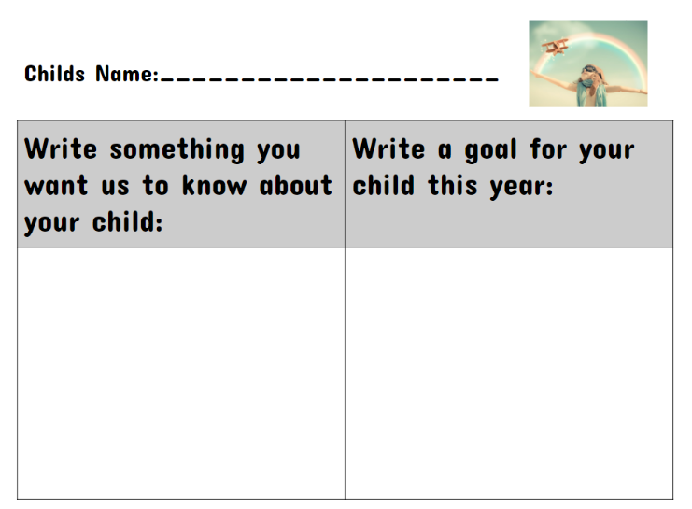
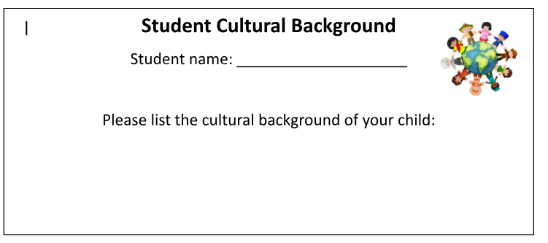
About your child
Please complete the following forms (available at the front of the room while you wait for the presentation to begin).

Slide 4
01
Meet your child’s teacher
02
Positive behaviour for learning
03
4Cs - Learning Disposition Wheel
Outline
04
Curriculum
05
Technology
06
Community Partnerships

Slide 5
01
Meet your classroom teacher

Slide 6
Stage 2 2024
There are 5 Stage 2 classes this year:
3K (Mrs Kennedy) 4G (Miss Gorman)
3M (Mrs Mackintosh) 4L (Mr Lao)
3/4R (Mrs Rozmeta & Mrs Montgomery)
The Assistant Principal is: Mrs Rozmeta

Slide 7
Who Supports Us?
Library
Community Languages (Italian)
Mrs Adams & Mrs Montgomery
Ms Johnstone (Signora)
Physical Education
Curriculum Reform
GotGame (external provider)
Mrs White

Slide 8
Homework- Due on Thursday, redistributed Friday
Term 1 homework consists of 3 components:
1. Reading (20 minutes per day)
2. Maths problem solving (differentiated tasks)
3. Spelling
Some components will be uploaded online via Google Classroom.
Homework will commence from Week 4.

Slide 9
Food at School
Canteen
Birthdays
The school canteen is open Monday - Thursday (inclusive).
All lunch orders must be ordered via Flexischools.
We welcome birthday treats on your child’s special day.
We ask that all birthday treats are individually portioned and packed ready to hand out e.g. cupcakes, lolly bags etc.
PLEASE NOTE: due to an increase in students with severe allergies we ask that you please be mindful when packing lunches and incorporate foods that do not contain nuts.

Slide 10
02
Positive Behaviour for Learning

Slide 11
Our OPS Expectations
Be Safe
Be Respectful
Be a Learner.

Slide 12
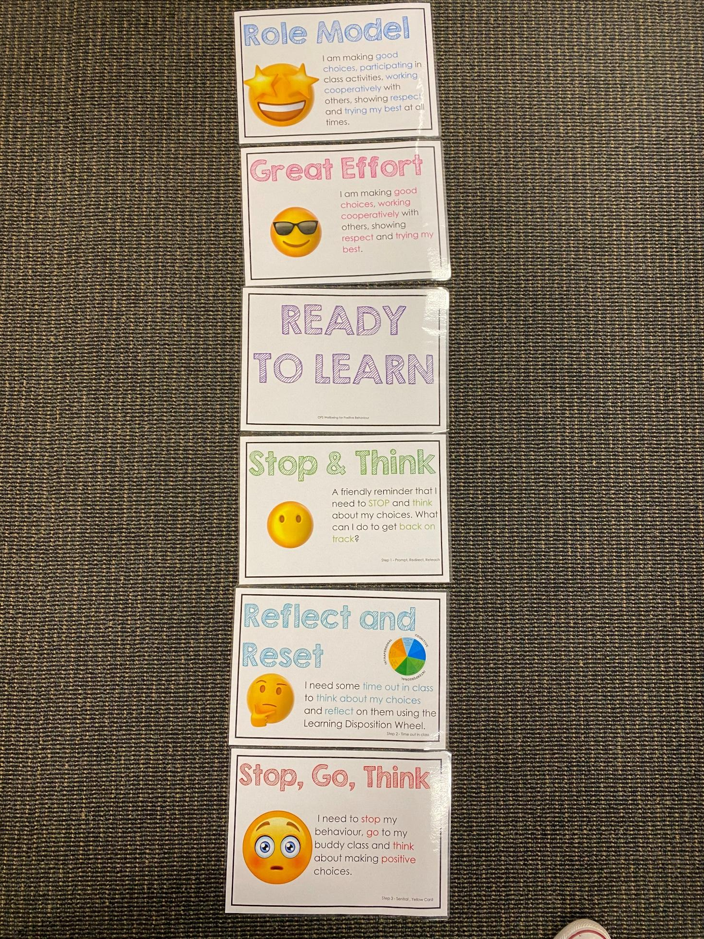
Positive Behaviour for Learning
Classroom Expectations
NSW public schools are committed to providing safe, supportive and responsive learning environments for everyone. We teach and model the behaviours we value in our students.
Every student begins on ‘READY TO LEARN’. Every day is a new day.

Slide 13
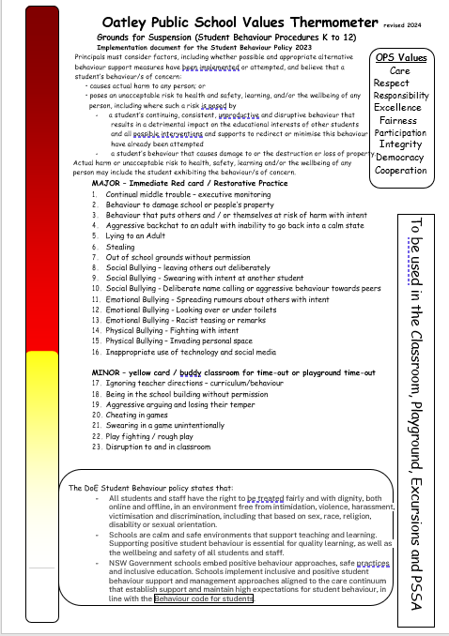
Minor and Major Incidents
Procedures
Behaviour aligned to thermometer through discussion with teacher or assistant principal.
Minor - monitored by classroom teacher
Major - parents contacted, managed by Assistant Principal

Slide 14
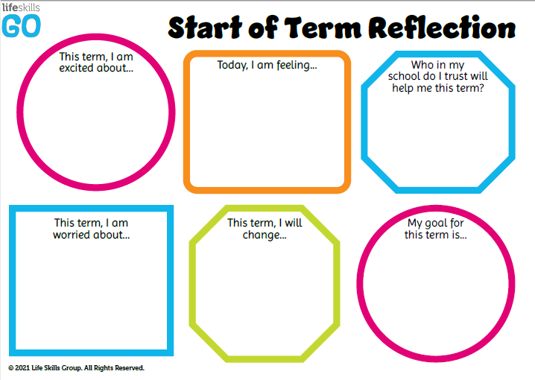
Student Wellbeing Focus
Experiences
Growing Strong Minds
Gratitude Journals
Student Voice experiences
Incursions – Zero Bullying, Backflips against Bullying

Slide 15
03
4Cs
Learning Disposition
Wheel

Slide 16
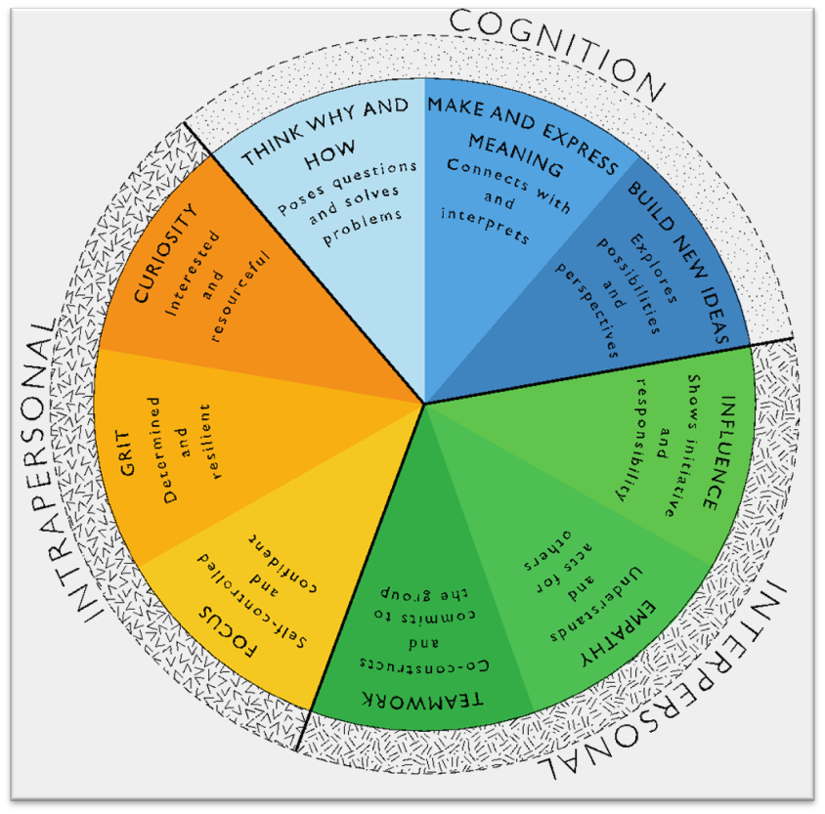
Learning Disposition Wheel
Communication, Creativity, Collaboration
& Critical Reflection
The Learning Disposition Wheel is a tool used to talk about learning and drive a deeper understanding of the 4Cs
Development of these dispositions is fundamental for students to develop an awareness of the way they learn and establish attitudes to learning.
This facilitates a common language about learning which empowers students to critically reflect.

Slide 17
04
Curriculum

Slide 18
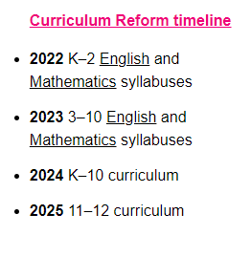
Curriculum Reform

Slide 19
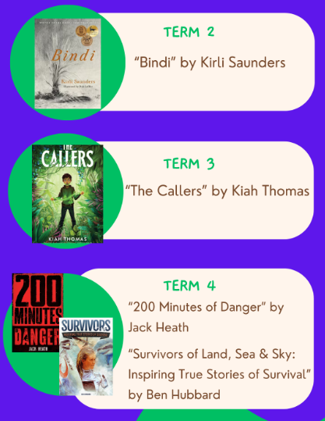
English syllabus - Class Novels
Year 3 (3K, 3M & 3/4R)
Year 4
(4G & 4L)
You may choose to buy these books for your child to support learning of the English curriculum.

Slide 20
Learning in Stage 2 - Key Learning Areas
English
Mathematics
Science & Technology

Slide 21
Learning in Stage 2 - Key Learning Areas
Personal Development, Health & Physical Education (PDHPE)
Creative Arts
History and Geography

Slide 22
2024 NAPLAN Assessment
NAPLAN Assessment Online - Year 3 students only
Assessment Test Window is 9 days:
Wednesday 13th March - Monday 25th March 2024
Students will need to have headphones/earbuds to access the assessments.

Slide 23
05
Technology

Slide 24
Protocols for Technology Use @ Oatley Public School
Stage 2 students utilise a combination of chromebooks and iPads.
All parents/carers need to sign the online ICT Agreement before the student’s class is allowed to commence using technology in their classroom.
This agreement includes the use of mobile phones and smart watches worn by students to school.
Inappropriate or irresponsible use of devices will result in the student losing access to the device for that lesson.
Students need to show the utmost respect and care for the technology at all times. It is a privilege to use any of the school-managed devices.

Slide 25
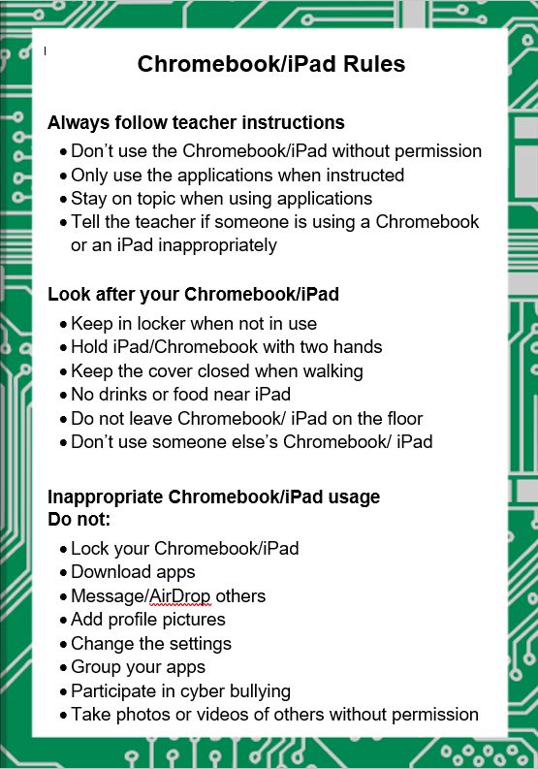
Technology rules in the classroom

Slide 26
06
Community
Partnerships

Slide 27
Community Partnerships @ Oatley Public School
School Bytes via Email
All requests for permission
All requests for payment
Teachers can send emails to parents/carers (1 way communication)
Alerts and Reminders
Good News Stories
Oatley Public School Email: oatley-p.school@det.nsw.edu.au
School Bytes Parent Portal
School Website
Payment and permission
School Community Calendar
Student Absence Notifications
Under development: 1-1 private messaging
https://oatley-p.schools.nsw.gov.au
School Calendar and more static information
Oatley Public School Phone Number: 9580 5519

Slide 28
Community Partnerships @ Oatley Public School
How do I pay for excursions/incursions/PSSA and give permission/notify of my child’s absence?
Permission and payment for any student is completed online via the School Bytes system.
The preferred parent/carer contact for communication will be sent an email from School Bytes, requesting online permission and payment (where applicable).
One email per child in each family will be sent by the school. For example, if there are three children in one OPS family, the preferred contact will receive 3 separate emails requesting permission and/or payment. One permission form per child in each family needs to be completed.
A cut-off date for response will always be clearly indicated in your email message and the school administration staff will send at least one reminder to you via email before the event is effectively ‘closed’ for payment.

Slide 29
Community Partnerships @ Oatley Public School
School Website: https://oatley-p.schools.nsw.gov.au/
The school’s website has an up-to-date calendar of future events.
School Email address: oatley-p.school@det.nsw.edu.au
Please use this email address to contact the school at any time for matters that are not time-critical. This is also an effective mechanism for sending a message to your child’s teacher. These messages will be forwarded by the school administration staff.
School Phone Number: 9580 5519
Please use this number to contact the school for any time-critical questions or to pass on time-critical information.

Slide 30
Questions
?

Slide 31
THANK YOU!
Looking forward to working in partnership with you.

