Slide 1
Welcome to Stage 3
Meet The Teacher 2024

Slide 3
About your child
4Cs activity!
Collect 2 different colour Post-it notes
Write something you want us to know about your child and a goal for them this year
Place your post-it notes on the whiteboard
Blue Post-it Note
Yellow Post-it Note
Write something you want us to know about your child
Write a goal for your child this year

Slide 4
Stage 3 2024
There are four Stage 3 classes this year:
5P (Mr Prenzel) 5H (Mrs Hogan )
6G (Mrs Gadaleta & Mrs Wilson) 6D (Mr Dodd)

Slide 5
Who Supports Us?
Library
Community Languages (Italian)
Mrs Adams
Ms Johnstone (Signora)
Curriculum Reform
Mrs White

Slide 6
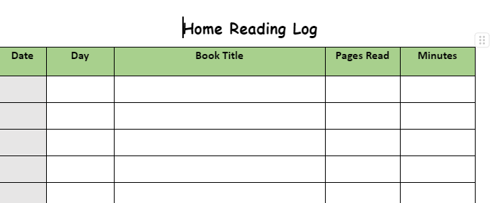
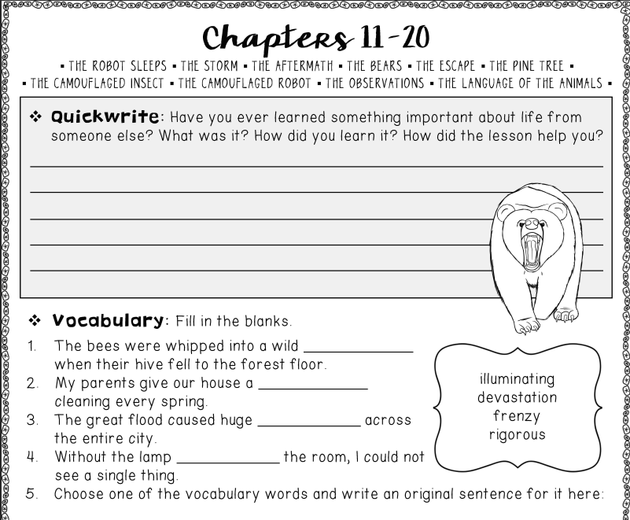
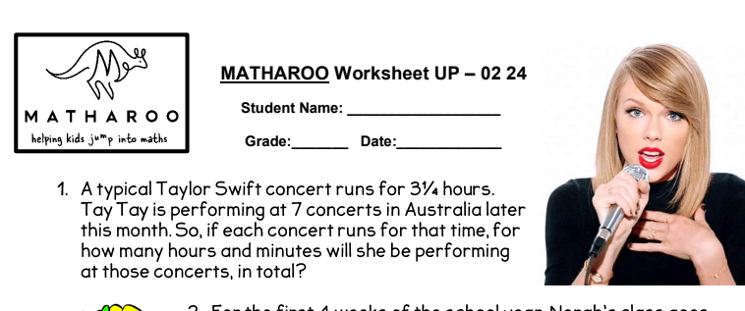
Homework- Due on Thursday, redistributed Friday
Term 1 homework consists of 3 components:
Reading Comprehension – related to our novel
Maths (differentiated tasks)
Home Reading

Slide 7
Key Days to Remember
Monday
Got Game
Wednesday
Scripture: 9:50am-10.20am
(Protestant, Catholic, Greek Orthodox, Ethics and Non-Scripture)
Italian
Thursday
Library
Friday
Sport

Slide 8
Food at School
Canteen
Birthdays
We welcome birthday treats on your child’s special day. We ask that all birthday treats are individually portioned and packed ready to hand out e.g. cupcakes, lolly bags etc
The school canteen is open Monday - Thursday (inclusive).
All lunch orders must be ordered via Flexischools.
PLEASE NOTE: due to an increase in students with severe allergies we ask that you please be mindful when packing lunches and incorporate foods that do not contain nuts.

Slide 9
Our OPS Expectations
Be Safe
Be Respectful
Be a Learner.

Slide 10
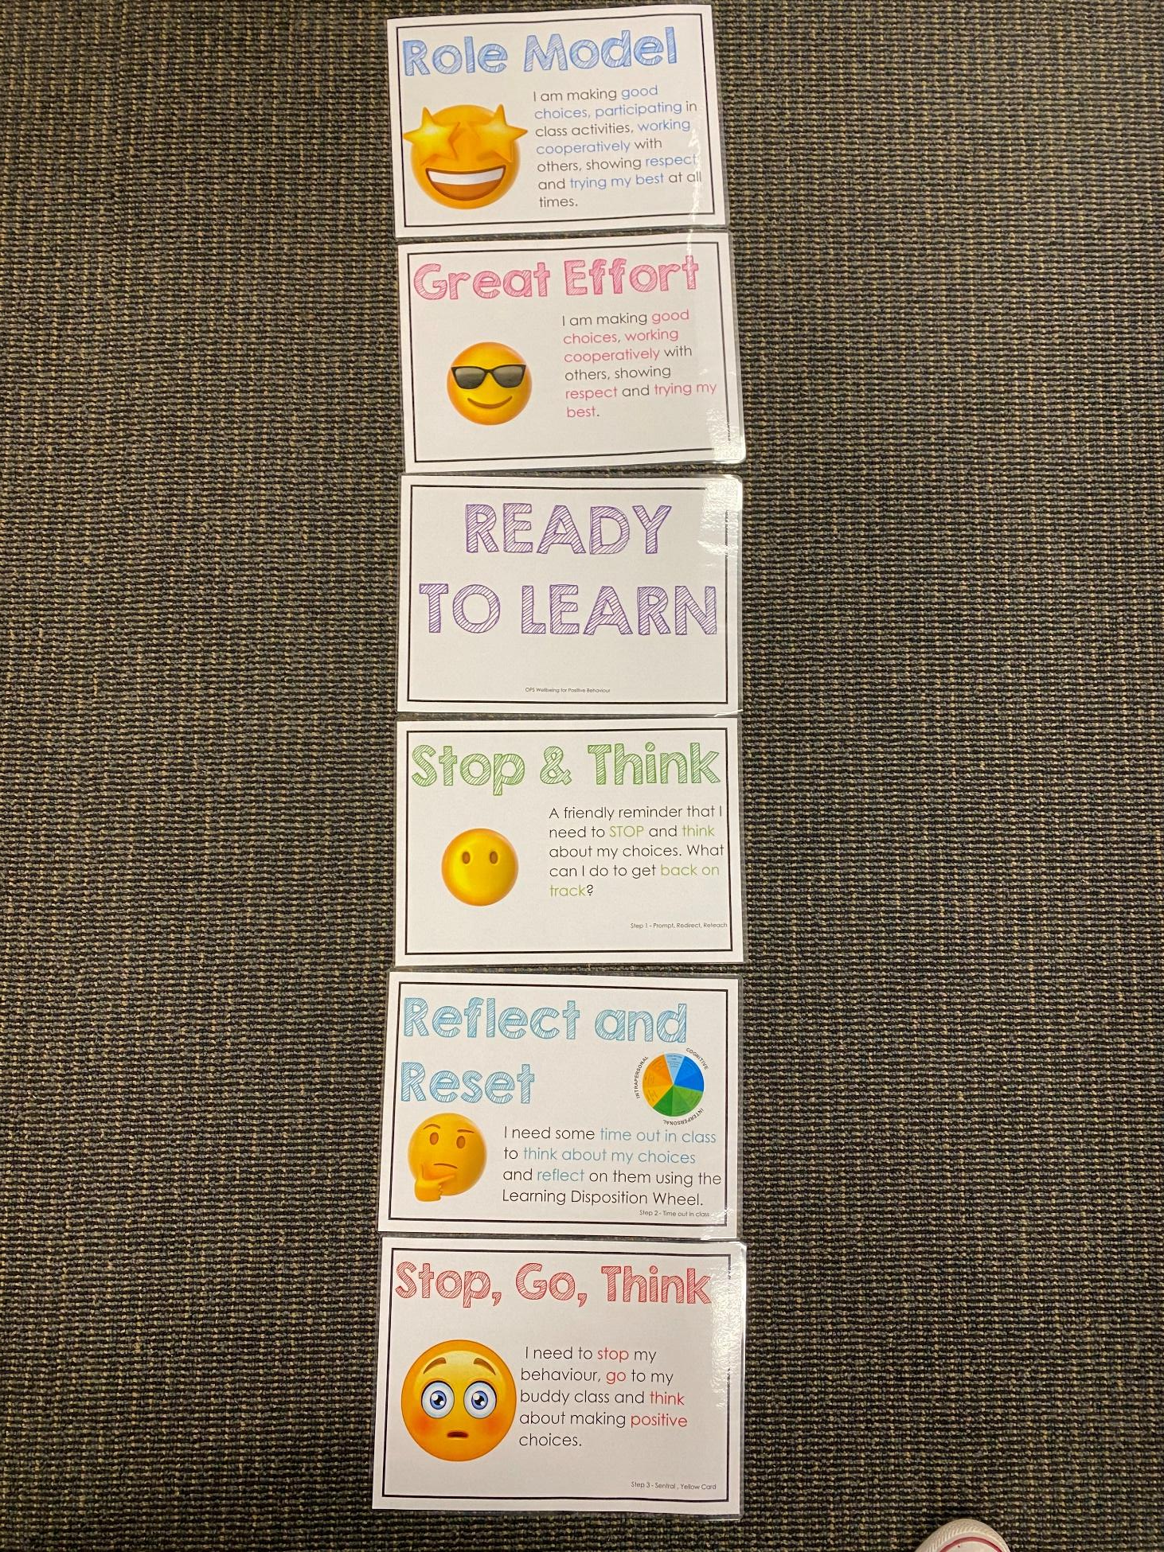
Positive Behaviour for Learning
Classroom Expectations
NSW public schools are committed to providing safe, supportive and responsive learning environments for everyone. We teach and model the behaviours we value in our students.
Every student begins on ‘READY TO LEARN’. Every day is a new day.

Slide 11
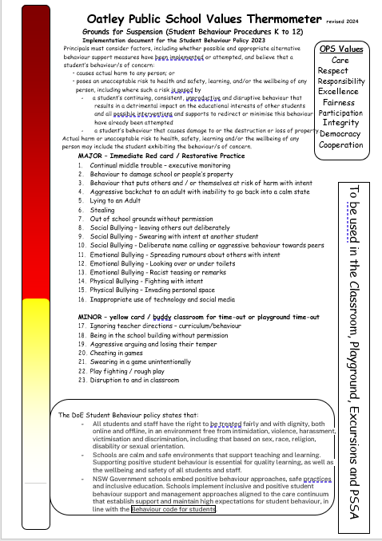
Minor and Major Incidents
Procedures
Behaviour aligned to thermometer through discussion with teacher or assistant principal.
Minor - monitored by classroom teacher
Major - parents contacted, managed by Assistant Principal

Slide 12
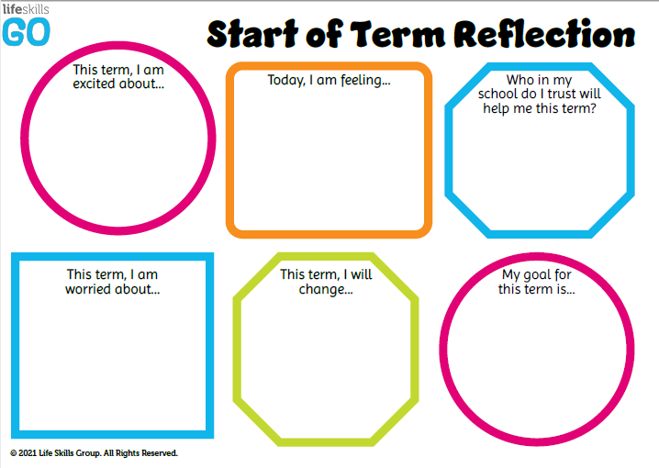
Student Wellbeing Focus
Experiences
Growing Strong Minds
Gratitude Journals
Student Voice experiences
Incursions – Zero Bullying, Backflips against Bullying

Slide 13
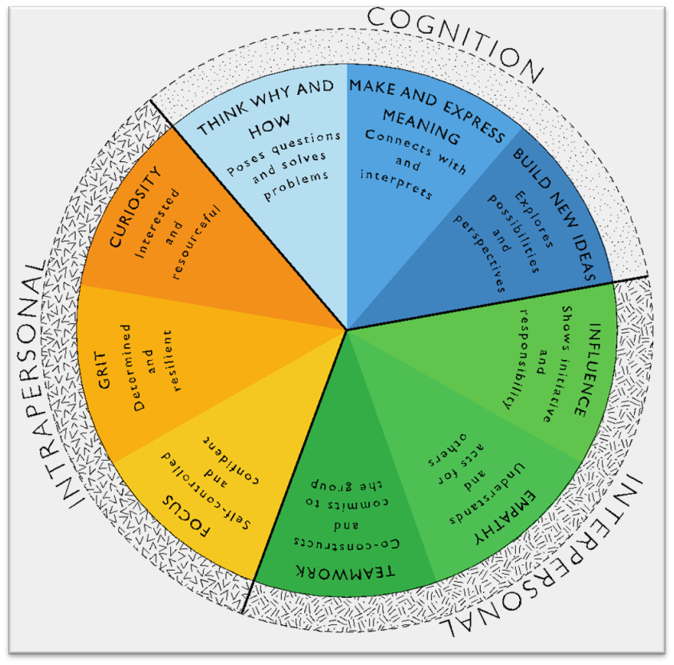
Learning Disposition Wheel
Communication, Creativity, Collaboration
& Critical Reflection
The Learning Disposition Wheel is a tool used to talk about learning and drive a deeper understanding of the 4Cs
Development of these dispositions is fundamental for students to develop an awareness of the way they learn and establish attitudes to learning.
This facilitates a common language about learning which empowers students to critically reflect.

Slide 14
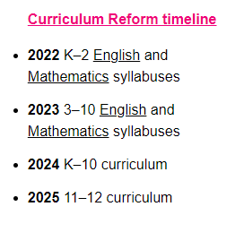
Curriculum Reform
The NSW Curriculum Reform aims to:
make the NSW curriculum clearer to understand and teach
de-clutter the curriculum so that it allows teachers to focus on the main knowledge and skills that all students should have
provide students with strong foundations of knowledge, capabilities and values to be lifelong learners.

Slide 15
Learning in Stage 3 - Key Learning Areas (Semester 1)
English
Mathematics
Science & Technology
(Earth’s Place in Space)

Slide 16
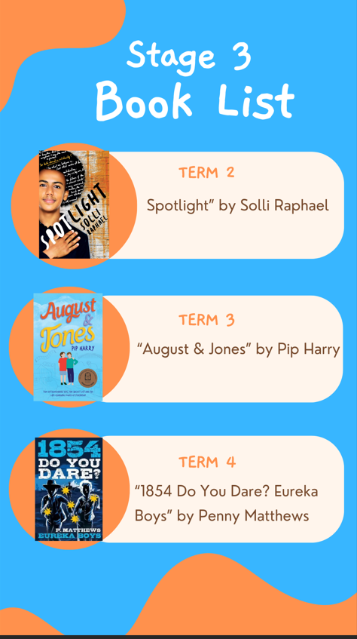
Parents do not have to purchase these books, however, it is useful for many students to have their own copy.

Slide 17
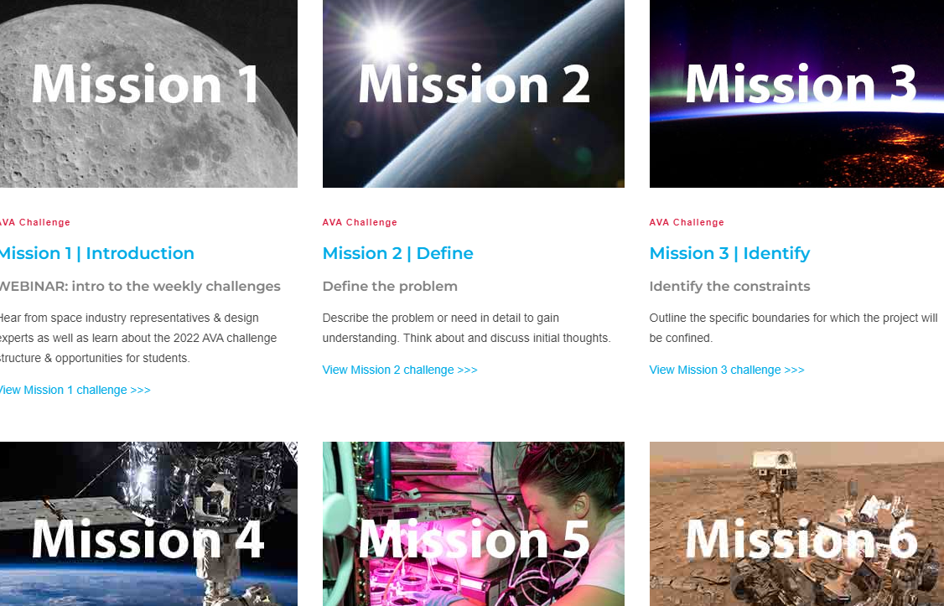
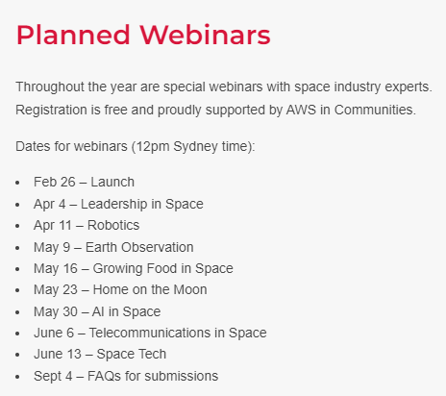

Slide 18
Learning in Stage 3 - Key Learning Areas
Personal Development, Health & Physical Education
(Student Voice & Road Safety)
Creative Arts
History and Geography
(A Diverse and Connected World)

Slide 19
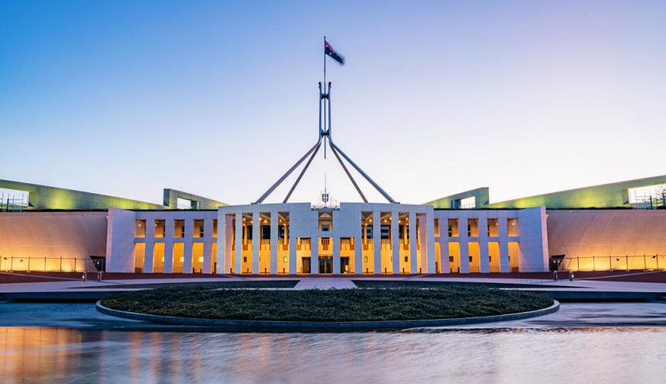
Canberra Excursion
21- 23 October 2024 (Term 4 Week 2)

Slide 20
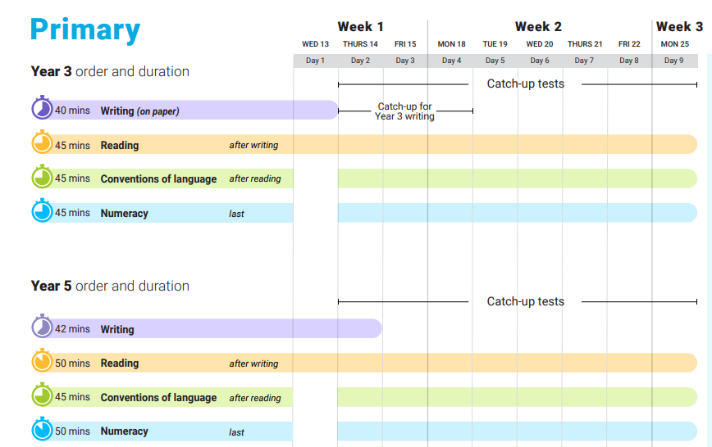
2024 NAPLAN Assessment
NAPLAN Assessment Online - Year 5 students ONLY
Assessment Test Window is 9 days:
Wednesday 13th March - Monday 25th March 2024
Students will need to have headphones/earbuds to access the assessments.

Slide 21
Year 6 Activities
Year 6 Funday (end of Term 3)
Year 6 Farewell Parent Committee (we will meet towards the end of Term 3)
Year 6 Farewell - Monday 16th December
Jamberoo Excursion - Tuesday 17th December (we will neet parent helpers)
Guard of Honour - Wednesday 18th December

Slide 22
Protocols for Technology Use @ Oatley Public School
Stage 3 classes have access to their own iPads.
All parents/carers need to sign the online ICT Agreement before the student’s class is allowed to commence using technology in their classroom.
This agreement includes the use of mobile phones and smart watches worn by students to school.
Inappropriate or irresponsible use of devices will result in the student losing access to the device for that lesson.
Students need to show the utmost respect and care for the technology at all times. It is a privilege to use any of the school-managed devices.

Slide 23
Community Partnerships @ Oatley Public School
School Bytes via Email
All requests for permission
All requests for payment
Teachers can send emails to parents/carers (1 way communication)
Alerts and Reminders
Good News Stories
Oatley Public School Email: oatley-p.school@det.nsw.edu.au
School Bytes Parent Portal
School Website
Payment and permission
School Community Calendar
Student Absence Notifications
Under development: 1-1 private messaging
https://oatley-p.schools.nsw.gov.au
School Calendar and more static information
Oatley Public School Phone Number: 9580 5519

Slide 24
Community Partnerships @ Oatley Public School
How do I pay for excursions/incursions/PSSA and give permission/notify of my child’s absence?
Permission and payment for any student is completed online via the School Bytes system.
The preferred parent/carer contact for communication will be sent an email from School Bytes, requesting online permission and payment (where applicable).
One email per child in each family will be sent by the school. For example, if there are three children in one OPS family, the preferred contact will receive 3 separate emails requesting permission and/or payment. One permission form per child in each family needs to be completed.
A cut-off date for response will always be clearly indicated in your email message and the school administration staff will send at least one reminder to you via email before the event is effectively ‘closed’ for payment.

Slide 25
Community Partnerships @ Oatley Public School
School Website: https://oatley-p.schools.nsw.gov.au/
The school’s website has an up-to-date calendar of future events.
School Email address: oatley-p.school@det.nsw.edu.au
Please use this email address to contact the school at any time for matters that are not time-critical. This is also an effective mechanism for sending a message to your child’s teacher. These messages will be forwarded by the school administration staff.
School Phone Number: 9580 5519
Please use this number to contact the school for any time-critical questions or to pass on time-critical information.

Slide 26
Questions
?

Slide 27
THANK YOU!
Looking forward to working in partnership with you.

