Slide 1
Meet the Teacher
2019

Slide 2
Welcome to Stage 1
There are 7 Stage One classes this year:
1H (Mrs Haman) 2E (Mrs Edwards)
1M (Miss Mieszkuc) 2L (Mr Lao)
1D (Miss Downs Tuck) 2D (Miss Dayman)
2H (Mrs Hogan)

Slide 3
School Routines
All payments to the office before school. Please sign a permission slip for each child
Lunch orders on Mondays, Tuesdays, Wednesdays and Thursdays. Place orders online through flexischools app prior to the school day
Late arrivals/early departures to the office to sign register prior to going to your child’s class
Absences
Food at school- Birthdays/Allergy awareness

Slide 4
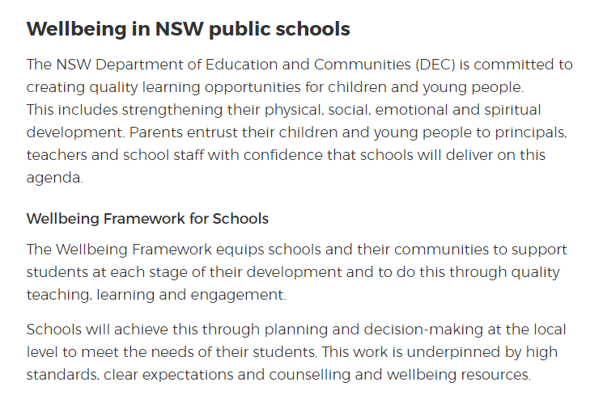

Student Wellbeing

Slide 5
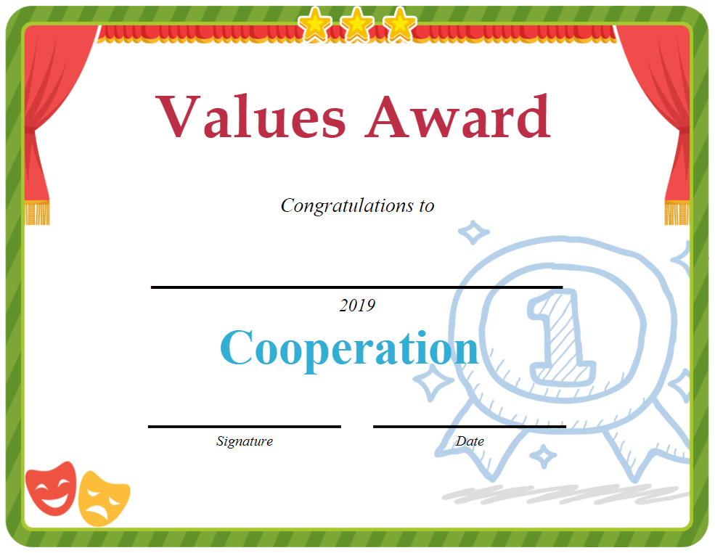
Student Wellbeing at OPS
Growth Mindset
Values – Assembly Recognition
School Based Student Wellbeing
Class Acknowledgement

Slide 6
Homework
Handed out on a Monday morning, due back to school on Friday
Weekly homework consists of:
  PRACTICE EXERCISES
  InitiaLit Spelling
  Maths Problem Solving
  Home Reading
  Bug Club and Mathletics (optional)
  TALKING AND LISTENING
  News

Slide 7

Keeping Informed
School Stream app
Oatley Public School website www.oatleypublicschool.nsw.edu.au
Stage One Newsletter – Twice a term

Slide 8
OPS Strategic Directions
School Plan 2018-2020
Knowledge Construction
Collaboration
Effective Feedback Strategies

Slide 9
Integrated Unit of Work
Integrated units focus on making connections for students, allowing them to engage in relevant, meaningful activities that can be connected to real life.
Integration helps students to become life-long learners and allows efficient coverage and delivery of curriculum in terms of expertise, resources and time.

Slide 10
Schoolyard Safari
Unit Summary
Students learn about how insects exist on our planet, the way they interact with the environment and the impact they make on our world.
Students are set challenges throughout the unit to create and test a variety of objects such as an ant hotel, bug catcher and a new insect.
Students learn about a variety of insects in our world. They discuss their appearance, habitat, diet and life span as well as the way they function in their insect community.
Students collaborate to solve a variety of problems or complete STEM challenges.

Slide 11
Topic: Schoolyard Safari
Learning Intention
ENGLISH | MATHEMATICS | SCIENCE | HISTORY | GEOGRAPHY
create short imaginative, informative and persuasive texts using growing knowledge of text structures and language features for familiar and some less familiar audiences, selecting print and multimodal elements appropriate to the audience and purpose understand the process of planning, drafting and publishing imaginative, informative and persuasive texts plan, compose and review simple imaginative, informative and persuasive texts on familiar topics compose texts supported by visual information (eg diagrams and maps) on familiar topics understand that different types of texts have identifiable text structures and language features that help the text serve its purpose Recognise that time connectives sequence information in texts recognise that different types of punctuation, including full stops, question marks and exclamation marks, signal sentences that make statements, ask questions, express emotion or give commands | check solutions using a different strategy recognise which strategies are more efficient and explain why uses objects, diagrams and technology to explore mathematical problems supports conclusions by explaining or demonstrating how answers were obtained | Identifies and describes the structure and function of living things, concentrating on insects, and ways in which living things interact with other living things and their environment. Plants and animals depend on each other in their environments. Environments for living things need to provide basic requirements for the life of those living things. Environments may be disturbed in a range of ways by human and natural actions, and these disturbances can affect the living things in those environments. Conducts investigations by observing, questioning, predicting, testing, collecting, recording and analysing data, and drawing conclusions. Identifies, with guidance, the types of measurements and data to be collected and decides how to do this and with whom. Uses equipment accurately, reliably and safely. Records data in an appropriate form and works out trends or patterns in the collected data. Reports to others, using simple factual texts such as information reports, procedures and explanations. | brainstorm what aspects of the past can be seen in the local area identify a significant person, building, site or part of the natural environment in the local community and discuss what they reveal about the past and why they are considered important sequence familiar objects and events distinguish between the past, present and future explore and use a range of sources about the past identify and compare features of objects from the past and present develop a narrative about the past use a range of communication forms (oral, graphic, written, role play) and digital technologies | investigate connections that people, including Aboriginal and Torres Strait Islander Peoples, have to local and global places, for example: discussion of Aboriginal and Torres Strait Islander Peoples’ connections with land, sea and animals of their place description of reasons people are connected to places in Australia and/or countries across the world eg birthplace
Week 1 | Week 2 | Week 3 | Week 4 | Week 5
Planning board What do we know already? What do we want to find out? What can we bring? How are we showing our learning? Who are we going to tell? Primary Connections: Lesson 1 | Agricultural (silk worms and worms) Primary Connections: Lesson 2 | Pests (snails, mosquito, cockroach) Primary Connections: Lesson 3 STEM: Build a Bug Catcher | Symbiotic (ants) Primary Connections: Lesson 4 STEM: Ant Strength or Ant Playground Science Experiment: What snacks do ants prefer | Flying Insects (butterfly, moth, bee) Primary Connections: Lesson 5 STEM: Bug’s Eye View
Week 6 | Week 7 | Week 8 | Week 9 | Week 10
Arachnids (spiders, scorpions, tics) | Parasite (wasp, flea, botfly) STEM: Build a Bug House | Camouflage (stick insects) | Primary Connections: Lesson 6 STEM: Build a Bug

Slide 12
STEM Challenges
What is STEM?
  Authentic learning experience for the children that is both fun and educational.
  It teaches students science, technology, engineering and maths as an integrated subject.
  Puts the focus on the students
  Students investigate the answers and information themselves using their critical thinking skills and doing lots of hands-on activities, rather than having the information being spoon-fed to them.
Why is STEM important?
  Cultivate and foster 21st century skills
    Creativity
    Critical thinking
    Collaboration
    Communication

Slide 13
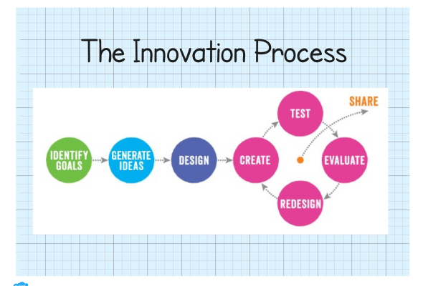
How Collaboration Works

Slide 14
How STEM challenge effectiveness is measured
Learning Intentions:
Are the goals of the lesson is.
Success Criteria:
Are the steps needed to work towards and achieve the learning intention.
(Cluster markings in Writing).
These are all discussed with students so they are familiar with the language and vocabulary. Students then understand why they are learning a particular topic, where they are headed and how they will get there as well as where to next?
They are working towards becoming critical reflectors of their own work and use positive statements in class such as “I can”.
Effective Feedback:
Is then given to students verbally and via cluster marking cards.

Slide 15
Literacy and Numeracy
InitiaLit - Year One
Mathematics - A Learning Place, A Teaching Place

Slide 16
Can You Help?
Thank you for your interest so far. The Reading Group Program in 1D for Term 1 is consolidating placement to ensure individual student growth. 1D will not need parent helpers this Term, however we will be seeking assistance in Term 2
Before committing yourself to helping in the classroom, we ask parents to sign a child protection declaration, sign on and off at the visitors register and wear a visitors badge, and come without younger children when helping

Slide 17
Concerns
Please feel free to make an appointment to speak with me in regards to your child’s learning in the classroom
During pick up time in the afternoon it is my duty of care to ensure all the children go home with their parents or caregivers so I would appreciate if you did not approach me during this time
Appointments can be made by phoning the office. I am available most afternoons after school

Slide 18

Thank You!!
I look forward to a productive and rewarding year working with you and your child in 1D

