Slide 1
Welcome to Oatley Public School Kindergarten Transition, 2020
Session 1- School Transition Information

Slide 2
Formal Communication Platforms
By accessing and using OPS Communication Platforms the community is provided with the most updated and correct information regarding school events.
Oatley Public School Website https://oatleypublicschool.nsw.edu.au/
Information about- About our School, Student Wellbeing, For Parents, Kinder 2021 page, Newsletter (From the Principal)
Online Payment via school website
School Notes are posted for viewing

Slide 3
Formal Communication Platforms
School Stream App
Alerts: Brief messages to inform changes to events
Permission/Absentee Forms: this menu item is where you explain your child’s absence. Please provide a note (online or written) explaining your child's absence on the first day that you child is back at school. All absences are mandated and note are required.
All absences must be explained within 7 days. After this time rolls are locked and no changes can be made. Absence notes are to be given to your child's classroom teacher.
Online Payments: this menu items links to the online payment available on the school website.
Permission/Absentee Forms : this is the menu item for online permission for incursions and excursions.
Translation of language available and easy to access via Home button

Slide 4
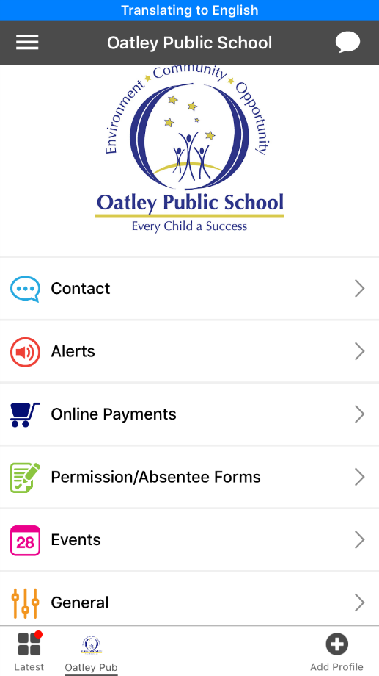

Slide 5
Formal Communication Platforms
School Stream App
Online Payments
Payments can be made via School Stream or the School Website
Payments must be completed according to the permission note and the due payment date.
If payments are made after 6pm, the office will receive confirmation 2 business days after. If payments are made before 6pm the office will receive confirmation the next day.
Online Permission:
The majority of events will have online permission via School Stream app. Permission is necessary for students to attend the event.
Non- permission or payment will result in your child not participating an event, unless contact has been made with school regarding support (assumption can’t be made regarding your permission).

Slide 6
Formal Communication Platforms
Class Dojo
Parents/caregivers have the ability to electronically and privately directly message the classroom teacher and/or Assistant Principal.
Responses from the classroom teacher will not be immediate. Teachers will check for messages between 8:00am-4:00pm.
Information may be posted throughout the term as needed.

Slide 7
Class Dojo
What is Class Dojo used for?
Every term an overview of the topics being covered will also be sent out by each stage team.
To be used by parents/caregivers for general communication e.g. initial raising of issues and appointment requests with the classroom teacher.
Communication Protocols
Your message may be acknowledged by the classroom teacher on Class Dojo but any follow up by them will be via a phone call, not via ongoing Class Dojo messages.
Please be reminded that the use of Class Dojo to communicate to the classroom teacher is still a formal communication and this should always be reflected in the tone and language used in all messages.

Slide 8
Formal Communication Platforms
Meet the Teacher evening- Term 1
Parent Teacher/Student Interview- Term 1 Week 10
Semester 1 Report- end of Term 2
Semester 2 Report- end of Term 4
Confidential Protocols-
Any concerns for student learning or wellbeing contact the school office, provide information- students name, class and brief details of the concern. Teachers will make contact or schedule a meeting at an appropriate time.
School Email: oatley-p.school@det.nsw.edu.au
School Phone: 9580 5519

Slide 9
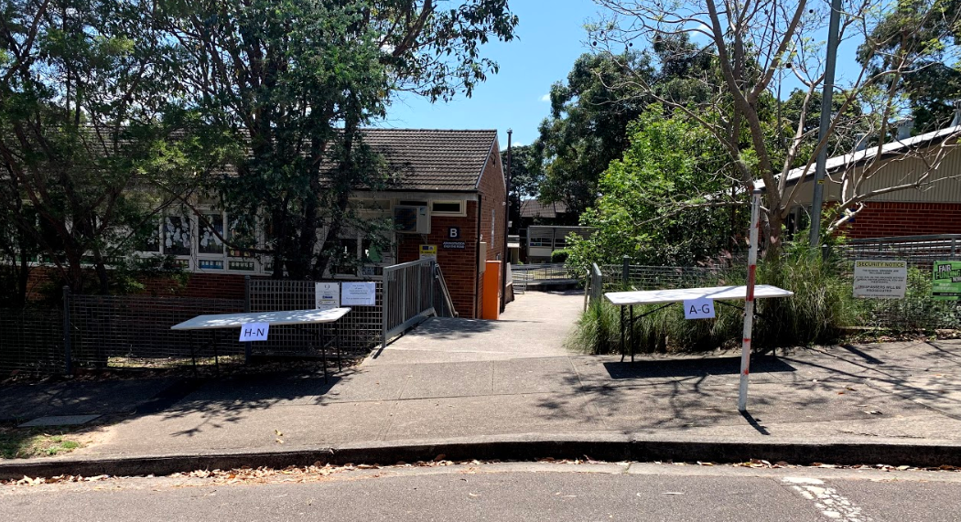
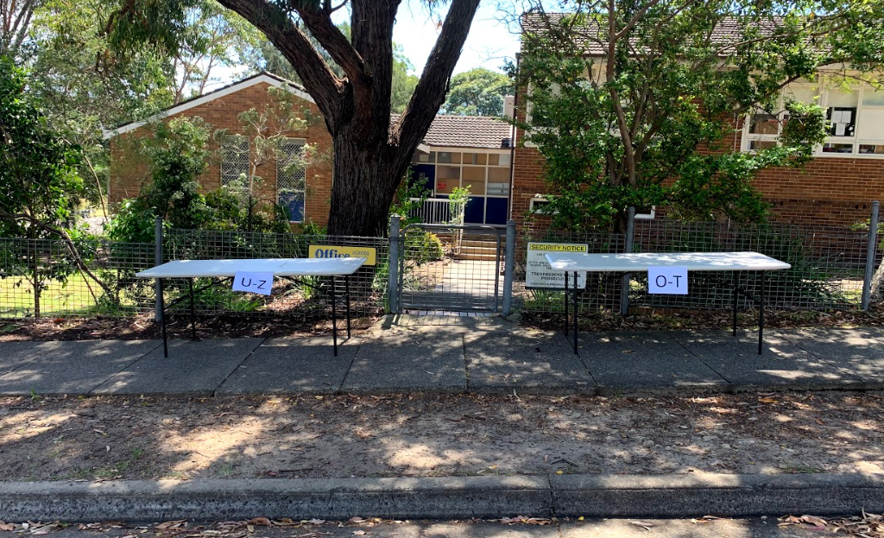
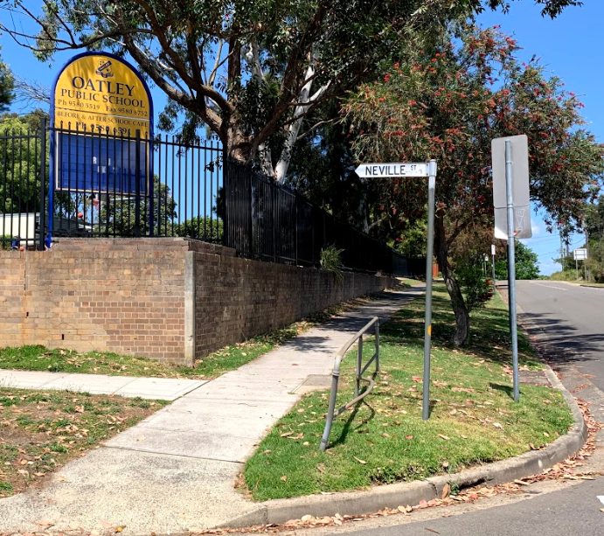
Kindergarten Transition Day
Date: Tuesday 10th November
Session 1: 10.00am – 11.00am
Session 2: 12.30pm – 1.30pm
What to bring- A water bottle clearly labelled with your child name
Drop off Procedures
Registration will open 15 minutes before the session begins. (Morning Session 9.45am, Afternoon 12.15pm)
Tables will be set up at our 2 entrance points on Neville Street. Names will be organised in alphabetical order according to your child surname.
Please social distance when lining up to sign children in.
Once you have signed in your child and they have received a name tag, you will be guided to the nearest gate where a teacher will walk your child into our Kindergarten classroom for their session.

Slide 10
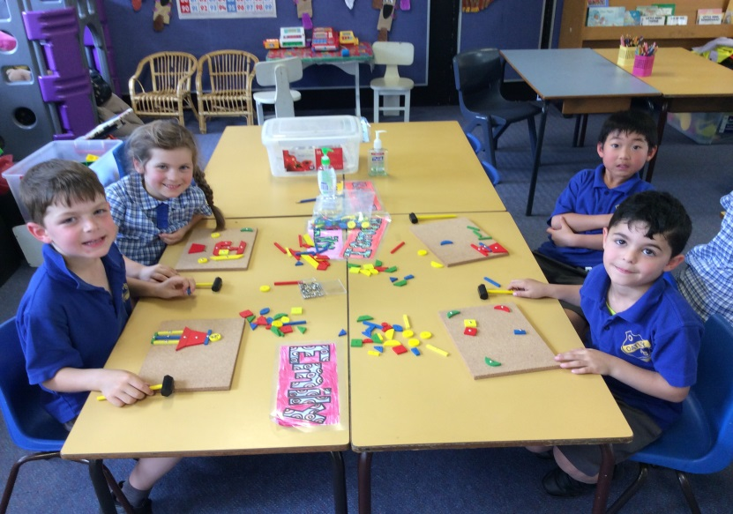
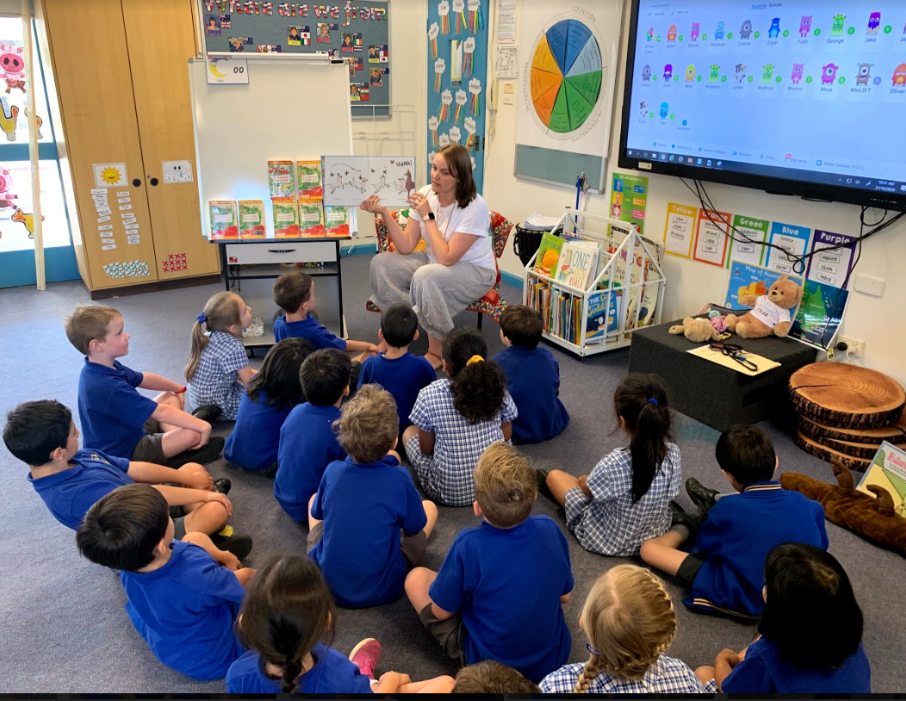
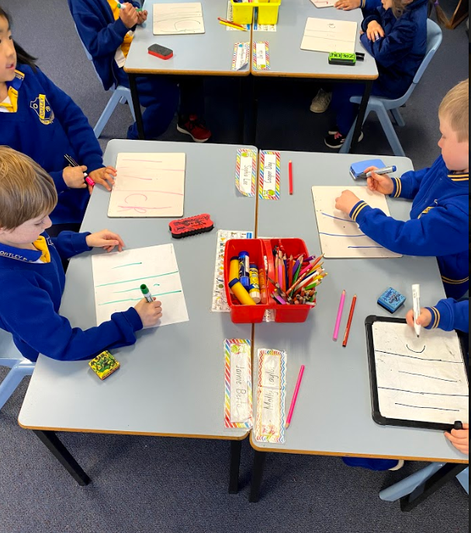
Kindergarten Transition Day
Upon registration students will be given a name tag that also has a coloured dot on it. The colours are allocated based on the alphabetical order of surnames and used as a quick visual reference to guide us with our observations and dismissal. Please note these are not the classes students will be placed in, or organised based on academic achievement.
Whilst in the classroom children will engage in a range of activities including developmental play, with a fine motor and social skills focus, story time and a short worksheet.
We will take children on a short orientation of the facilities on our North Site- Toilets and play areas.

Slide 11
Kindergarten Transition Day
Pick up Procedures
At the end of the Transition session, 11.00 or 1.30:
we will bring all children back to the gate at which they entered.
We will release children one by one once a parent/carer is sighted.
What they will bring home
All students will bring home a yellow folder containing any some helpful resources including:
A Social Story
Kindergarten Information Booklet

Slide 12
Kindergarten Transition Day
We will continue to use email to connect with you over the coming weeks. Please look out for:
Our Kindergarten Video- ‘The Secret Life of Kindergarten’
This video has been created starring our current Kindergarten students sharing some of their routines and experiences in Kindergarten.
Our second ZOOM session- Once our Transition Sessions are complete and you have had enough time to go through the information provided in the information pack, we will run another ZOOM session. This will be to elaborate on what to expect next year, and to answer any questions you may have.
Please note, if you have any concerns specific to your child, please email the school and we can respond via email or a phone call if required.
A positive start to school is important and depends on everyone working together to make it happen – family, community, early childhood service and the school team. (DET NSW)

