Slide 1
Please complete this sheet by the end of the session :)

Slide 2
Welcome to Meet the Teacher 2025
4A
Mrs Anthony

Slide 4
A Little About Me

Slide 5
Meet the South Site Team
There are four Stage two and four Stage 3 classes this year:
3KV (Mrs Montgomery & Mrs Worthington) 5L (Mr Lao)
3/4H (Mrs Hogan) 5P (Mr Prenzel)
4A (Mrs Anthony) 6M (Miss Gorman)
4/5R (Mrs Rozmeta – Stage 2 AP) 6G (Mrs Gadaleta – Stage 3 AP)

Slide 6
Who Supports Us?
Library
Mrs Haman
Wellbeing
Mrs Edwards
Curriculum Support
Mrs Gavanas
Mrs White
Community Languages
(Italian)
Signora Johnstone

Slide 7
Days to Remember
Monday Got Game Novel study | Tuesday Italian
Wednesday Scripture: 9:20am-9.50am (Protestant, Catholic, Greek Orthodox, Ethics, Islamic and Non-Scripture) Sport uniform | Friday PSSA / School sport Library Peer Support

Slide 8
Food At School
Canteen Birthdays
The school canteen is Monday - Thursday. We welcome birthday treats on your
child’s special day. We ask that all
All lunch orders must be ordered via birthday treats are individually
Flexischools. portioned and packed ready to hand
out, e.g. cupcakes, lolly bags
Please note: due to an increase in students with severe allergies, we ask that you please be mindful when packing lunches.

Slide 9
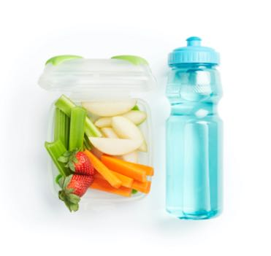
Crunch and Sip
What is it?
Mid-morning break
Refuel/refocus
Healthy habits
What to pack:
Fresh fruit or vegetables
Water
Please note: due to an increase in students with severe allergies, we ask that you please be mindful when packing lunches.

Slide 10
Student Wellbeing Focus
Gratitude Journals/Got Game Resilience Program
Growing Strong Minds
Student Voice experiences
Peer Support
Incursions – Zero Bullying, Backflips against Bullying, Life Education

Slide 11
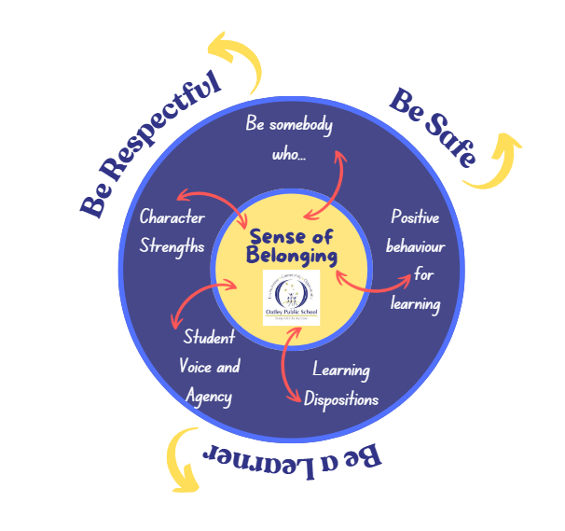
Wellbeing

Slide 12
Positive Behaviour for Learning

Slide 13
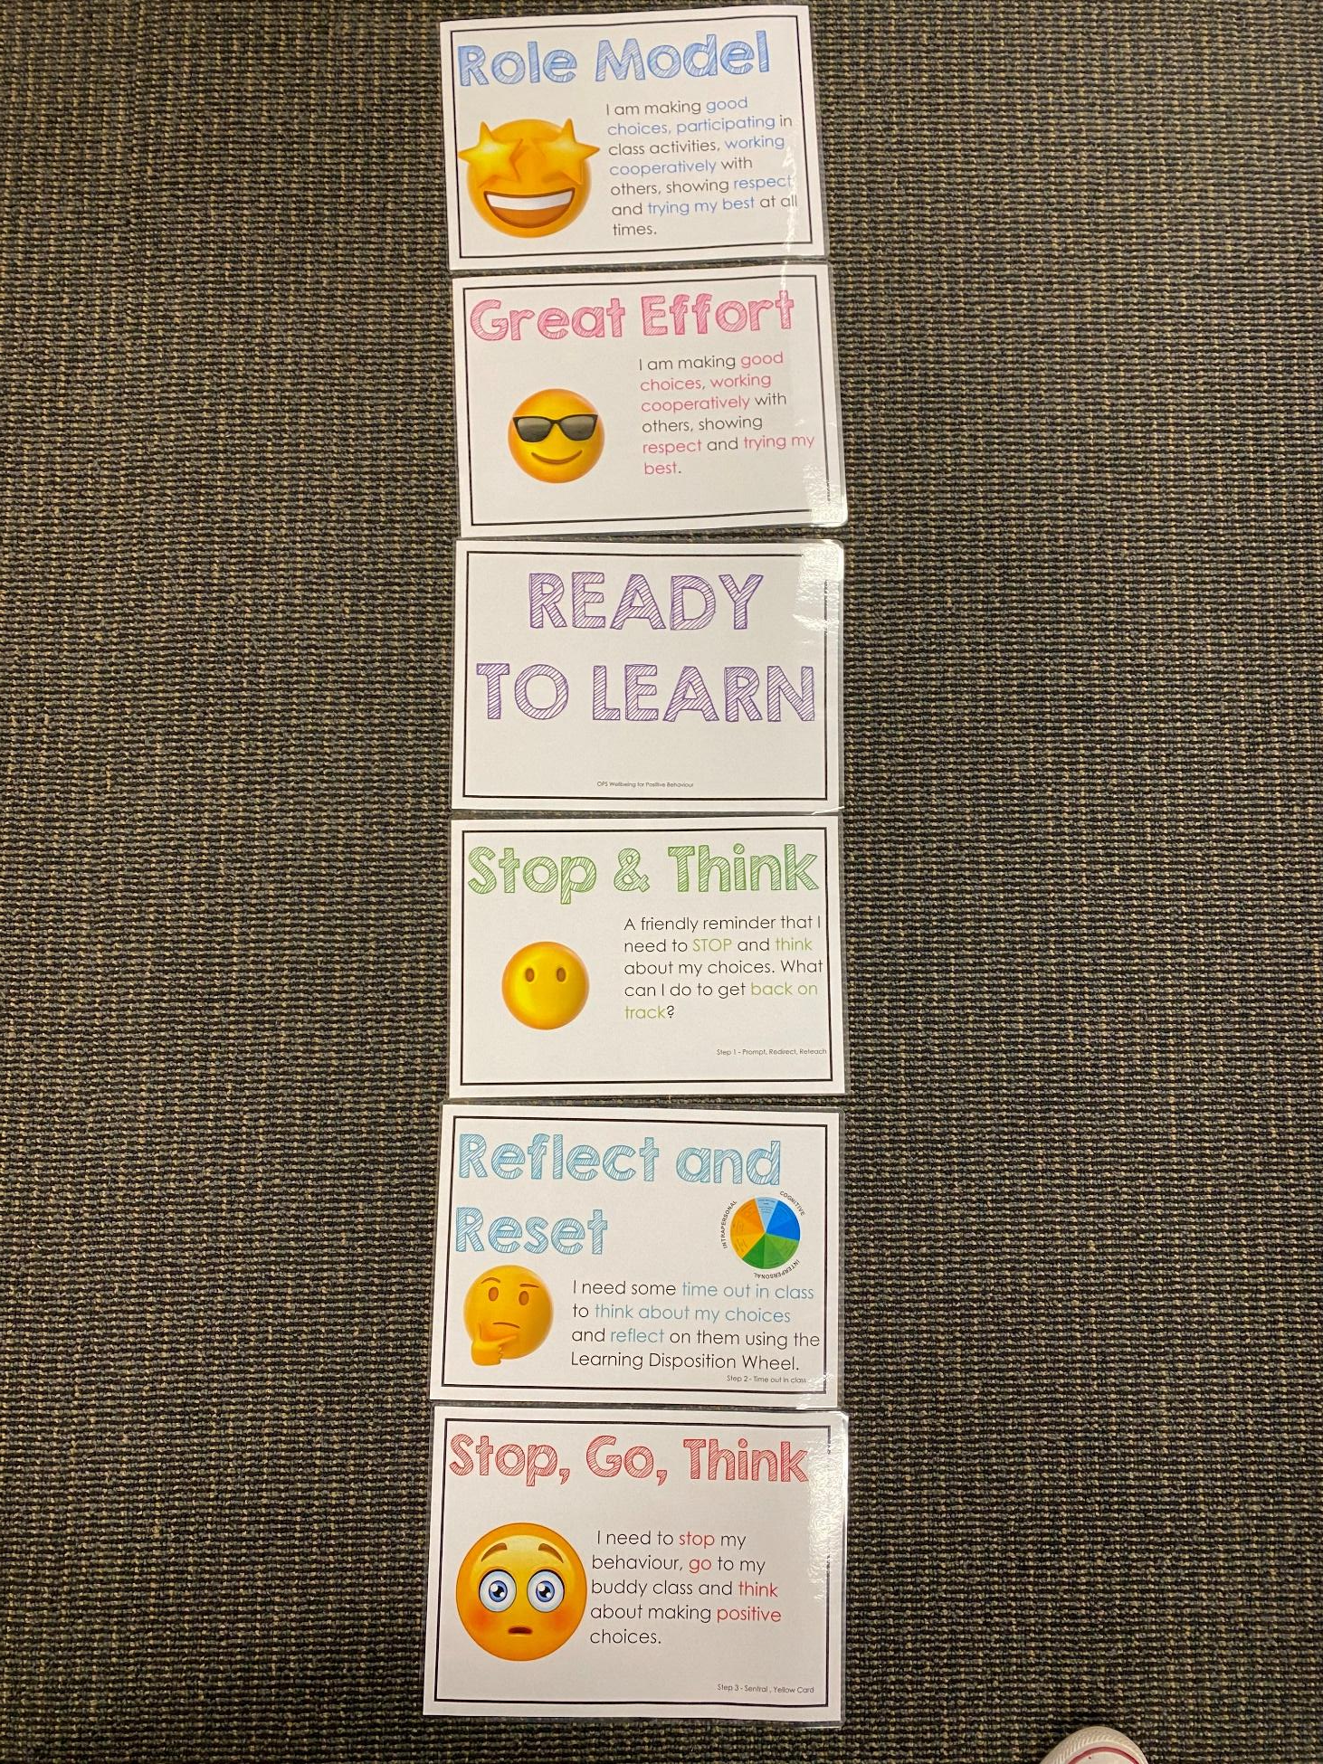
Positive Behaviour for Learning
NSW public schools are committed to providing safe, supportive and responsive learning environments for everyone. We teach and model the behaviours we value in our students.
Every student begins on ‘READY TO LEARN’.
Every day is a new day.

Slide 14
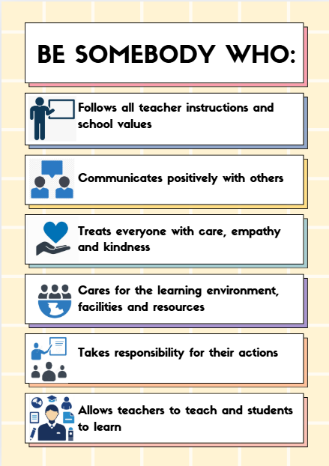
Be Somebody Who…

Slide 15
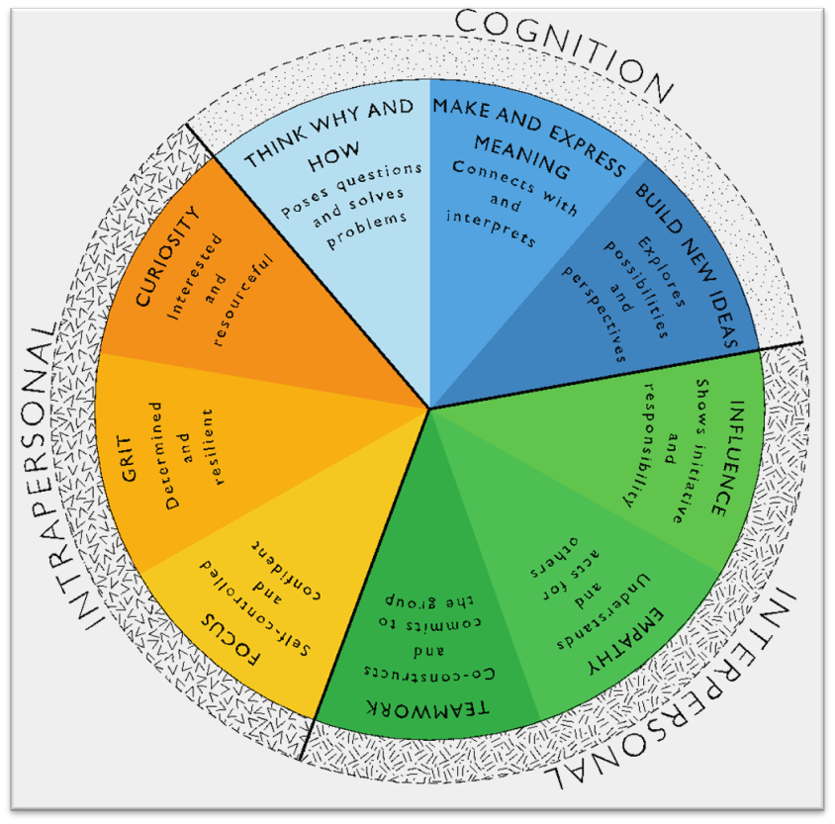
Learning Dispositions
Communication, Creativity, Collaboration
& Critical Reflection
The Learning Disposition Wheel is a tool used to talk about learning and drive a deeper understanding of the 4Cs
Development of these dispositions is fundamental for students to develop an awareness of the way they learn and establish attitudes to learning.
This facilitates a common language about learning which empowers students to critically reflect.

Slide 16
Curriculum

Slide 17
Curriculum

Slide 18
Curriculum

Slide 19
Curriculum

Slide 20
Curriculum

Slide 21
Curriculum

Slide 22
Technology
All Year 4 students will have access to a school-managed Chromebook
All parents/carers need to sign the online ICT Agreement before the student’s class is allowed to commence using technology in their classroom.
This agreement includes the use of mobile phones and smart watches worn by students to school.
Inappropriate or irresponsible use of devices will result in the student losing access to the device for a period of time
Students need to show the utmost respect and care for the technology at all times. It is a privilege to use any of the school-managed devices.

Slide 23
How can you support?
Ensure you have reviewed the agreement with your child
Discuss why OPS has set the given rules and how they relate to real life situations
Regularly discuss how you and your child have used devices during your day
Be aware of the content they are consuming at home

Slide 24
Homework
Term 1 homework consists of 3 components:
1. Reading (minimum of 30 mins per day)
2. Maths (differentiated)
3. Spelling/Grammar
Due on Thursday, redistributed Friday
Later in the term, the homework will change to support our upcoming ‘Multicultural Perspectives Public Speaking’ competition.

Slide 25
How can you support?
Work with your child to set-up a routine that they can stick to
Discuss opportunities where they can align homework tasks with their goals/interests
Talk about how you use the learned skills (reading, writing, maths) in your everyday life

Slide 26
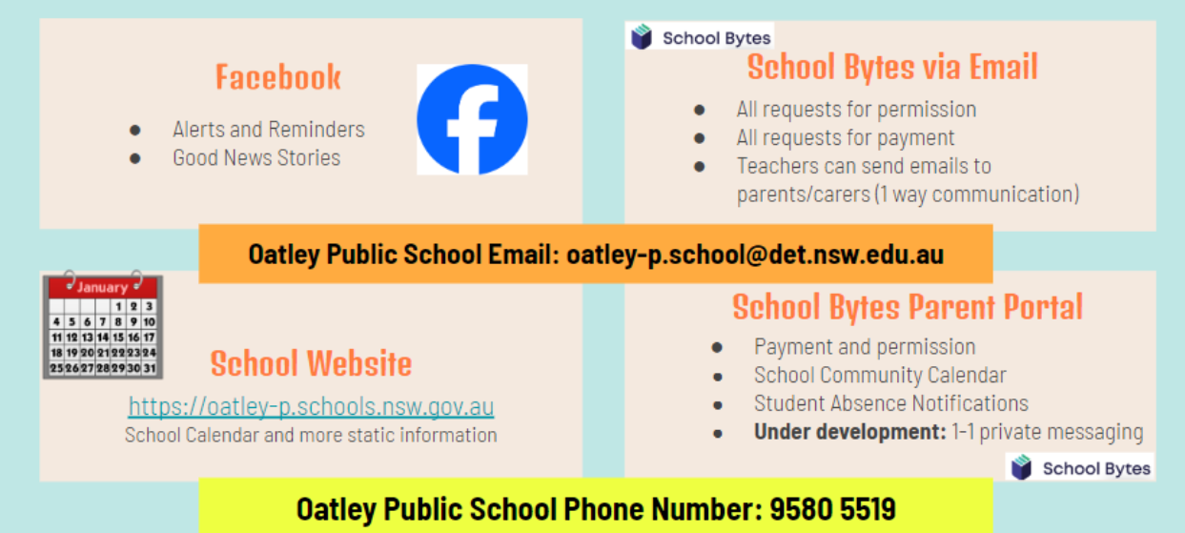
Community Partnerships

Slide 27
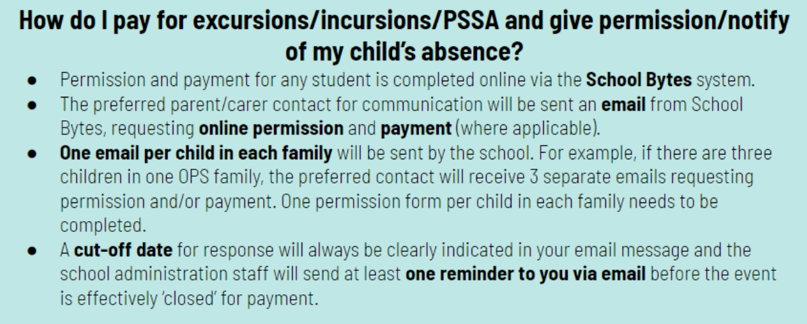
Payment Excursions/Incursions

Slide 28
Communication
School Website: https://oatley-p.schools.nsw.gov.au/
The school’s website has an up-to-date calendar of future events.
School Email address: oatley-p.school@det.nsw.edu.au
Please use this email address to contact the school at any time for matters that are not time-critical. This is also an effective mechanism for sending a message to your child’s teacher. These messages will be forwarded by the school administration staff.
School Phone Number: 9580 5519
Please use this number to contact the school for any time-critical questions or to pass on time-critical information.

Slide 29
Interviews
Parent teacher interviews will commence early next term. This will give us the opportunity to discuss your child’s progress at school.
If you have any other concerns throughout the year, please feel free to email the office or approach me to make a phone or in-person appointment.
I am here to help!
☺

Slide 30
Thank You

