Slide 1
Welcome to Meet the Teacher 2025
4/5R
Mrs Rozmeta & Mrs Mackintosh

Slide 3
About your Child
4Cs activity!
Collect 2 different colour Post-it notes
Write something you want us to know about your child and a goal for them this year
Place your post-it notes on the whiteboard
Blue Post-it Note
Yellow Post-it Note
Write something you want us to know about your child
Write a goal for your child this year

Slide 4
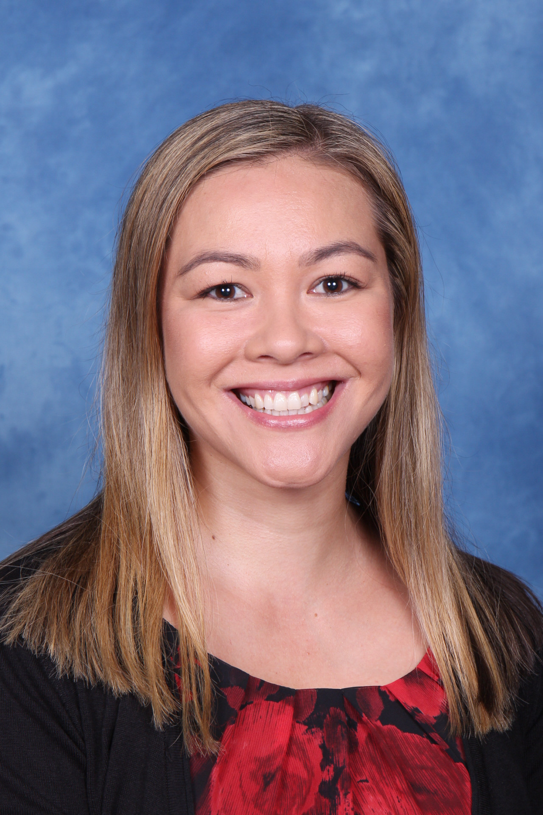
A Little About Me!
About Mrs Rozmeta
Passion for teaching and learning
Bachelor Commerce Degree – Marketing Major
Studied part of a Masters in Business Administration (MBA)
Worked in corporate for 9 years prior
Completed Post Graduate study in Primary Education
Worked at Oatley for 10 years
Assistant Principal Stage 2
Teaching 4/5R Mon-Wed

Slide 5
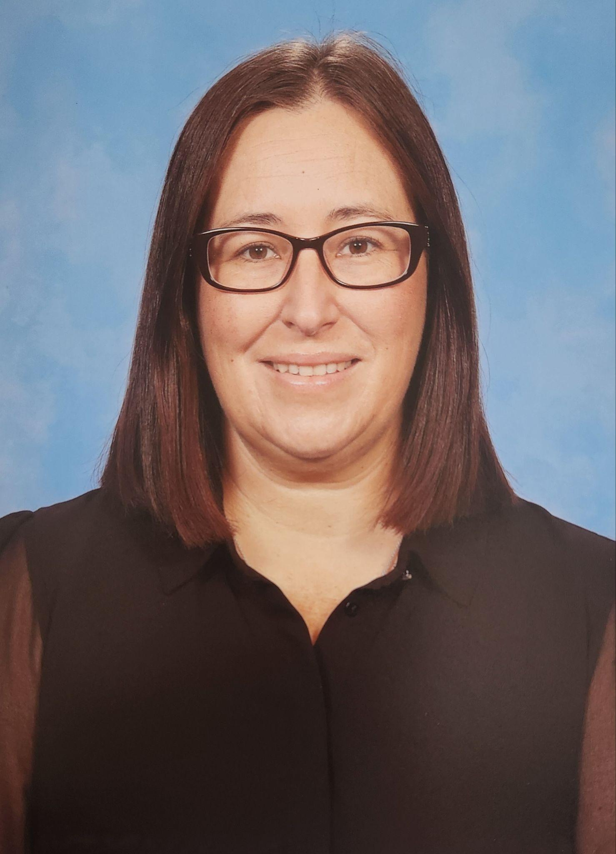
A Little About Me!
About Mrs Mackintosh
I am a wife and mum of 2 boys (18 and 15 years old)
Passion for learning how to incorporate good mental health strategies in the classroom.
Bachelor of Education Degree
Worked in South Africa as a classroom teachers for 14 years
Been teaching in Australia for 5 years
Teaching 4/5R Thursday & Friday

Slide 6
Meet the Team
There are four Stage two and four Stage 3 classes this year:
3KV (Mrs Montgomery & Mrs Worthington) 5L (Mr Lao)
3/4H (Mrs Hogan) 5P (Mr Prenzel)
4A (Mrs Anthony) 6M (Miss Gorman)
4/5R (Mrs Rozmeta – Stage 2 AP) 6G (Mrs Gadaleta – Stage 3 AP)

Slide 7
Who Supports Us?
Community Languages
(Italian)
Signora Johnstone
Library
Mrs Haman
Curriculum Support
Mrs Gavanas
Mrs White
Wellbeing
Mrs Edwards

Slide 8
Homework
Term 1 homework consists of 3 components:
1. Reading (Min 30 mins per day)
2. Maths (differentiated)
3. Spelling/Grammar
Due on Thursday, redistributed Friday
Later in the term, the homework will change to support our upcoming ‘Multicultural Perspectives Public Speaking Competition’.

Slide 9
Days to Remember
Monday – Mrs Rozmeta Mrs Rozmeta on class Got Game | Thursday – Mrs Mackintosh Mrs Mackintosh on class
Tuesday – Mrs Rozmeta Italian & Geography: 12.10pm-1.55pm | Friday – Mrs Mackintosh PSSA / School sport Peer Support
Wednesday – Mrs Rozmeta Scripture: 9:20am-9.50am (Protestant, Catholic, Greek Orthodox, Ethics, Islamic and Non-Scripture)

Slide 10
Food At School
Canteen Birthdays
The school canteen is Monday - Thursday. We welcome birthday treats on your
child’s special day. We ask that all
All lunch orders must be ordered via birthday treats are individually
Flexischools. portioned and packed ready to hand
out, e.g. cupcakes, lolly bags.
Please note: due to an increase in students with severe allergies, we ask that you please be mindful when packing lunches.

Slide 11
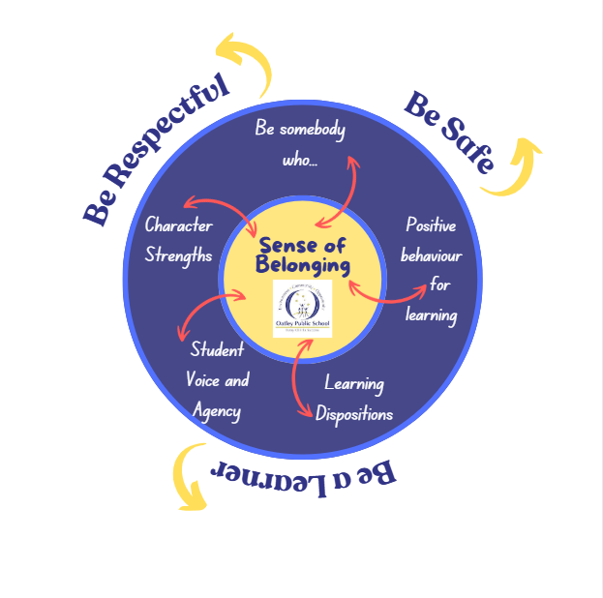
Wellbeing

Slide 12
Positive Behaviour for Learning

Slide 13
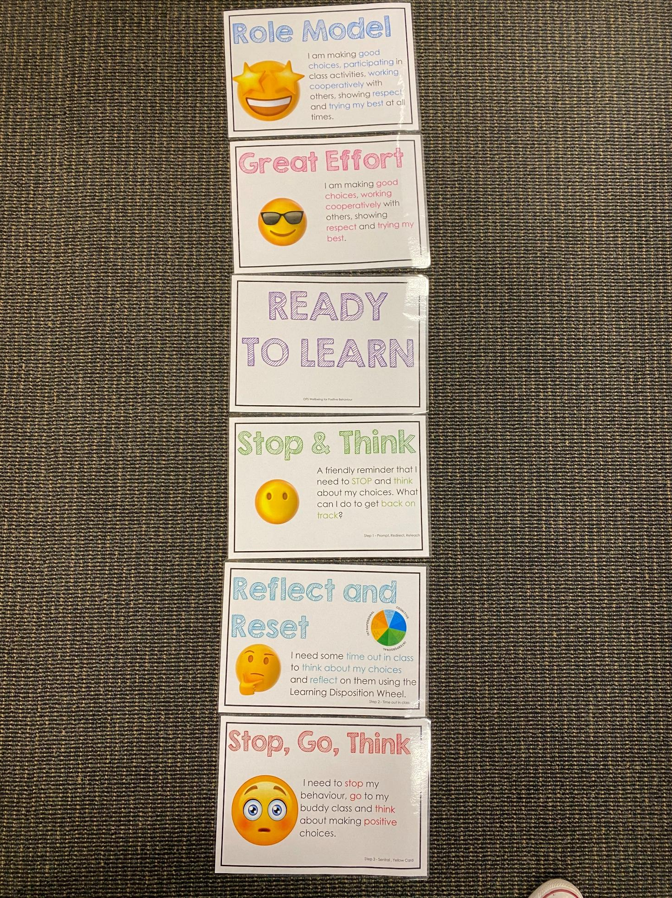
Positive Behaviour for Learning
NSW public schools are committed to providing safe, supportive and responsive learning environments for everyone. We teach and model the behaviours we value in our students.
Every student begins on ‘READY TO LEARN’.
Every day is a new day.

Slide 14
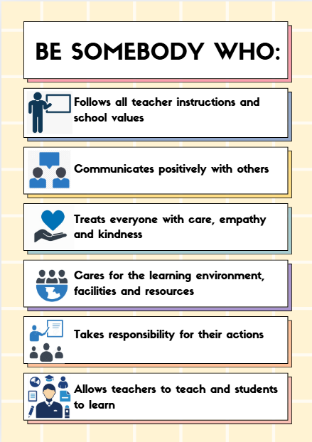
Be Somebody Who…

Slide 15
Student Wellbeing Focus
Growing Strong Minds
Gratitude Journals/Got Game Resilience Program
Student Voice experiences
Peer Support
Incursions – Zero Bullying, Backflips against Bullying, Life Education

Slide 16
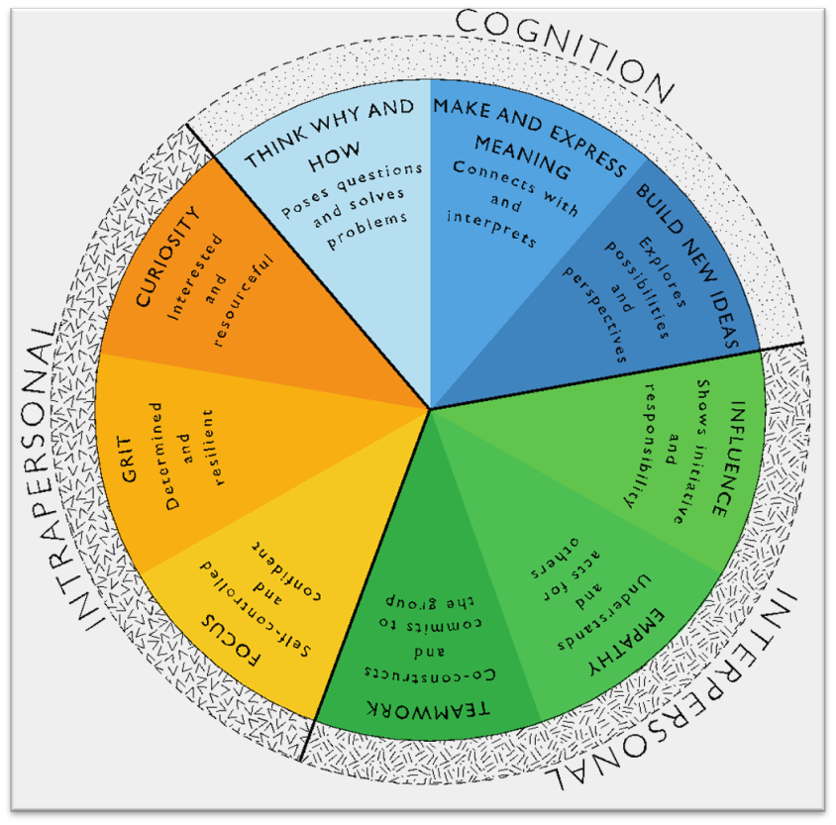
Learning Dispositions
Communication, Creativity, Collaboration
& Critical Reflection
The Learning Disposition Wheel is a tool used to talk about learning and drive a deeper understanding of the 4Cs
Development of these dispositions is fundamental for students to develop an awareness of the way they learn and establish attitudes to learning.
This facilitates a common language about learning which empowers students to critically reflect.

Slide 17
Curriculum

Slide 18
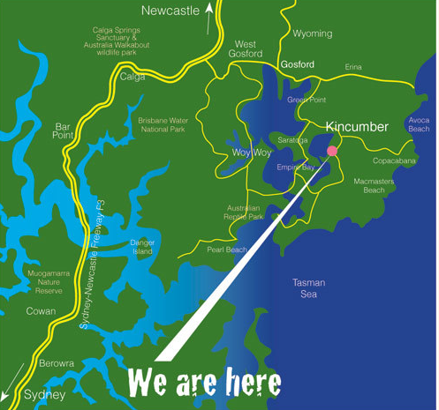
Camp
Monday 19th May - Wednesday 21st May 2025

Slide 19
Technology
Stage 1 classes utilise the K-2 shared iPads.
All parents/carers need to sign the online ICT Agreement before the student’s class is allowed to commence using technology in their classroom.
This agreement includes the use of mobile phones and smart watches worn by students to school.
Inappropriate or irresponsible use of devices will result in the student losing access to the device for that lesson.
Students need to show the utmost respect and care for the technology at all times.
It is a privilege to use any of the school-managed devices.

Slide 20
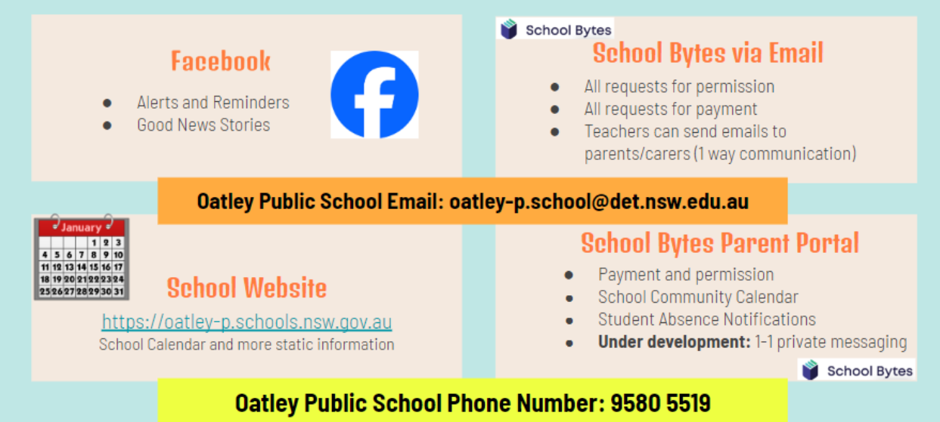
Community Partnerships

Slide 21
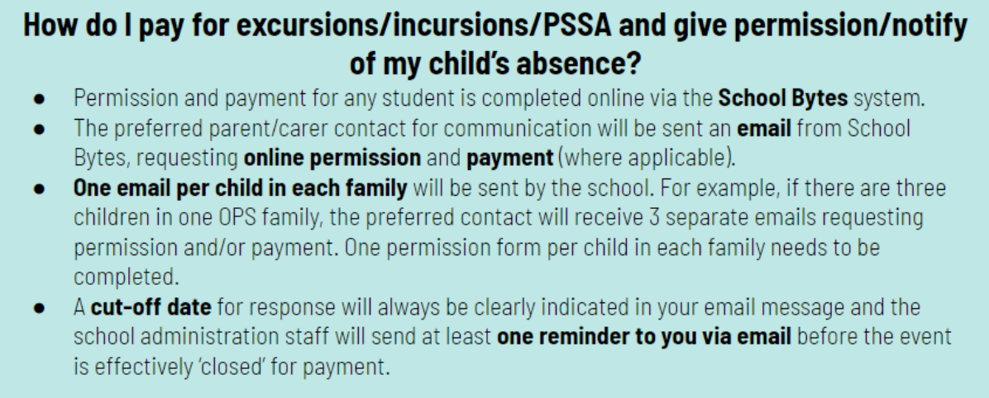
Payment Excursions/Incursions

Slide 22
Communication
School Website: https://oatley-p.schools.nsw.gov.au/
The school’s website has an up-to-date calendar of future events.
School Email address: oatley-p.school@det.nsw.edu.au
Please use this email address to contact the school at any time for matters that are not time-critical. This is also an effective mechanism for sending a message to your child’s teacher. These messages will be forwarded by the school administration staff.
School Phone Number: 02 9580 5519
Please use this number to contact the school for any time-critical questions or to pass on time-critical information.

Slide 23
Interviews
Parent teacher interviews will commence early next term. This will give us the opportunity to discuss your child’s progress at school.
If you have any other concerns throughout the year, please feel free to approach us or email the office to make an appointment.
We are here to help!
☺

Slide 24
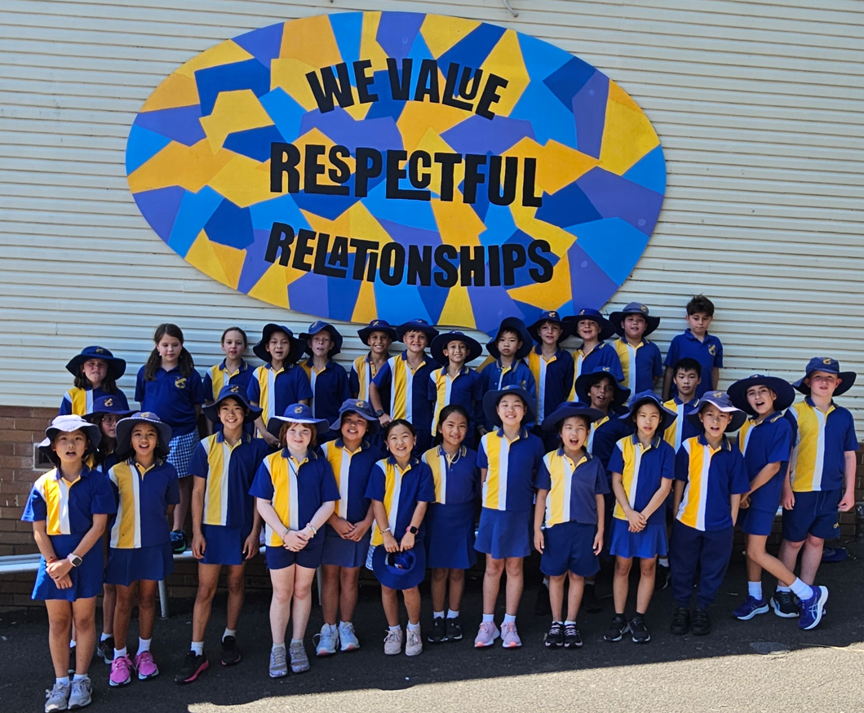
Thank You

