Slide 1
Welcome to Meet the Teacher 2025
5L
Mr Vicente Lao
(Mr Lao)

Slide 3
About your Child
4Cs activity!
On the sheet in front of you with the coloured boxes: write something you want us to know about your child and a goal for them this year
Leave your sheet on the desk. It’ll be collected by Mr Lao at the end of the session.
Blue Post-it Note
Yellow Post-it Note
Write something you want us to know about your child
Write a goal for your child this year

Slide 4
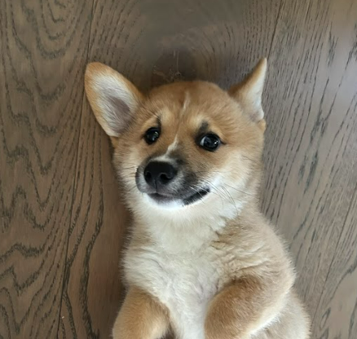
About Mr Lao
Passion for teaching and lifelong learning and incorporating practical
Hands-on experience for the students.
Bachelor of Education: Primary Education Degree from UTS
Worked in many other industries before teaching
This is my 10th year at Oatley Public School
Public Speaking, Greensparks, Swim Scheme and IT Coordinator at OPS
Teaching 5L Full Time
I live in Kogarah
I have a dog named Chilli

Slide 5
Meet the Team
There are 4.5 Stage 3 classes this year:
5P (Mr Prenzel) 6G (Mrs Joanne Gadaleta & Mrs Lauren Wilson)
5L (MR Lao) 6M (Miss Melissa Gorman)
4/5R (Mrs Rozmeta)
Our Assistant Principal is: Mrs Joanne Gadaleta

Slide 6
Who Supports Us?
Community Languages
(Italian)
Signora Johnstone
Library
Mrs Haman
Curriculum Support
Mrs Gavanas
Mrs White
Wellbeing
Mrs Edwards

Slide 7
Homework
Term 1 homework consists of 3 components:
1. Reading (Min 30 mins per day)
2. Maths (differentiated)
3. Reading Comprehension
Due on Thursday, redistributed Friday
Later in the term, the homework will change to support our upcoming ‘Multicultural Perspectives Public Speaking Competition’.

Slide 8
Days to Remember
Monday Thursday
Got Game (Term One)
Italian (12:10-3:20 - Senora will also teacher Geography, Science and English)
Tuesday Friday
STEAM Session with Year 5 PSSA
School Sport
Wednesday
Scripture: 9:50am-10.20am
(Protestant, Catholic, Greek Orthodox, Ethics, Islamic and Non-Scripture)
Library

Slide 9
Food At School
Canteen Birthdays
The school canteen is Monday - Thursday. We welcome birthday treats on your
child’s special day. We ask that all
All lunch orders must be ordered via birthday treats are individually
Flexischools. portioned and packed ready to hand
out, e.g. cupcakes, lolly bags
Please note: due to an increase in students with severe allergies, we ask that you please be mindful when packing lunches.

Slide 10
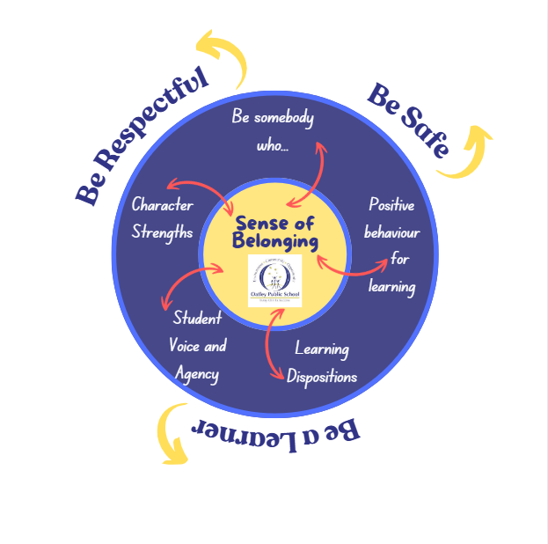
Wellbeing

Slide 11
Positive Behaviour for Learning

Slide 12
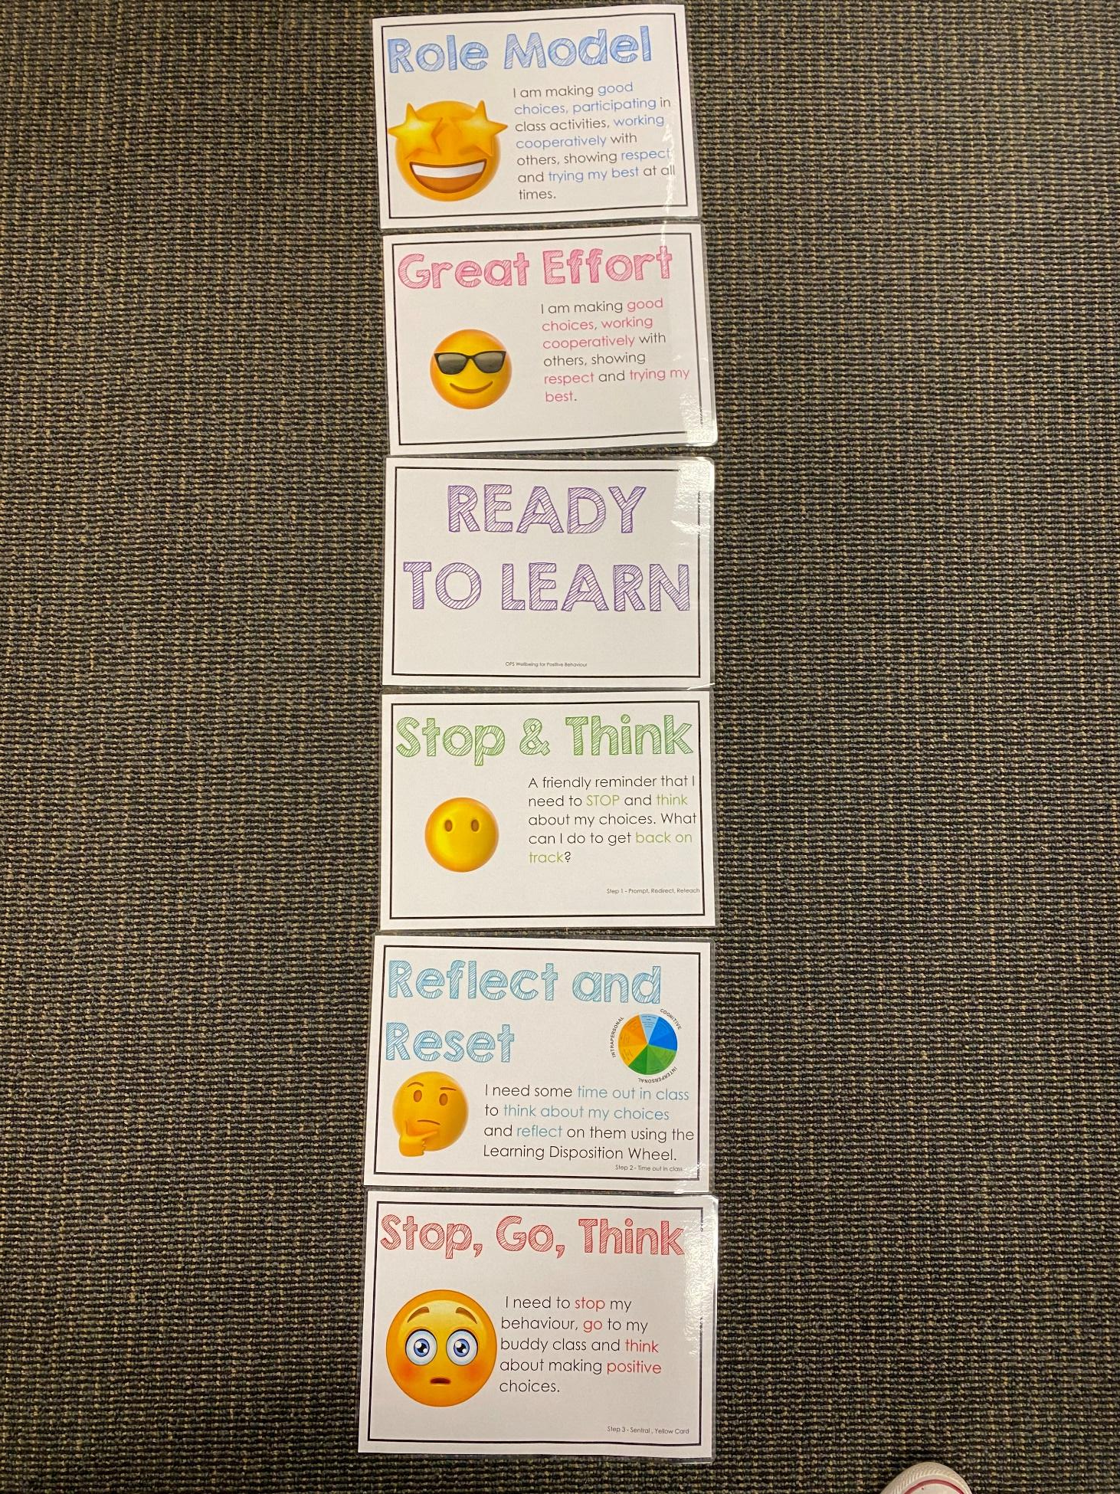
Positive Behaviour for Learning
NSW public schools are committed to providing safe, supportive and responsive learning environments for everyone. We teach and model the behaviours we value in our students.
Every student begins on ‘READY TO LEARN’.
Every day is a new day.

Slide 13
Be Somebody Who…

Slide 14
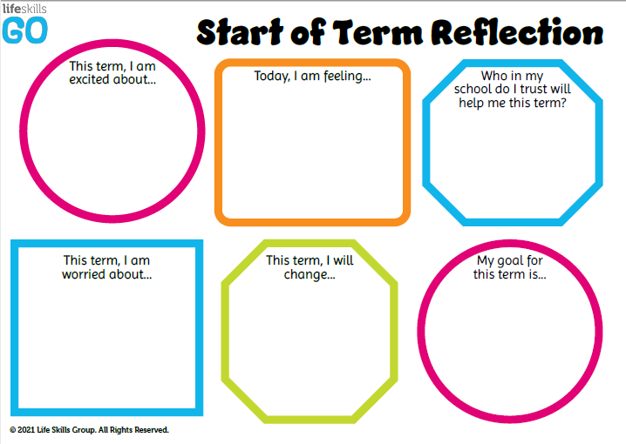
Student Wellbeing Focus
Growing Strong Minds
Gratitude Journals/Got Game Resilience Program
Student Voice experiences
Peer Support
Incursions – Zero Bullying, Backflips against Bullying, Life Education

Slide 15
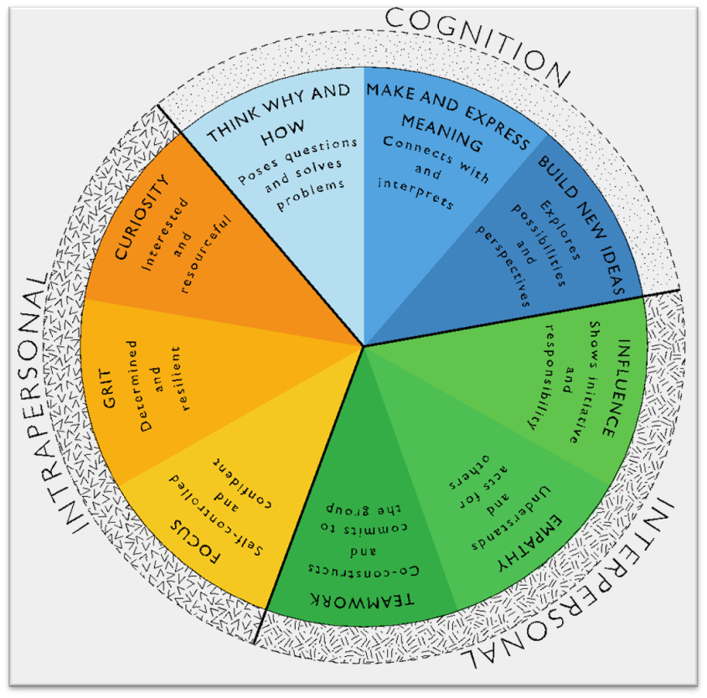
Learning Dispositions
Communication, Creativity, Collaboration
& Critical Reflection
The Learning Disposition Wheel is a tool used to talk about learning and drive a deeper understanding of the 4Cs
Development of these dispositions is fundamental for students to develop an awareness of the way they learn and establish attitudes to learning.
This facilitates a common language about learning which empowers students to critically reflect.

Slide 16
Curriculum

Slide 17
Technology
Stage 3 classes have access to their own school iPad.
All parents/carers need to sign the online ICT Agreement before the student’s class is allowed to commence using technology in their classroom.
This agreement includes the use of mobile phones and smart watches worn by students to school.
Inappropriate or irresponsible use of devices will result in the student losing access to the device for that lesson.
Students need to show the utmost respect and care for the technology at all times. It is a privilege to use any of the school-managed devices.

Slide 18
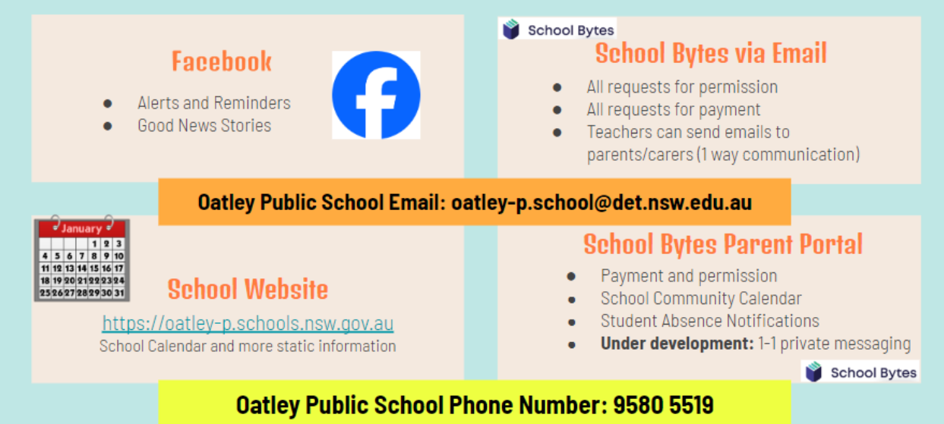
Community Partnerships

Slide 19
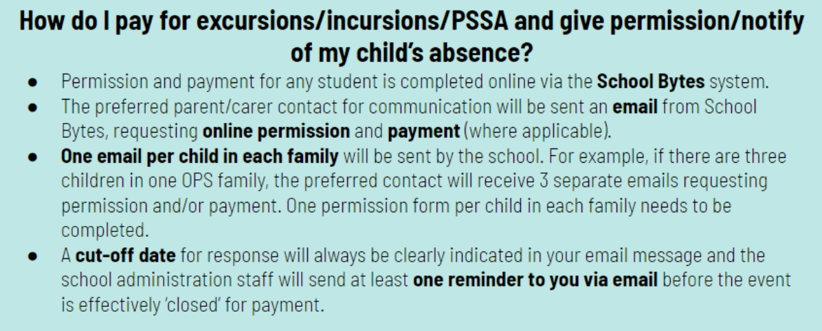
Payment Excursions/Incursions

Slide 20
Communication
School Website: https://oatley-p.schools.nsw.gov.au/
The school’s website has an up-to-date calendar of future events.
School Email address: oatley-p.school@det.nsw.edu.au
Please use this email address to contact the school at any time for matters that are not time-critical. This is also an effective mechanism for sending a message to your child’s teacher. These messages will be forwarded by the school administration staff.
School Phone Number: 9580 5519
Please use this number to contact the school for any time-critical questions or to pass on time-critical information.

Slide 21
Interviews
Parent teacher interviews will commence early next term. This will give us the opportunity to discuss your child’s progress at school.
If you have any other concerns throughout the year, please feel free to approach me or email the office to make an appointment.

Slide 22
Thank You

