Slide 1
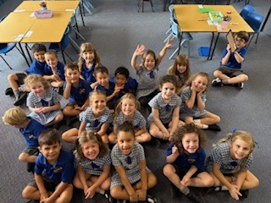
Welcome to Meet the Teacher 2025
KA
Mrs Michelle Adams

Slide 3
A Little About Me!
I am the mother of 4 adult children, three of whom are teachers (and the other is a midwife!)
I have seven grandchildren ranging in age from 1 through to 11 years of age. I teach YOUR children the way I would like my grandchildren to be taught - with care and compassion. I truly want your child to ENJOY school!
I have been teaching for 18 years, 13 of which have been here at OPS
This is my 6th time teaching Kindy - I love it!!

Slide 4
Meet the Team
There are 6 Early Stage One and Stage 1 classes this year:
KD (Miss Dayman) KA (Mrs Adams)
1M (Miss Miezskuc) 1/2B (Mrs Boutsikakis)
2M (Miss Matthews) 2K (Mrs Kennedy)
Our Assistant Principal is: Mrs Edwards

Slide 5
Who Supports Us?
Community Languages
(Italian)
Signora Johnstone
Library
Mrs Haman
Curriculum Support
Mrs Gavanas
Mrs White
Wellbeing
Mrs Edwards

Slide 6
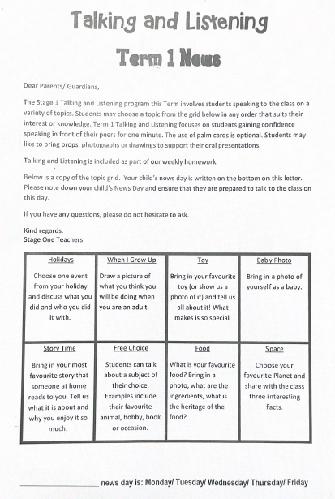
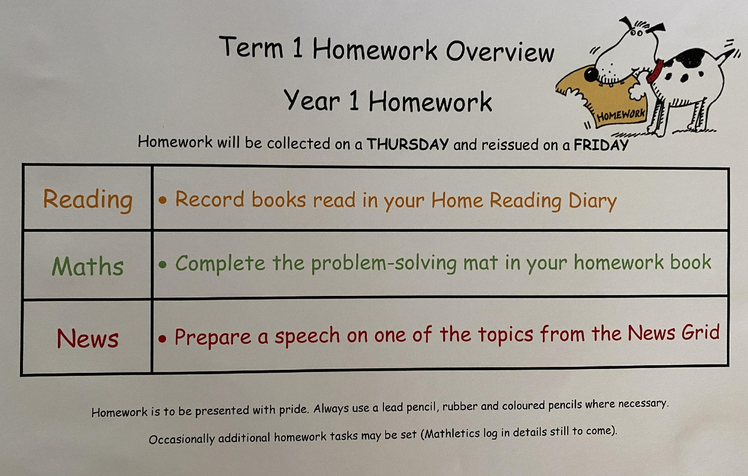
Homework
Term 1 homework consists of 3 components:
1. Reading (4 home readers recorded in diary)
2. Maths (problem solving grid)
3. News (grid topics)
Due on Thursday, redistributed on Friday

Slide 7
Days to Remember
Tuesday: Library (please send your child’s library bag). Books are to be returned to
the chute outside the Library before the morning bell
Wednesday: Scripture: 9:50am-10.20am (Protestant, Catholic, Greek Orthodox,
Ethics, Islamic and Non-Scripture)
Got Game (please send your child in their sports uniform)
Thursday: Italian

Slide 8
Food At School
Canteen Birthdays
The school canteen is Monday - Thursday. We welcome birthday treats on your
child’s special day. We ask that all
All lunch orders must be ordered via birthday treats are individually
Flexischools. portioned and packed ready to hand
out, e.g. cupcakes, lolly bags
Please note: due to an increase in students with severe allergies, we ask that you please be mindful when packing lunches.

Slide 9
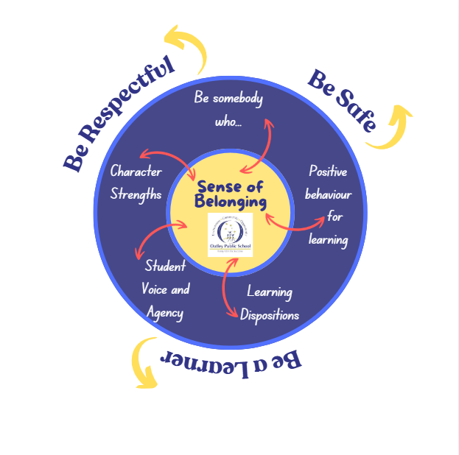
Wellbeing

Slide 10
Positive Behaviour for Learning

Slide 11
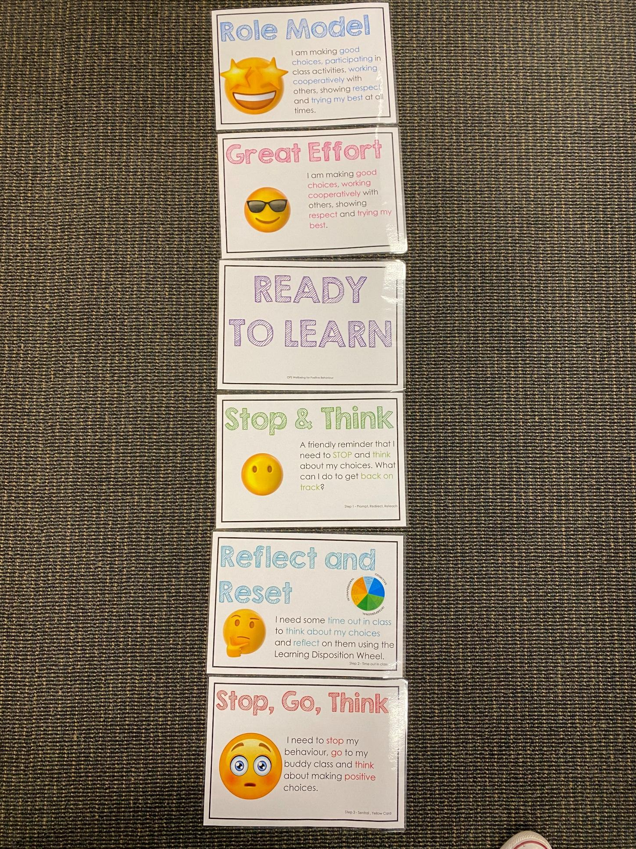
Positive Behaviour for Learning
NSW public schools are committed to providing safe, supportive and responsive learning environments for everyone. We teach and model the behaviours we value in our students.
Every student begins on ‘READY TO LEARN’.
Every day is a new day.

Slide 12
Be Somebody Who…

Slide 13
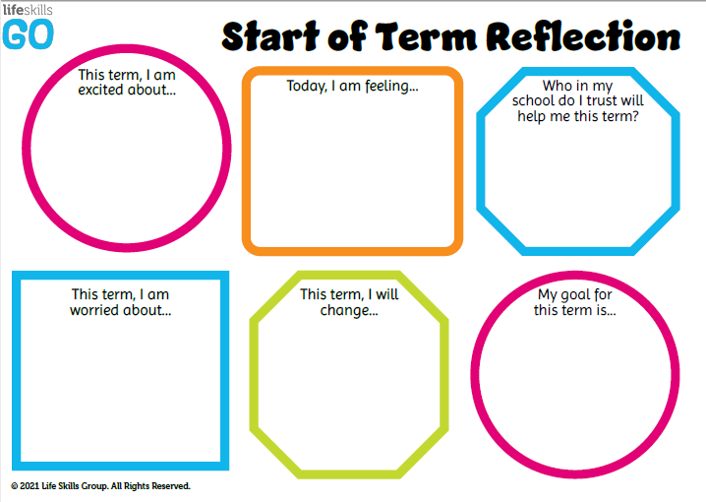
Student Wellbeing Focus
Growing Strong Minds
Gratitude Journals/Got Game Resilience Program
Student Voice experiences
Peer Support
Incursions – Zero Bullying, Backflips against Bullying, Life Education

Slide 14
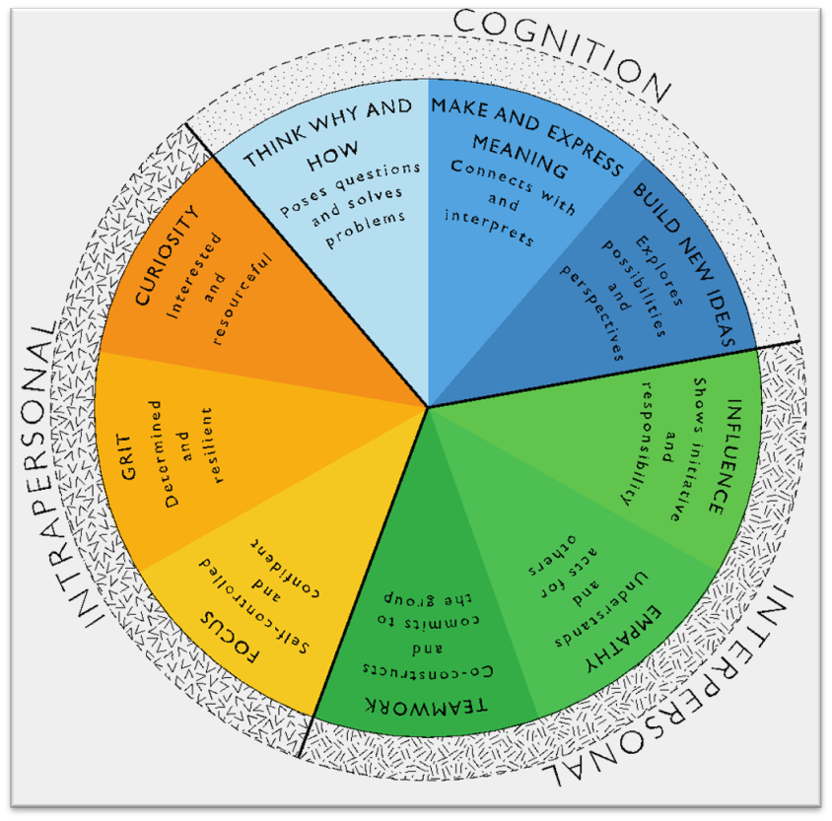
Learning Dispositions
Communication, Creativity, Collaboration
& Critical Reflection
The Learning Disposition Wheel is a tool used to talk about learning and drive a deeper understanding of the 4Cs
Development of these dispositions is fundamental for students to develop an awareness of the way they learn and establish attitudes to learning.
This facilitates a common language about learning which empowers students to critically reflect.

Slide 15
Curriculum
English - InitiaLit and the MultiLit writing program
Maths - new DET units of work
Science - the weather
HSIE - Me and my Family
Creative Arts - Amplify music program and Visual Arts linked to other curriculum areas
PDHPE - Got Game, Growing Strong Minds etc

Slide 16
Technology
Kindergarten classes utilise the K-2 shared iPads.
All parents/carers need to sign the online ICT Agreement before the student’s class is allowed to commence using technology in their classroom.
This agreement includes the use of mobile phones and smart watches worn by students to school.
Inappropriate or irresponsible use of devices will result in the student losing access to the device for that lesson.
Students need to show the utmost respect and care for the technology at all times. It is a privilege to use any of the school-managed devices.

Slide 17
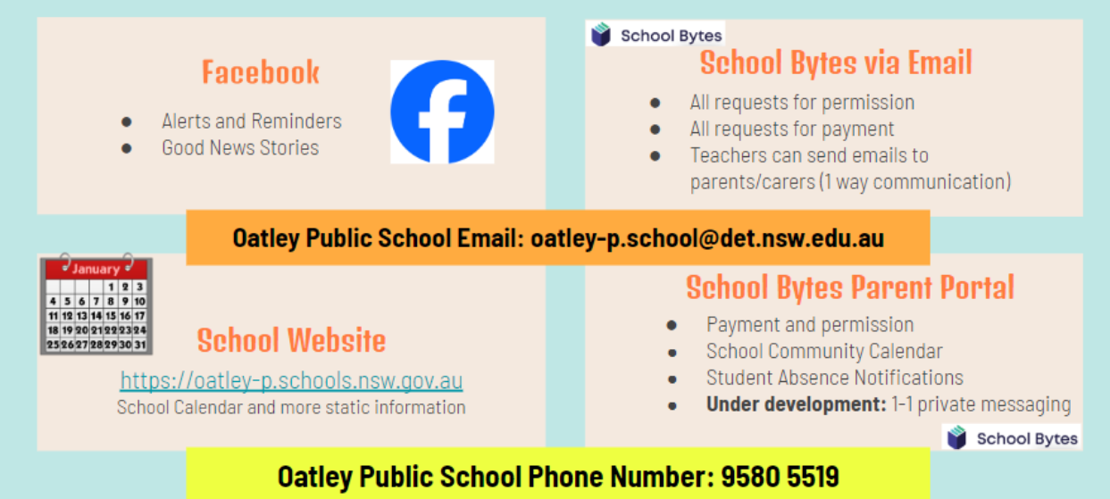
Community Partnerships

Slide 18
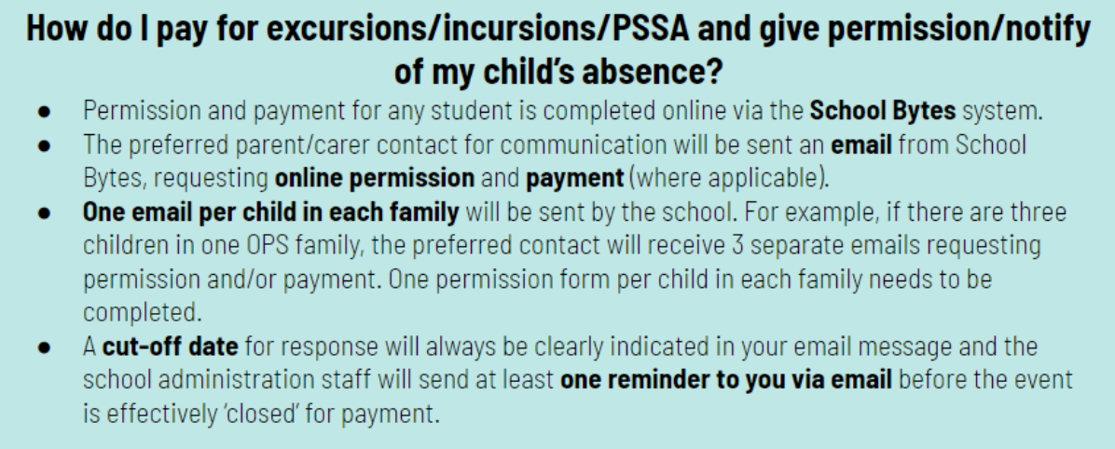
Payment Excursions/Incursions

Slide 19
Communication
School Website: https://oatley-p.schools.nsw.gov.au/
The school’s website has an up-to-date calendar of future events.
School Email address: oatley-p.school@det.nsw.edu.au
Please use this email address to contact the school at any time for matters that are not time-critical. This is also an effective mechanism for sending a message to your child’s teacher. These messages will be forwarded by the school administration staff.
School Phone Number: 9580 5519
Please use this number to contact the school for any time-critical questions or to pass on time-critical information.

Slide 20
Interviews
Parent teacher interviews will commence early next term. This will give us the opportunity to discuss your child’s progress at school.
If you have any other concerns throughout the year, please feel free to approach me or email the office to make an appointment.
I am here to help!
☺

Slide 21
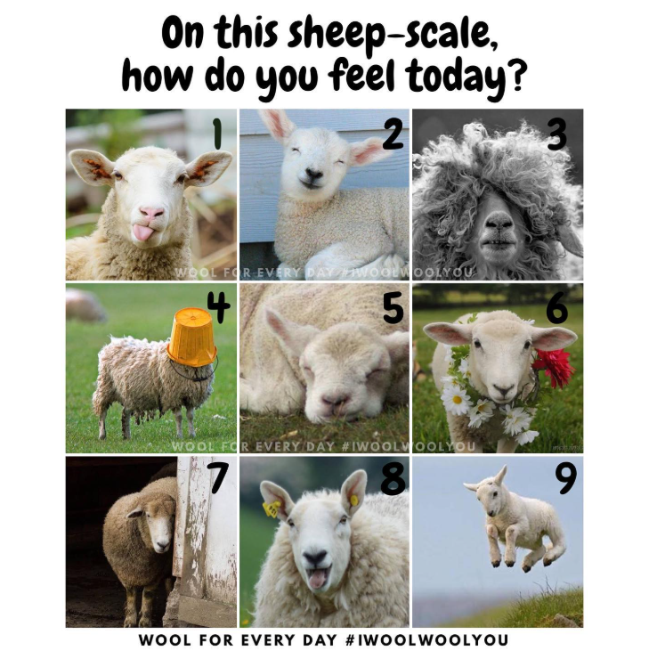
Scale of Sheep
Think about your feelings regarding your child’s start to 2025.
Which sheep best represents how you are feeling?

Slide 22
About your Child
4Cs activity!
Collect 2 different colour Post-it notes
Write something you want us to know about your child and a goal for them this year
Place your post-it notes on the whiteboard
Blue Post-it Note
Yellow Post-it Note
Write something you want us to know about your child
Write a goal for your child this year

Slide 23
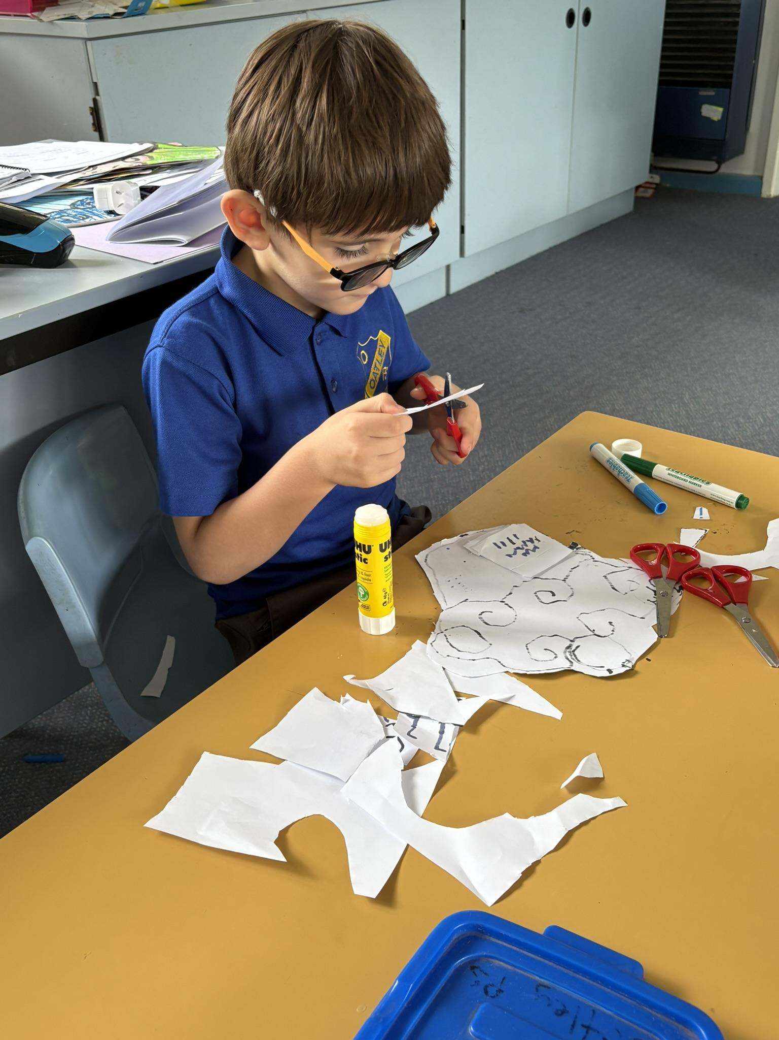
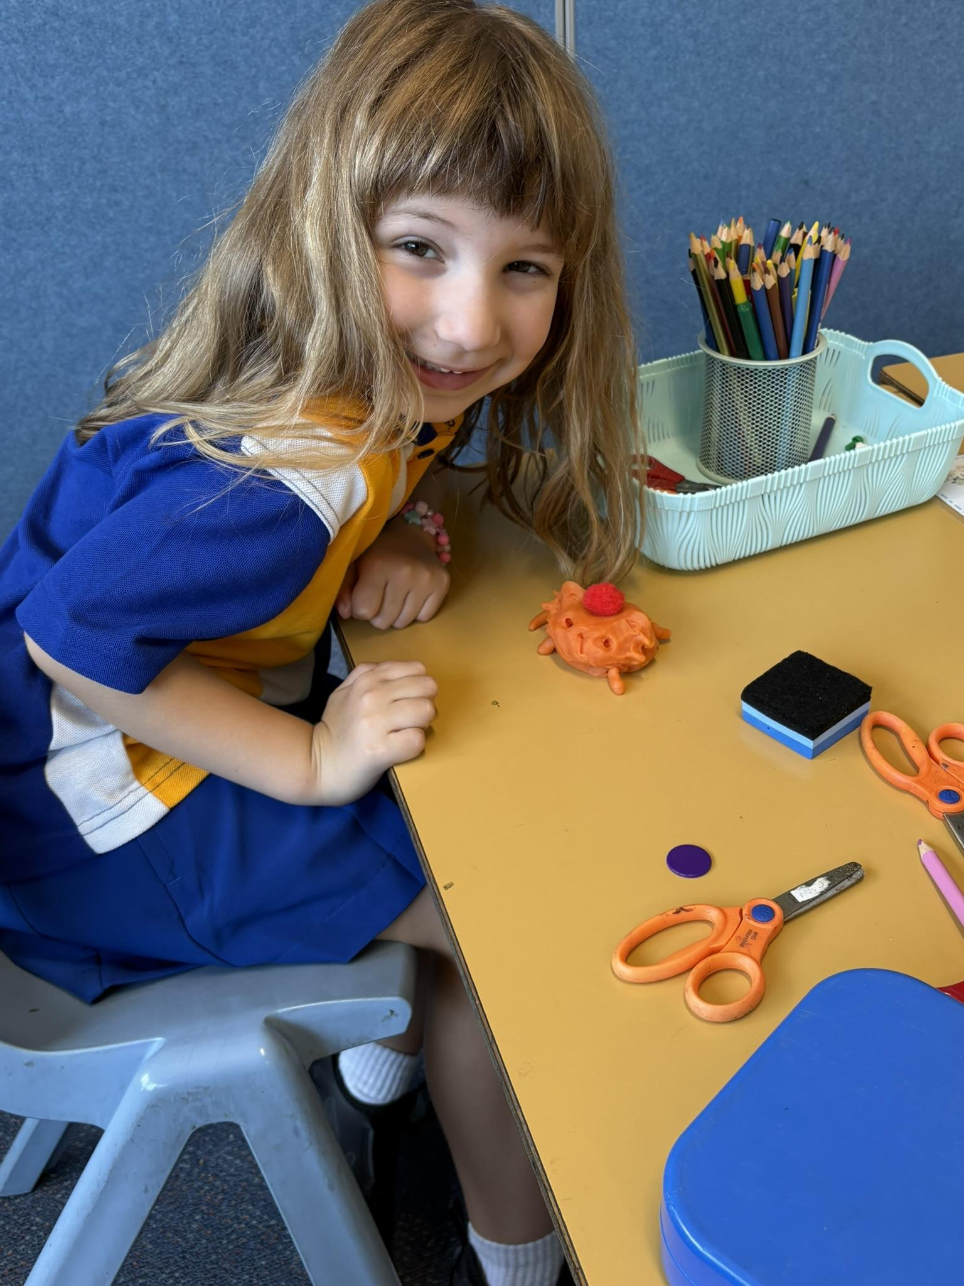
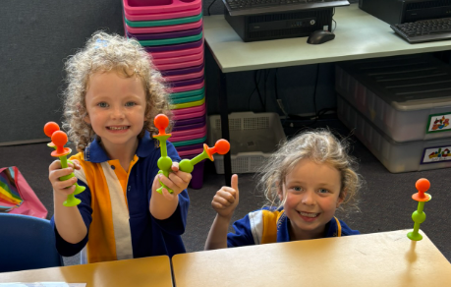
A peek at our first week!

Slide 24
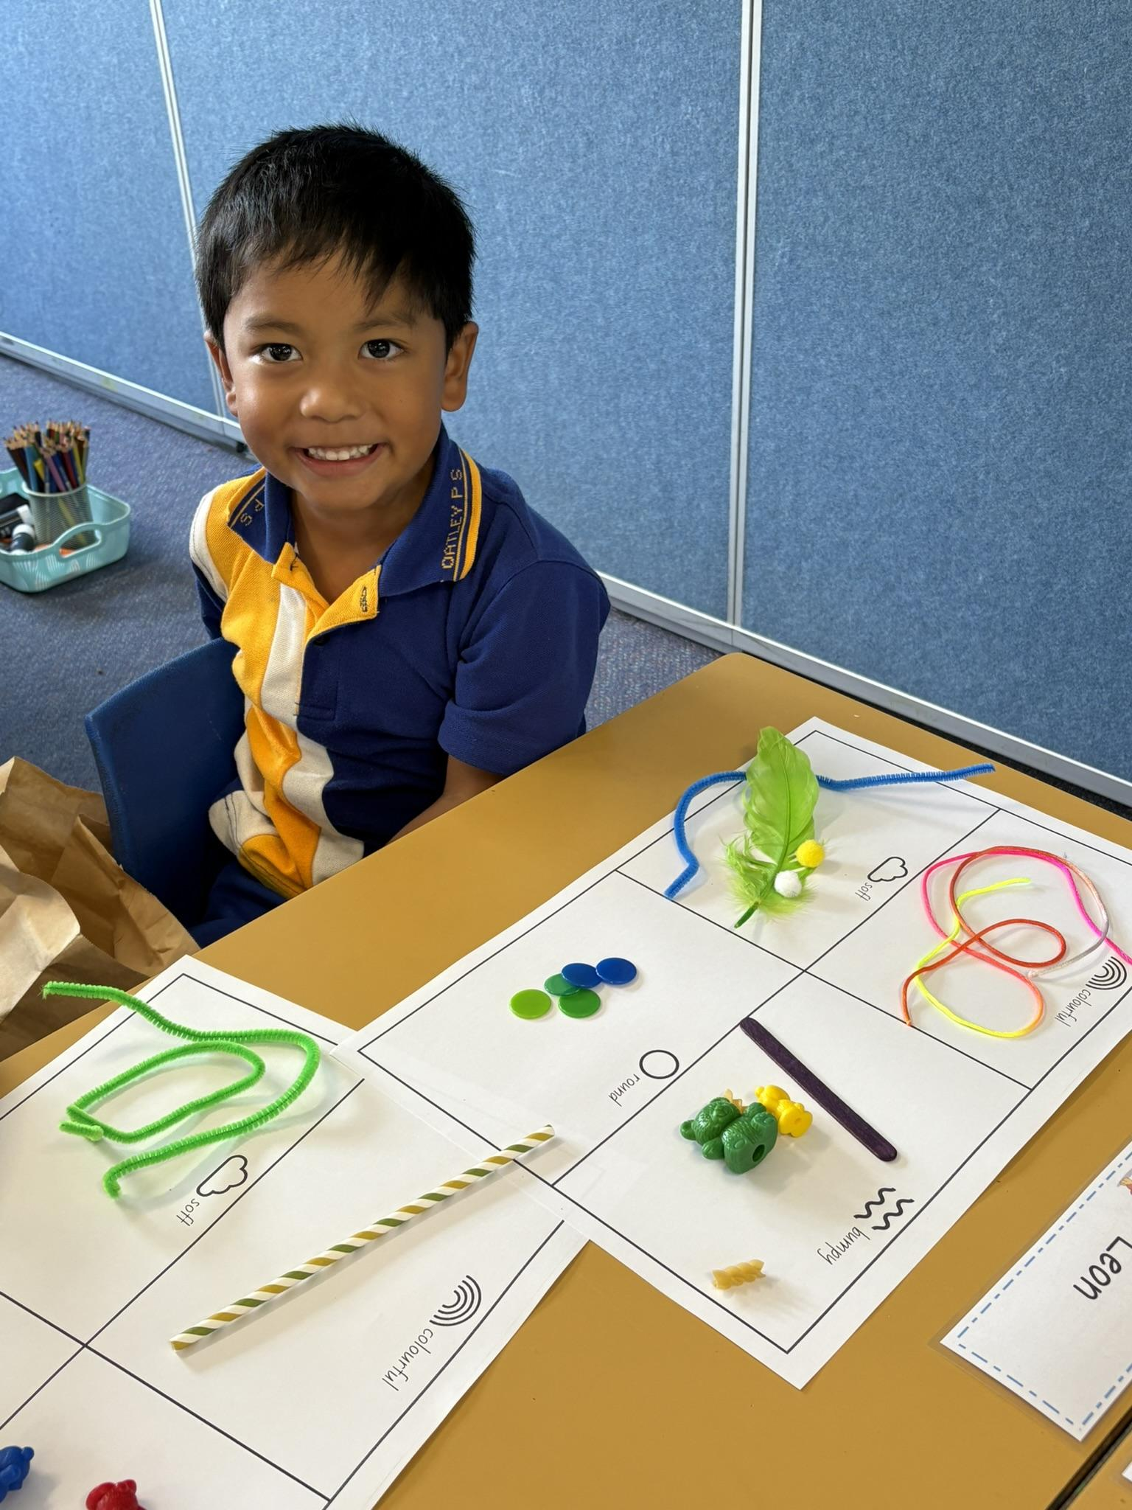
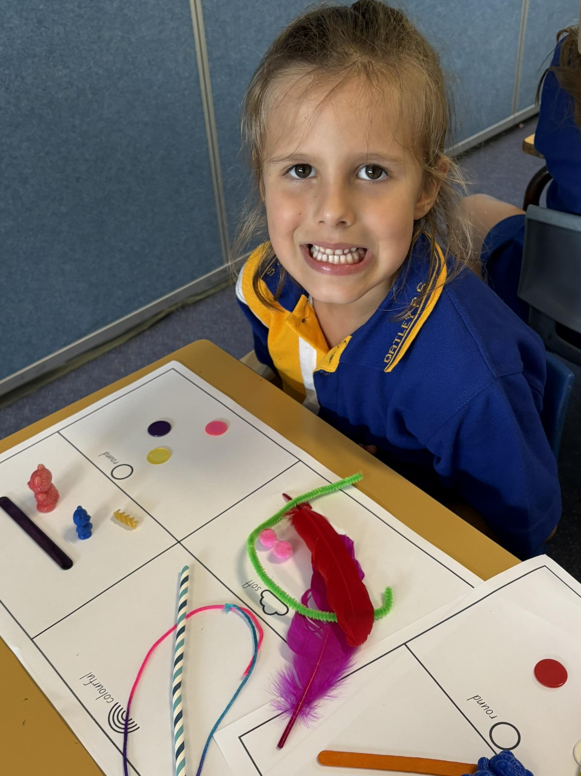
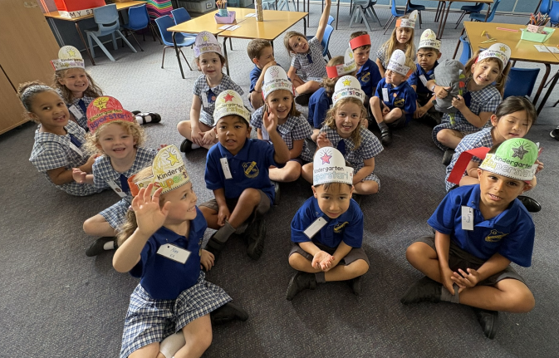

Slide 25
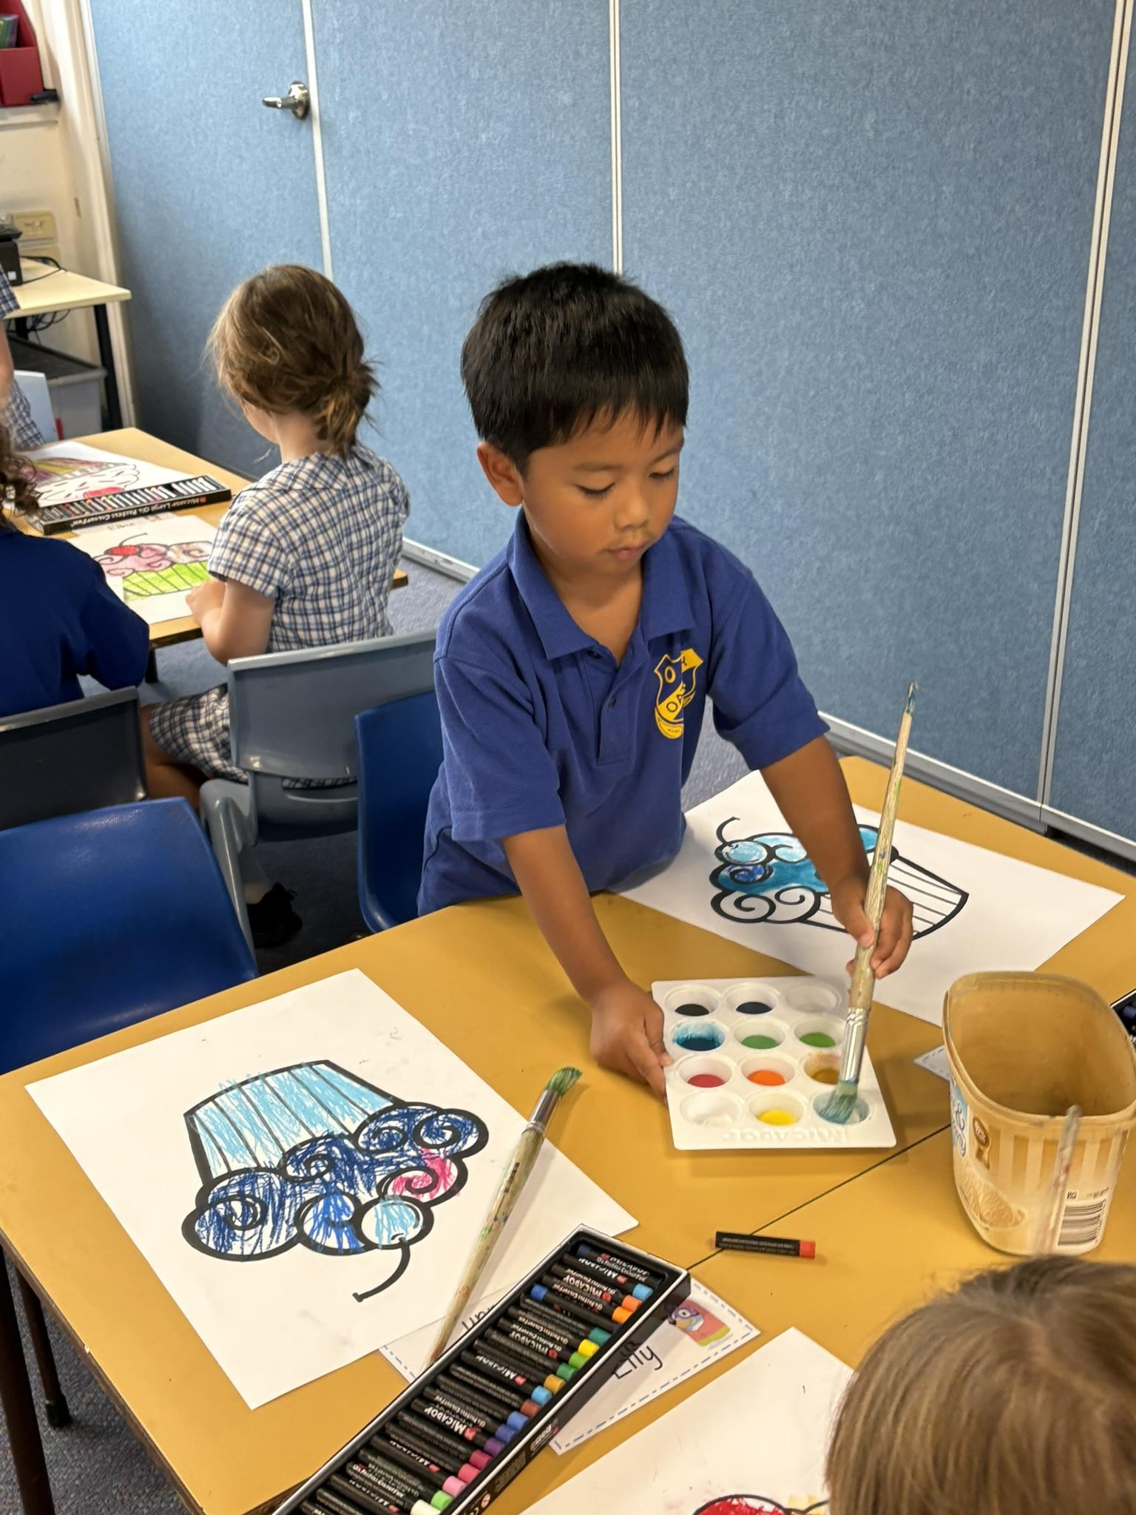
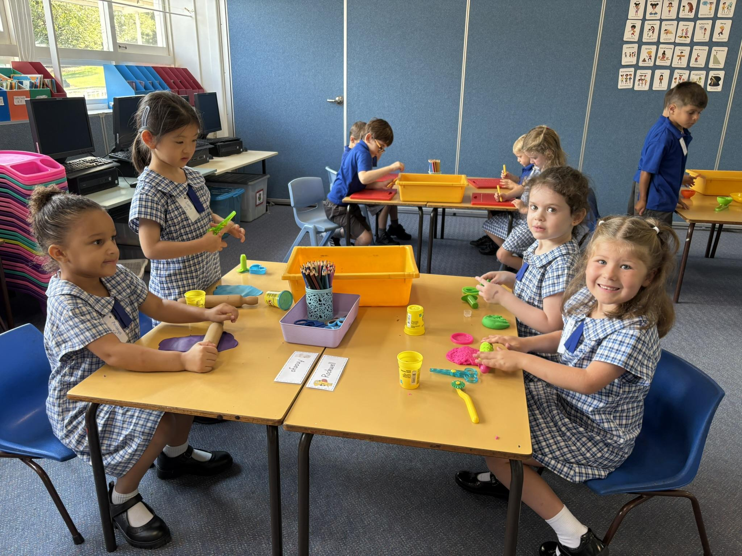

Slide 26
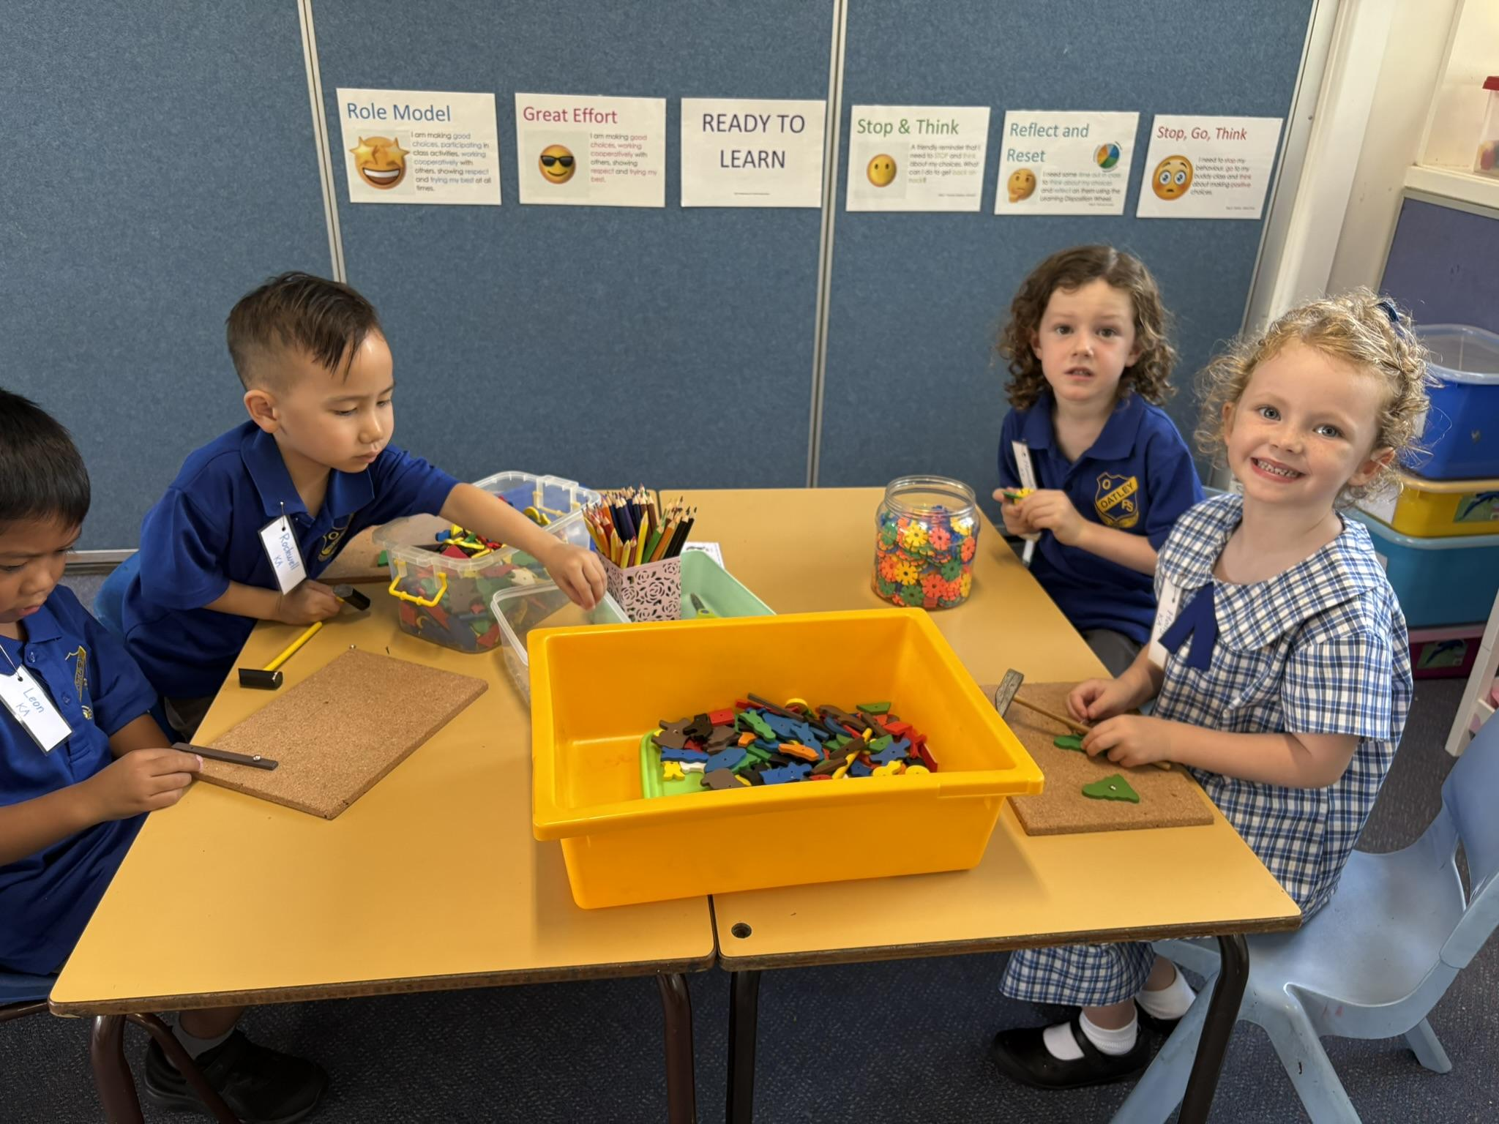

Slide 27
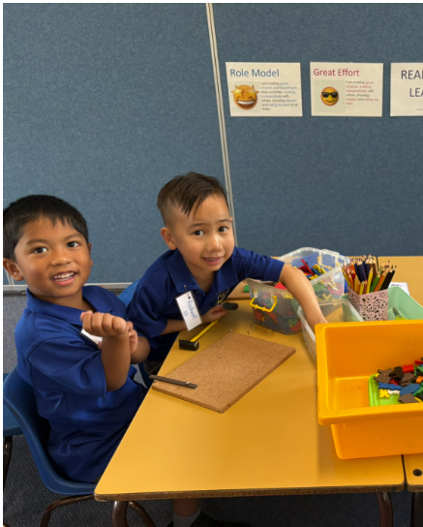
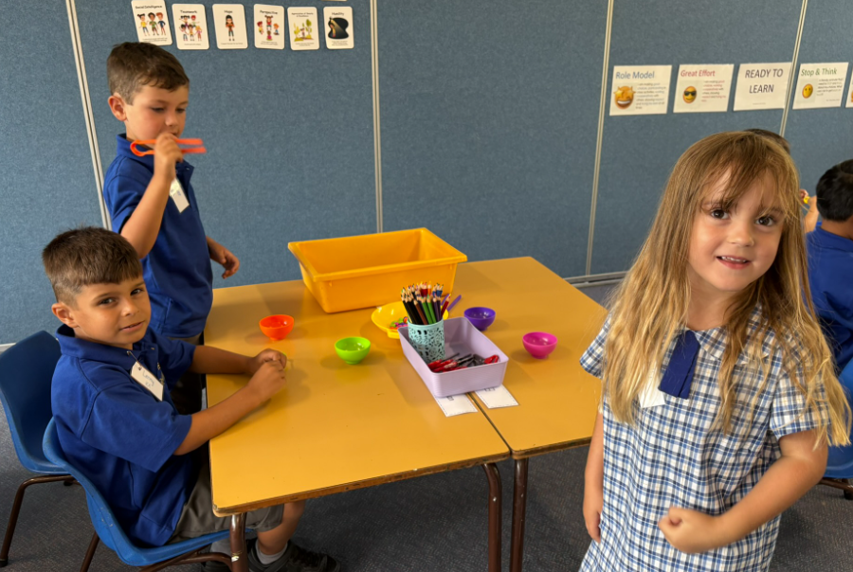

Slide 28
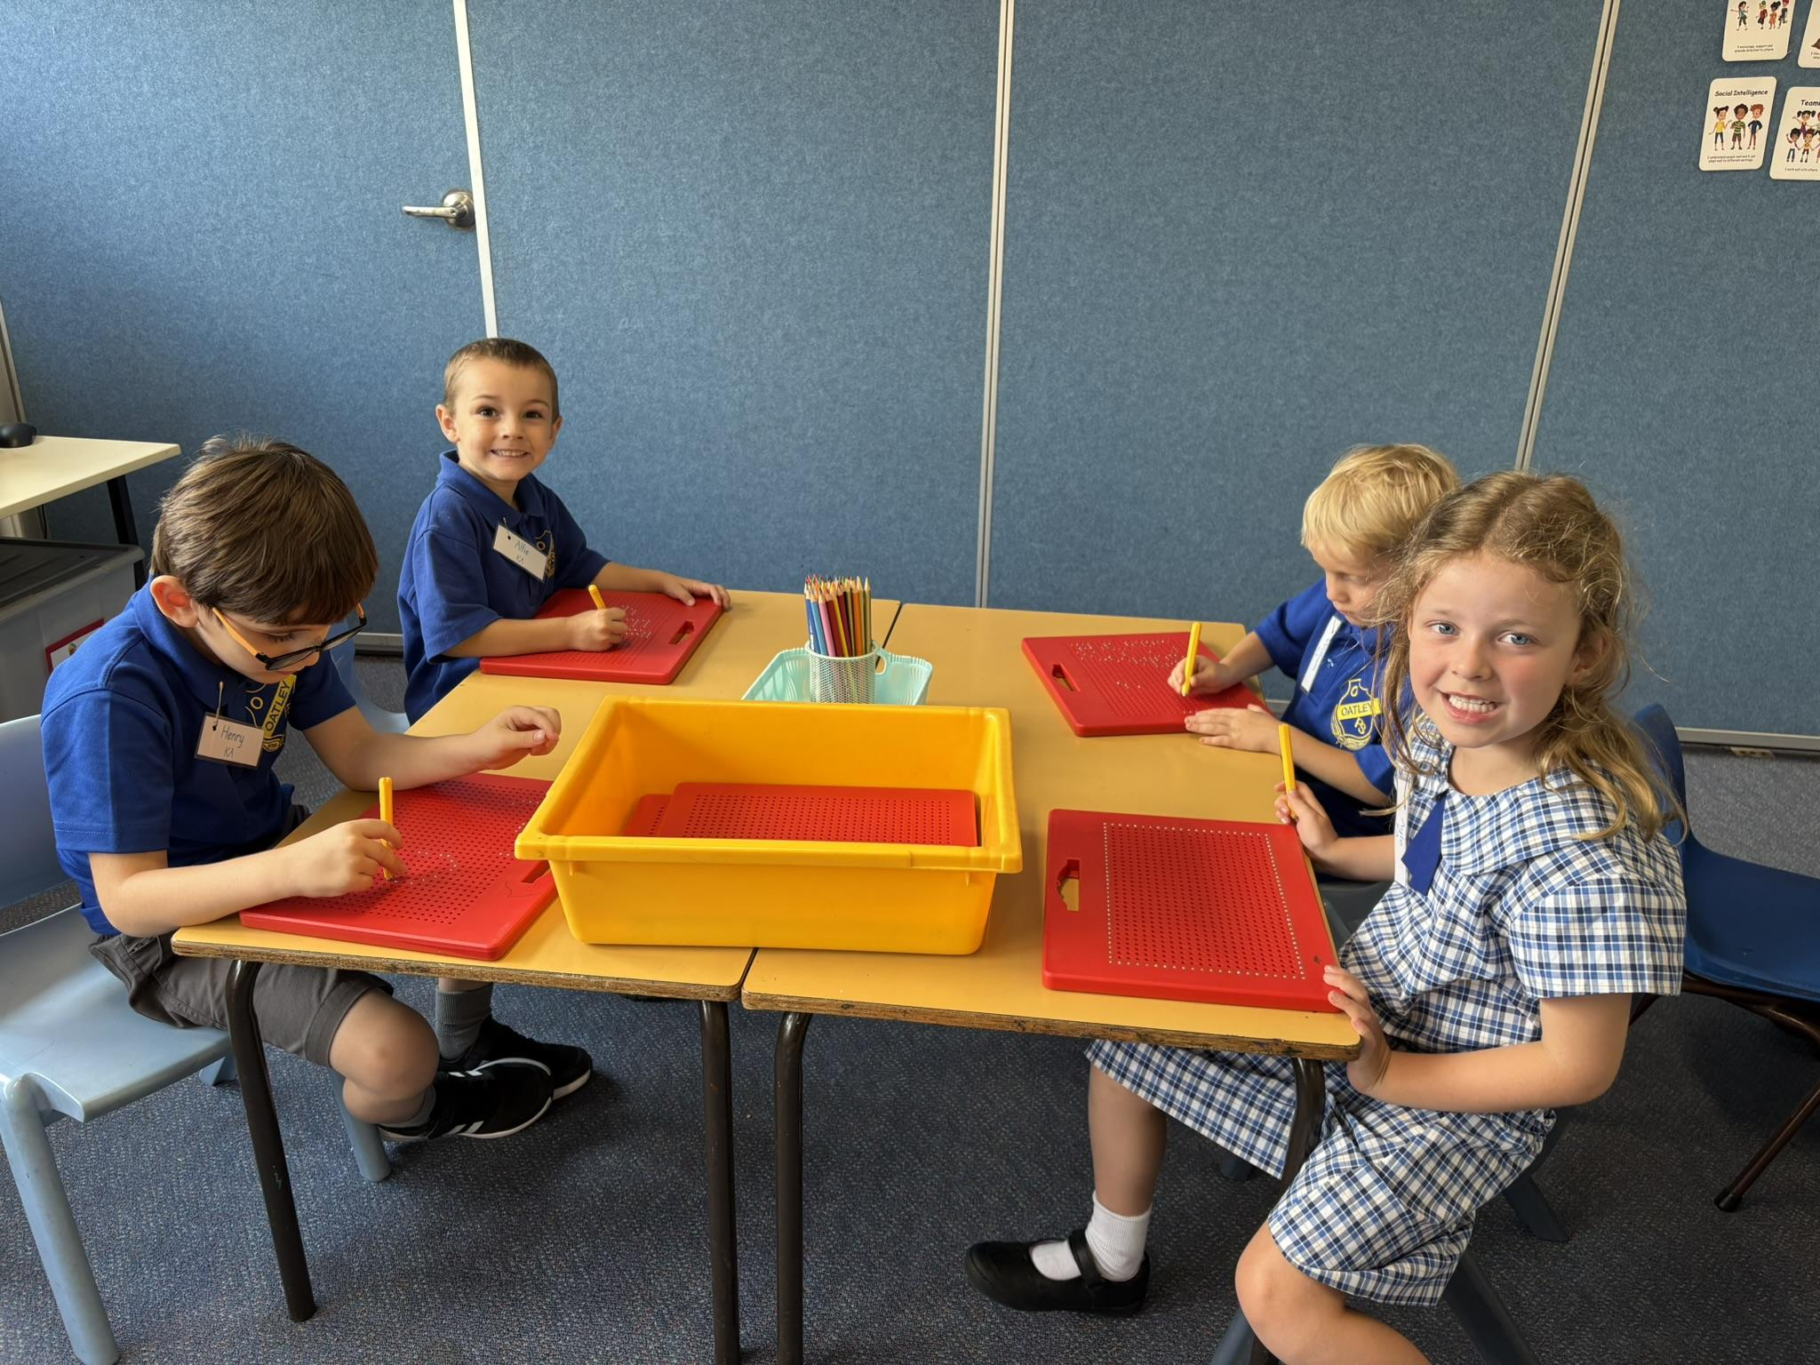
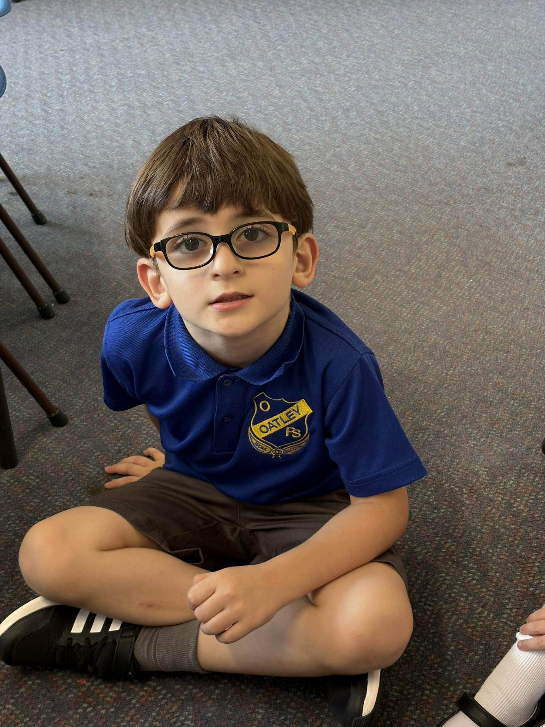
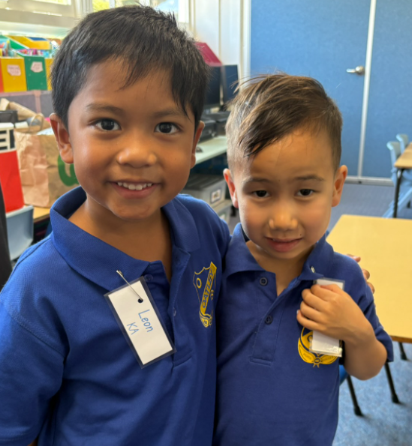

Slide 29
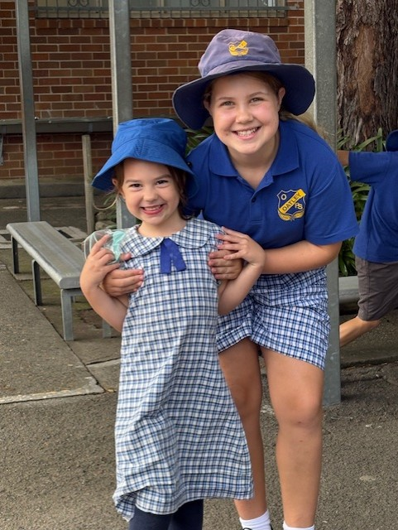
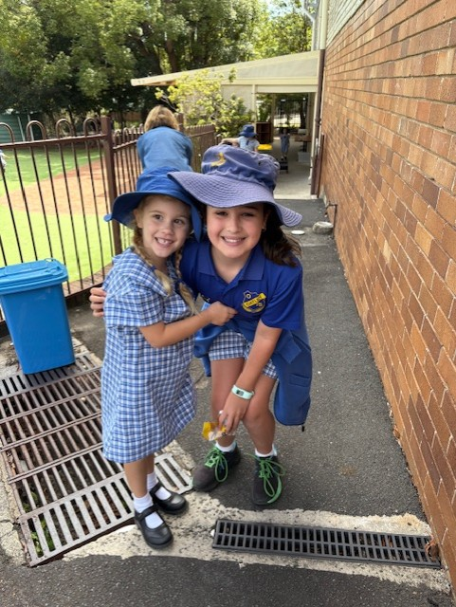
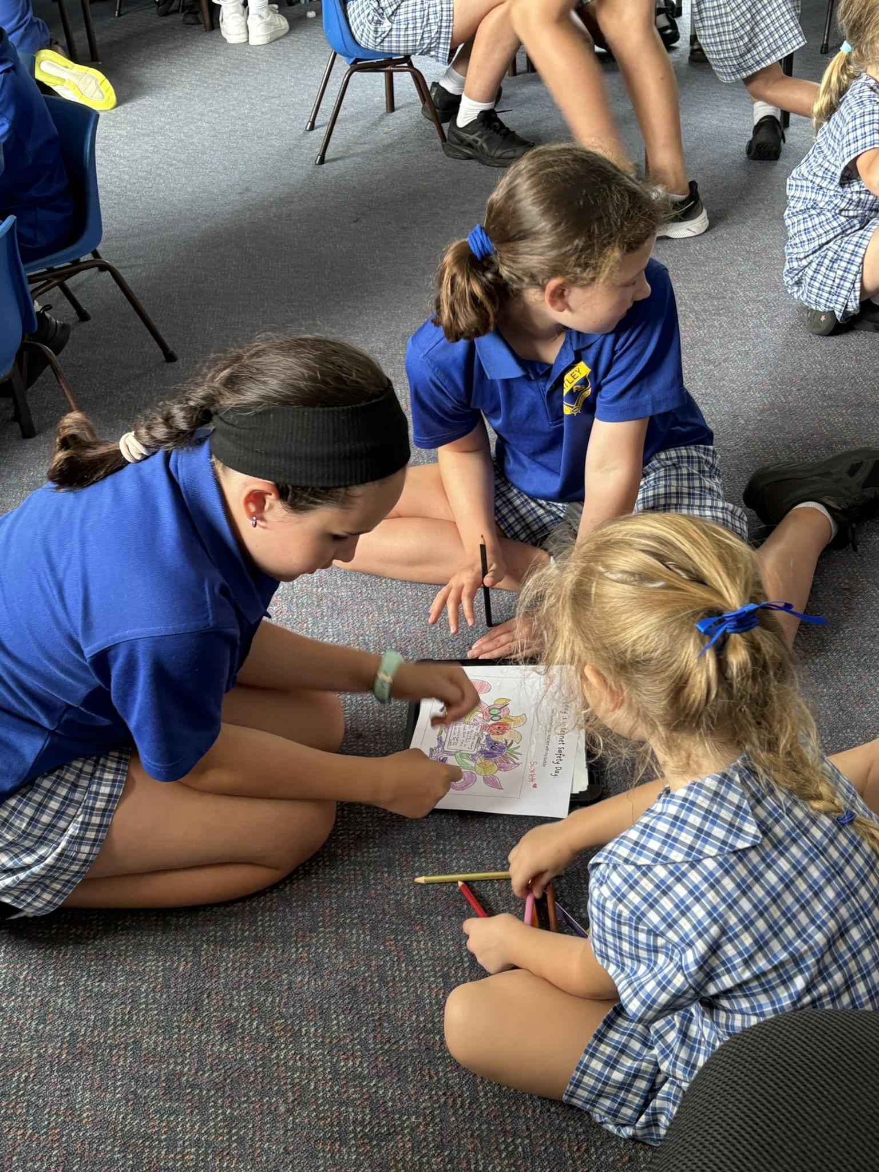
We love our buddies!

Slide 30
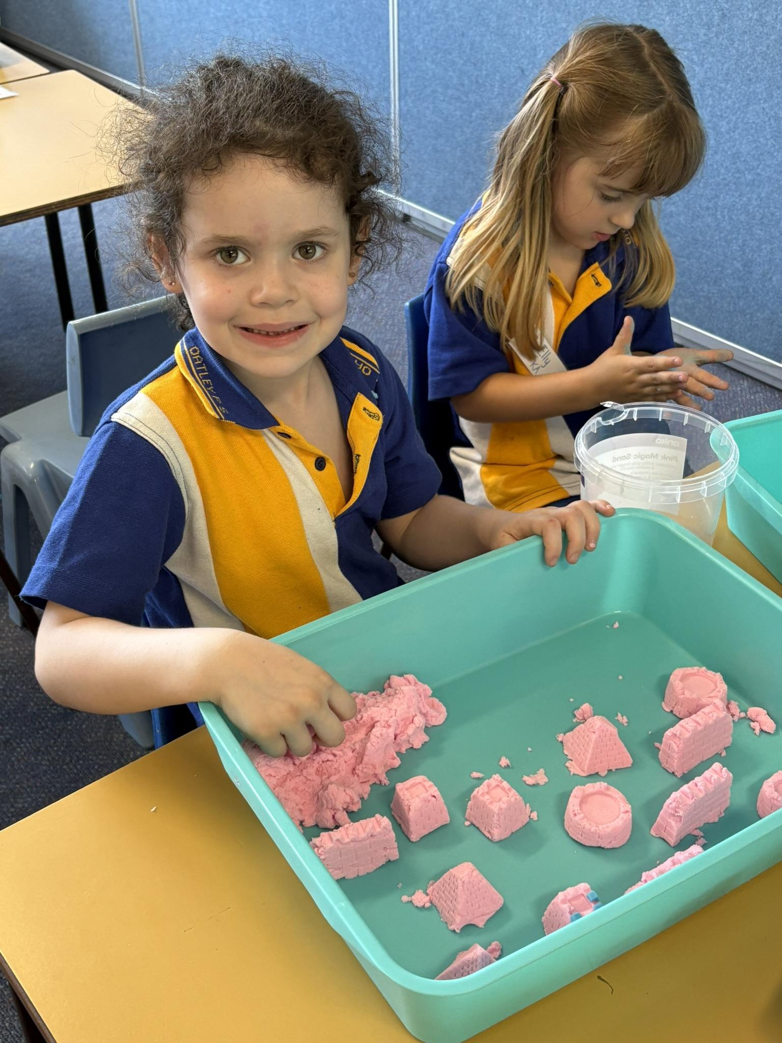
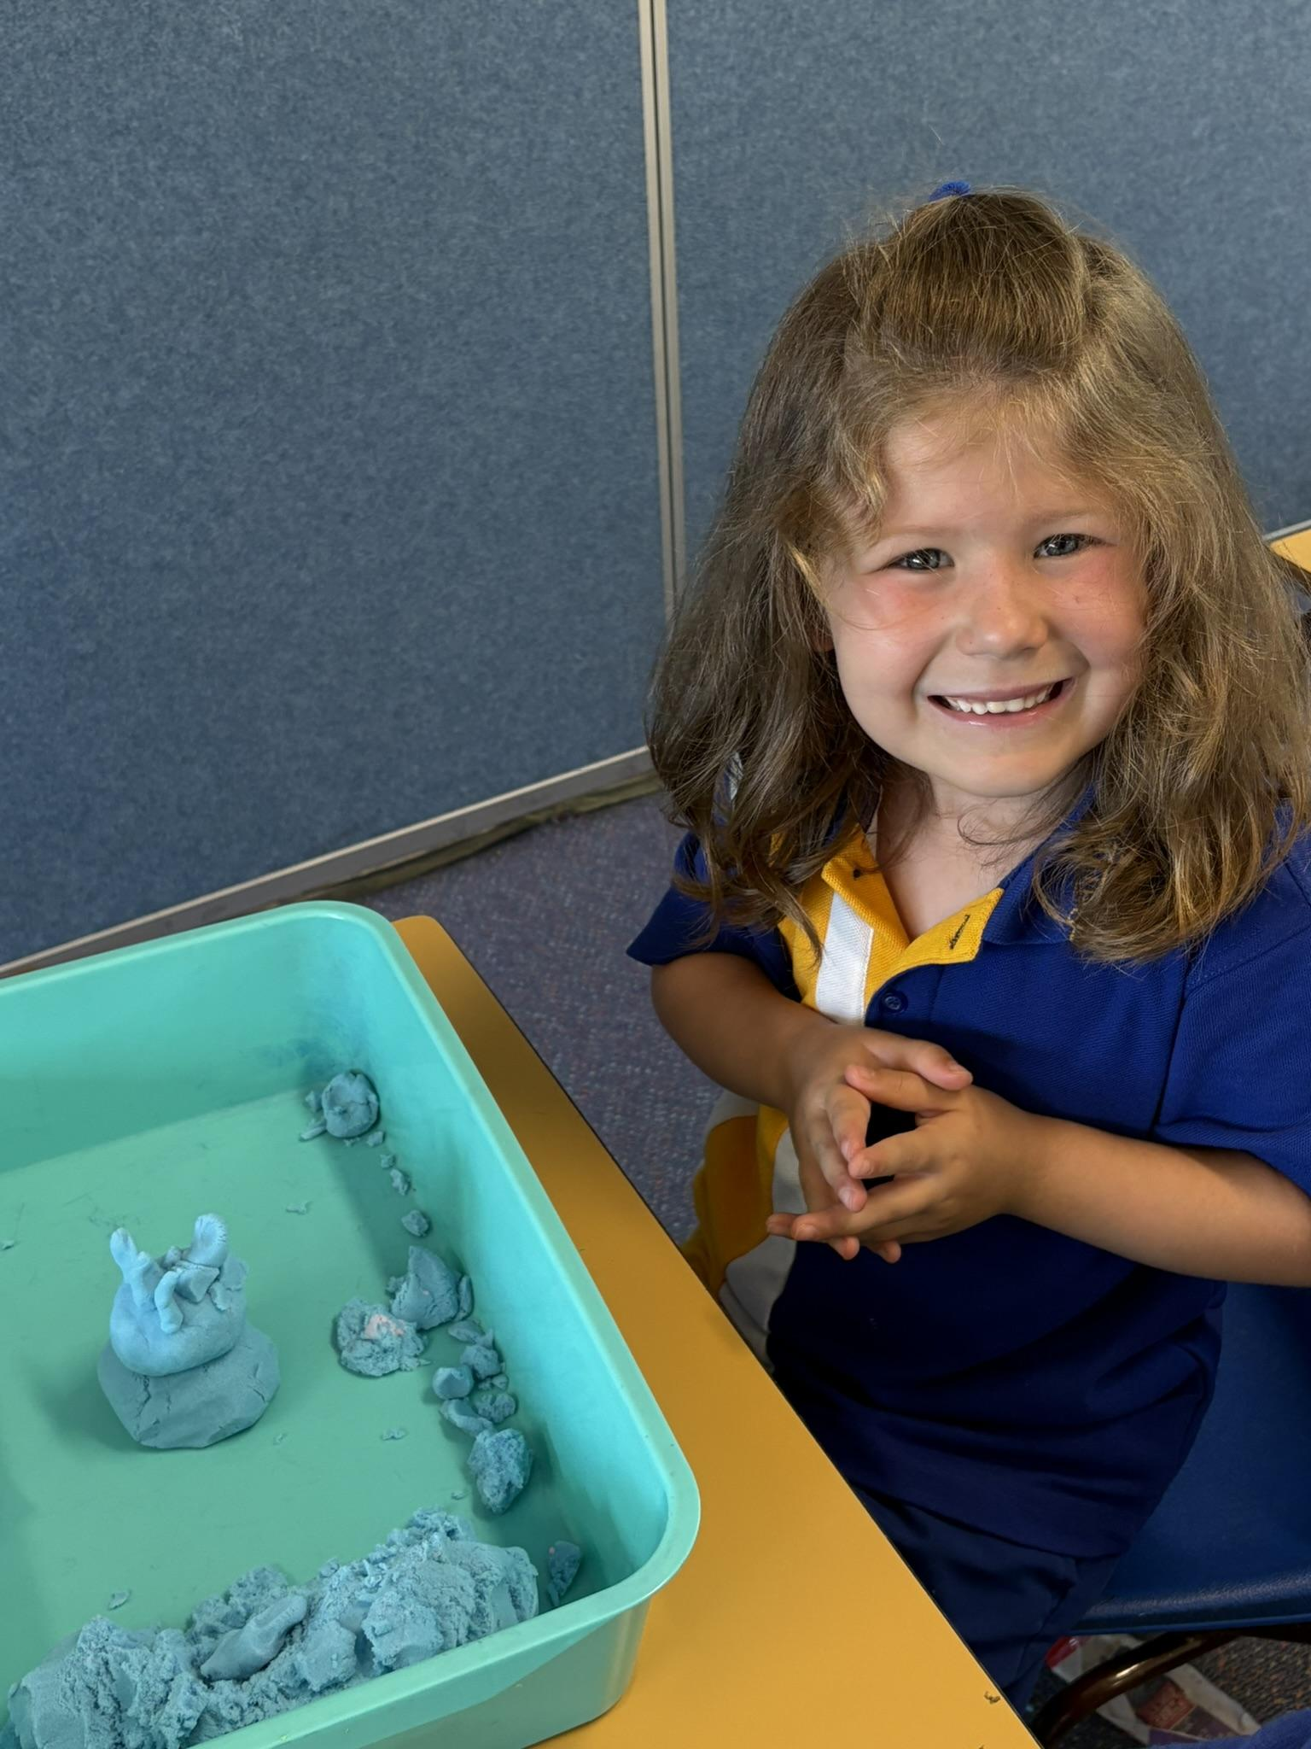
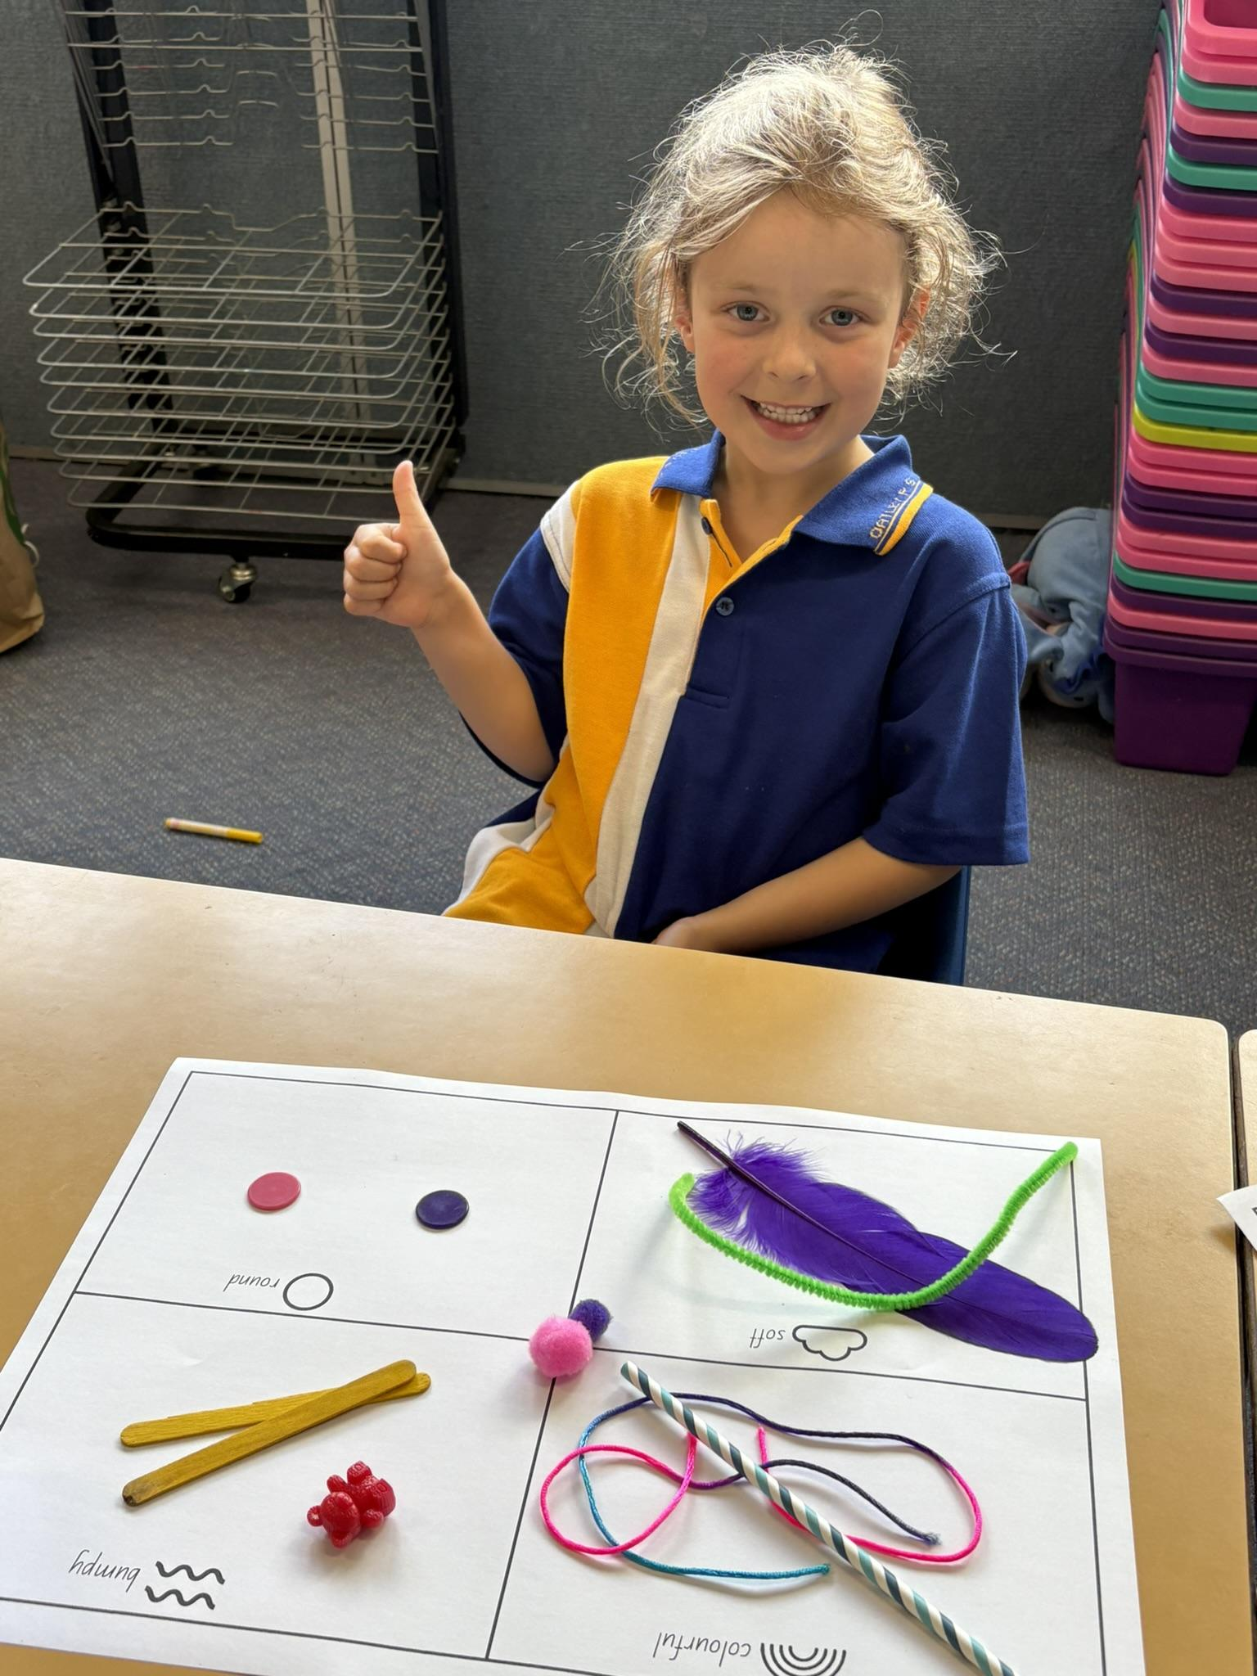
Thank You

